Slide 1
“LAW ENFORCEMENT AND CIVIL RIGHTS: DEFINING THE RELATIONSHIP”
Lindsey D. Draper
James Madison Legacy Project
Columbia, SC
July 2018

Slide 2
OVERVIEW
Review the images that have shaped the public perception of the relationship between the Civil Rights movement and law enforcement officers.
Examine events in the relationship between specific law enforcement officials and African-Americans that had direct impact on events that began the modern Civil Rights movement.
Discuss contemporary law enforcement efforts to improve relationships with various communities and improving technologies, given a nation with changing demographics

Slide 3
THE THEME THROUGHOUT…
“To say that the minority community has a conflicted relationship with law enforcement is a profound understatement. But if you listen closely, you can hear how often both groups are saying the same thing.
“Don’t look at me and just see the uniform.”
“Don’t look at me and assume the worst.”
There is a mutual desire to be understood. We can find commonality from this common ground.”
Loretta Lynch - April 4, 2014
(Then) U.S. Attorney for the Eastern District of New York

Slide 4
SOME IMAGES ARE FAMILIAR…
Many of the images associated with law enforcement interactions with “protesters, demonstrators and community members” are almost iconic and are locked into the collective memory….

Slide 5
THE BIRMINGHAM IMAGE FROM 1963…

Slide 6
ALABAMA STATE TROOPERS CONFRONT MARCHERS ON THE SELMA TO MONTGOMERY MARCH IN 1965

Slide 7
THE RODNEY KING IMAGES FROM MARCH 3, 1991

Slide 8
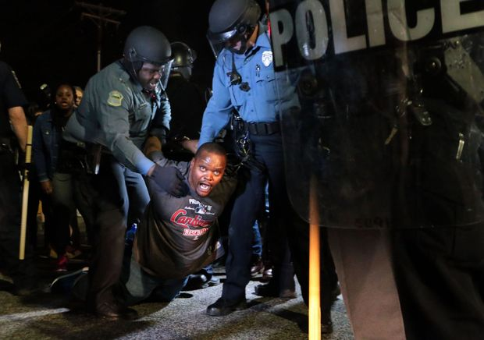
FROM FERGUSON, MO IN MARCH, 2015…
Protests occurred in Ferguson MO March 11, 2015 following the resignation of the Police Chief

Slide 9
BALTIMORE POLICE IN APRIL 2015…..

Slide 10
THE IMAGES DO NOT ALWAYS TELL ALL…
Note the entry that accompanied the previous photograph of the Baltimore Police Department:
“Many residents credited the Baltimore police for not overreacting after the curfew went into effect Tuesday night, setting the tone for peaceful dispersal”
CNN
April 28, 2015

Slide 11
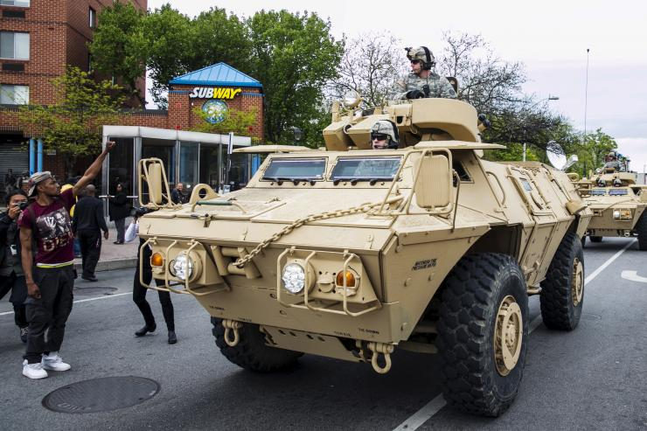
BUT, AT TIMES, MATTERS ARE COMPLICATED…
From May 1, 2015, also in Baltimore:

Slide 12
HOW DID WE GET HERE…?
Although there were many incidents that featured law enforcement interactions with the African-American community and are associated with the Civil Rights movement, most often cited as the beginning of the movement was the return of many African-American veterans from military service in World War II.
Among these returning veterans was Sgt. Isaac Woodard.

Slide 13
Sgt. Isaac Woodard

Slide 14
HOW IT ALL STARTED….
In February 1946, Sgt. Woodard was honorably discharged from Camp Gordon in Augusta, GA and while still in full uniform, began a long bus ride to his family in North Carolina.
Isaac Woodard served in the armed forces between 1942 and 1946 as a longshoreman in a labor battalion in the Pacific theater. During his time fighting the Japanese in the armed forces, Woodard was bestowed several honors which included a battle star, a Good Conduct Medal, a Service Medal, and a World War II Victory Medal.

Slide 15
BUT ON THE RIDE …
During a stop, Sergeant Woodard asked the bus driver if he had time to run out and use a bathroom. The white driver told him no and then cursed him out. Woodard cursed him back and the driver told him that he could go ahead to use the bathroom.
At the next stop which was Batesburg, South Carolina, the driver called the police and claimed that Woodard was drunk and quarrelsome.

Slide 16
POLICE INTERVENTION….
Woodard was taken off the bus by Police Chief Lynwood Shull and Officer Elliott Long, taken into an alleyway, repeatedly beaten with nightsticks, and arrested on the alleged charge of drinking beer in the back of the bus with other soldiers.
When he arrived at the jail, Isaac Woodard was punched in the eyes with the end of a billyclub. When he awoke the next morning, he was blind.

Slide 17
IMMEDIATELY THEREAFTER….
On the day following the arrest, Sgt. Woodard was taken before a local judge, found guilty, and fined $50.00. Sgt. Woodard requested medical care, but did not receive it for two days.
Woodard, who was suffering from amnesia and did not know where he was, ended up in an Aiken. SC hospital where, according to later reports, he received substandard care.
Relatives reported Woodard missing and, three weeks later, he was found and moved to an Army hospital in Spartanburg, SC.

Slide 18
OUTRAGE SPREADS…..
Although there was not a great deal of media coverage immediately following these events, news outlets across the country eventually began to run the story of Sgt. Woodard and
The National Association for the Advancement of Colored People (NAACP) worked to publicize the story of Sgt. Woodard and to press the State of South Carolina to investigate and prosecute
On his ABC radio broadcast, Orson Welles (best known for Citizen Kane), broadcast the story of Sgt. Woodard on at least four occasions, including, on the July 28, 1946 broadcast, describing the reaction of the South Carolina government as “intolerable and shameful.”

Slide 19
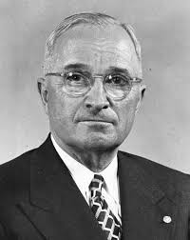
AND AT THE HIGHEST LEVELS…
On September 19, 1946, NAACP Executive Secretary Walter Francis White met with President Harry Truman in the White House Oval Office to discuss the Woodard case.
The events were presented to the President in the context of the failure of the officials of South Carolina “doing nothing for seven months.”
According to White, when President Truman heard these reports, “he exploded.”
Harry Truman

Slide 20
AFTERMATH OF THE MEETING WITH THE PRESIDENT
The response of President Truman was swift:
The following day, the President wrote a letter to U.S. Attorney General Tom C. Clark demanding that action be taken to address South Carolina’s apparent reluctance to try the case.
Six days later, on September 26, 1946 President Truman directed the United States Department of Justice to open an investigation on the case.
A short investigation ensued, and on October 2, 1946 Chief Shull and several of his officers were indicted in U.S. District Court in Columbia, South Carolina.

Slide 21
BATESBURG, SC POLICE CHIEF LYNWOOD SHULL

Slide 22
ABOUT THE TRIAL…
The trial was prosecuted at the federal level because
the beating had occurred at a bus stop on federal property
at the time of the assault, Woodard was still in uniform
The local U.S. Attorney charged with handling the case failed to interview anyone except the bus driver, causing the presiding official, Judge Julius Waties Waring to comment “I was shocked by the hypocrisy of my government…in submitting that disgraceful case….”
During the trial, the defense attorney also stated to the all-white federal jury that “if you rule against Shull, then let this South Carolina secede again.”

Slide 23
THE VERDICT
On November 5, 1946, after about thirty minutes of deliberation, Shull was found not guilty on all charges despite his admission that he had blinded Woodard.
The courtroom broke into applause upon hearing the verdict

Slide 24
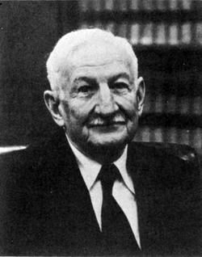
THE PRESIDENTIAL RESPONSE…
President Truman was deeply troubled by the events surrounding the attack on Woodard and
In 1947, appointed the President's Committee on Civil Rights.
Issued Executive Order No. 9981 on July 26, 1948 which stated that "It is hereby declared to be the policy of the President that there shall be equality of treatment and opportunity for all persons in the armed services without regard to race, color, religion, or national origin."
Established the President's Committee on Equality of Treatment and opportunity in the Armed Services (Fahy Committee).
Hon. Charles Fahy

Slide 25
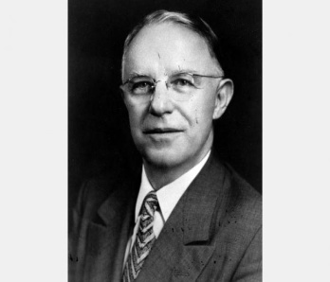
QUID PRO QUO…
Recall, that there was no uniform approach to racial issues and law enforcement in the post-World War II period. In Atlanta, GA, for example, one area of protests centered around a demand for the hiring of African-American police officers.
Following demonstrations that focused on police brutality, Mayor William Hartsfield finally agreed to hire eight African American police officers in 1948 after black leaders guaranteed thousands of votes for his reelection.
William Hartsfield

Slide 26
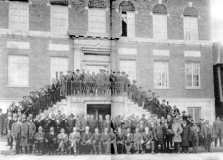
BUT THERE WERE LIMITATIONS…
Though hired as officers of the Atlanta Police Department, the city's first black policemen
could not arrest white suspects
were initially stationed at the Butler Street YMCA, a facility known informally as the “Black City Hall,” to avoid racial tension at police headquarters.
Butler Street YMCA
in 1920

Slide 27
BEFORE BIRMINGHAM, THE ALBANY (GA) MOVEMENT
In November 1961, residents of Albany, Georgia, launched an ambitious campaign to eliminate segregation in all facets of local life. The movement captured national attention one month later when local leaders invited Martin Luther King, Jr. to join the protest.
News of the invitation reached Albany Police Chief Laurie Pritchett, an Army veteran who had attended Auburn University and South Georgia College. He graduated from the National Academy of the Federal Bureau of Investigation and the Southern Police Institute at the University of Louisville.

Slide 28
MARTIN LUTHER KING WITH ALBANY, GA POLICE CHIEF LAURIE PRITCHETT

Slide 29
STRATEGY OF NON-VIOLENCE
Police Chief Pritchett, who, like King, was familiar with the strategies of Gandhi, saw the non-violent approach to demonstrators as an effective strategy to end the campaign in Albany before the demonstrators could secure gains
Passive law enforcement would allow the movement to fail
Officers being trained in non-violence frustrated King
Lack of violent confrontations prevented negative publicity
Documenting the American South

Slide 30
THE APPROACH IN ALBANY
“Well, …we had information that Dr. King was coming into the Albany Movement with the Southern Christian Leadership. And you know his philosophy was non-violence. So we were going on the same philosophy as that.
My men would train on non-violence: not that we had police dogs; they were deactivated. The men were instructed that if they were spit upon, cussed, abused in any way of that nature, that they were not to take their billy-clubs out. And they would act in a non-violent approach in that. And this is what they did; you know, there was no bloodshed.”
Albany Police Chief Laurie Pritchett
April 23, 1976 interview

Slide 31
PART OF THE EFFORT…
…And this incident right here was one that almost ignited Albany, Georgia, because all the whites (and we had them in there with their lunches, you know, with shotguns in the back of their cars and baseball bats; and they'd bring the kids with lunches and just sit waiting for something so they could come out), they figured that when the sheriff did this this would give them the right.
And we had to go out on public address systems and state that there would be no violence. We would not tolerate it. And we cleared the whole town…..

Slide 32
PART OF THE STRATEGY…
“I closed the bars; I closed everything in that town. There wasn't anything open. And we cordoned it off where nobody could come in…..”

Slide 33
FROM A DIFFERENT ANGLE…
“…you know Shelton and all them (the Klan) came in from Alabama. We would not let them come into Albany, Georgia.
When Dr. King come in he had escorts; we escorted him everywhere, police escorts.
The American Nazis out of Washington came in; we wouldn't let them parade. We packed them up in their car and they went back. Shelton and all of the Ku Klux Klan, they met on the outside of the city limits; we wouldn't let them come in. They never did come in for parading or anything.”

Slide 34
CHIEF PRITCHETT CONFRONTS THE NAZIS..

Slide 35
AND IN SUMMARY…
“My responsibility was to enforce the ordinances and laws of that city and state. As I told Dr. King many times, I did not disagree with his motives or his objectives; it was his method.
I believed in the courts; he believed in the streets. So I’ve never been classified as a segregationist and not as an integrationist. I was an administrator of the city of Albany’s police department.”

Slide 36
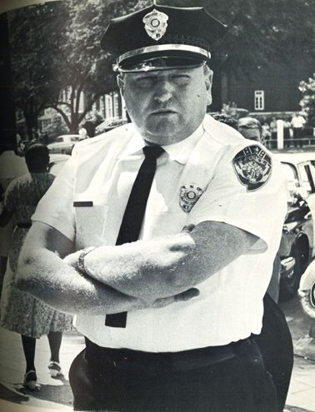
CHIEF PRITCHETT’S OBSERVATIONS…
“After King left Albany, Georgia he was at his lowest peak. He was defeated. Moneywise, he had had to spend all that money in Albany for nothing. He went back. He had to make a start. He went to Birmingham.”
- Laurie Pritchett

Slide 37
RECALL THE IMAGE FROM BIRMINGHAM…

Slide 38
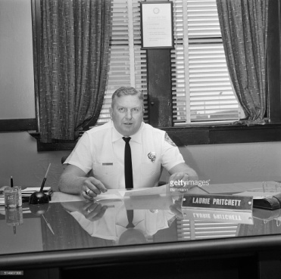
THE REST OF THE LAURIE PRITCHITT STORY…..
In 1966, Chief Pritchett left Albany and became Chief of the High Point, NC Police Department. He served as Chief from 1966 until his retirement in 1975. As Chief of the High Point Police Department, Chief Pritchett
Made express overtures to the African-American community
Hired several African-American police officers
Laurie Pritchett

Slide 39
ONE AIM IN MANY COMMUNITIES….
One of the goals of the newly-inspired movements across the country was to have African-American officers added to the various police departments that, in so many instances, had been seen as bastions of oppression.

Slide 40
MANY COMMUNITIES TRIED…
An example of the communities whose leaders made an effort to respond to pressure from African-Americans to hire black police officers was Bogalusa (Washington Parish), LA.
In 1964, Washington Parish brought the first African-American representation to its law enforcement when it hired O’Neal Moore and Creed Rogers as deputies.

Slide 41
O’NEAL MOORE

Slide 42
WHO WAS O’NEAL MOORE…?
Moore was described as a 34-year-old Army veteran who
had distinguished himself as a leader in his church, his local fraternal lodge, and the PTA
had four daughters who idolized him and a wife who had great ambitions for him and their children
while other black residents marched and picketed, avoided civil rights activities.

Slide 43
ON THE ANNIVERSARY OF HIS HIRING…
Exactly a year after Moore and Rogers were appointed – June 2, 1965 – Rogers and Moore were heading home when their car was hit by gunfire.
Moore was hit in the head and instantly killed.
Rogers was wounded in the shoulder and blinded in one eye. He managed to broadcast a description of the vehicle on the police radio – a black pickup truck with a Confederate flag decal on the front bumper.
Shortly after the murder, a man driving a pick-up truck which matched Rogers’ description of the assailant was picked up just across the Mississippi state line.

Slide 44
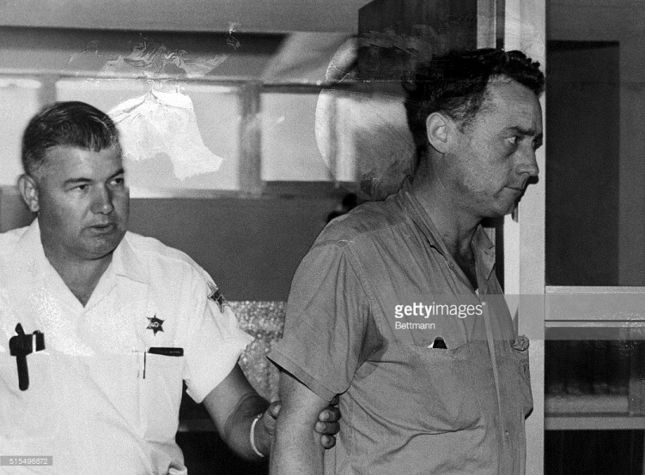
ERNEST RAY MCELVEEN
Ernest Ray McElveen, a forty-one year old white Bogalusa resident who worked as a lab technician and was a member of the National States’ Rights Party and the Citizens’ Council of Greater New Orleans was charged with Moore’s murder.

Slide 45
PROSECUTION OUTCOME
Although McElveen was arrested and charged with Moore’s murder, the case against him eventually collapsed for lack of evidence
Moore’s killers (police believed that three men took part in the crime) escaped justice.

Slide 46
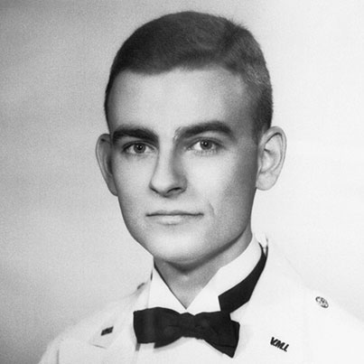
AT TIMES LAW ENFORCEMENT WAS SEEN AS COMPLICIT…
Among those who answered Martin Luther King’s call for demonstrators to come to Alabama for the 1965 Selma to Montgomery march was Jonathan Daniels, a twenty-six year old Episcopal seminary student from Massachusetts.
Jonathan Daniels

Slide 47
FATEFUL ENGAGEMENT…
Believing that he was living out the calling of his faith, Daniels chose to remain in Alabama following the march and remained in Lowndes County, AL where, on August 14, 1965, Daniels and two ministers joined black teenagers in Fort Deposit, AL picketing stores alleged to engage in discrimination.

Slide 48
TRUE TO THEIR WORD…
Police had already informed the marchers they would be arrested for their own protection. As the group approached downtown, Daniels and the Rev. Richard Morrisroe, a Catholic priest, were among 30 marchers arrested and taken to the jail in Hayneville, AL.
The marchers spent nearly a week in jail. On Aug. 20, 1965, they were released without explanation and with no transportation back to Fort Deposit. While one of them went to call someone for a ride home, two teenagers, Joyce Bailey and Ruby Sales, walked with Daniels and Morrisroe to a store to buy a soda. When they got to the door, they were met by a man with a shotgun who told them to leave “or I’ll blow your damned brains out!”

Slide 49
A DEATH, ARREST, INDICTMENT AND TRIAL
Daniels pushed Sales out of the way as the gun went off. The shot hit Daniels in the stomach, killing him instantly. Morrisroe was hit in the back, critically injured.
Tom Coleman, 55, a part-time deputy of Lowndes County, put down his shotgun, walked to the courthouse and called the state trooper commander. “I just shot two preachers,” he said. “You better get on down here.”
A grand jury indicted Coleman for manslaughter instead of murder after he testified Daniels pulled a knife on him.
The all-white jury took less than two hours to find Coleman not guilty and shook his hand as they filed out of the courtroom.

Slide 50
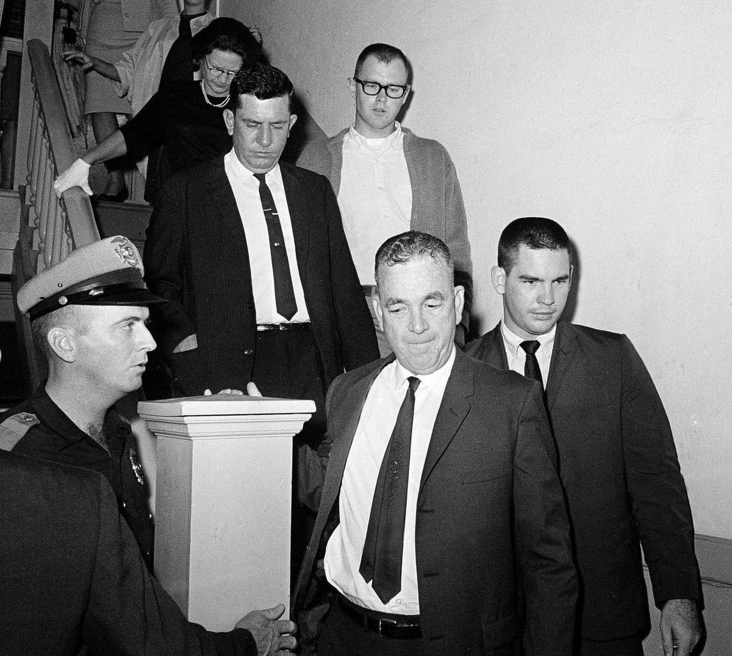
COLEMAN LEAVES THE COURTHOUSE
After acquittal…

Slide 51
A RECENT ISSUE IN POLICE/COMMUNITY RELATIONSHIPS
“I used to report for a local television station in town, and every time I’d cover a gang-related shooting, police would say one of the following:
We have no suspects and no one is coming forward.
The issue is, no one is coming forward.
There is this thing called the “No Snitch Code.” No one is talking.”
- DeSzaun Smallwood
Seattle, WA
May 14, 2014

Slide 52
“BLUE WALL OF SILENCE” v. “NO SNITCHING”
Mistrust between some communities and law enforcement remain when, for example, the “NO SNITCHING” controversy is met with the “BLUE WALL OF SILENCE.”

Slide 53
AND “THE COMMUNITY” OFTEN POINTS TO…
October 11, 2015
COLUMBUS, Ohio (AP) — The Cleveland police union and the local prosecutor remain at odds even after the release of expert reports that found a white officer was justified in fatally shooting a 12-year-old black boy last year.
Cuyahoga County Prosecutor Tim McGinty accuses the Cleveland Police Patrolmen's Association of failing to cooperate with the investigation into the death of Tamir Rice. The union counters that McGinty is just grandstanding.

Slide 54
AGAIN, THE COMPETING VIEWS
Many in the African-American community feel
that most cops are dishonest and out to get them
that the CIA is behind the drug epidemic
it’s all a conspiracy to lock up more and more African-American men.
Professor David Kennedy, Founder
National Network for Safe Communities (NNSC)

Slide 55
AND THE VIEW OF LAW ENFORCEMENT
On the other hand, the officers will say
the community is complicit
that “nobody cares,” “no one is raising their kids,” “everybody is living off of drug money,”
And as to the community, “the only thing we can do is occupy them.”
- Kennedy
January 12, 2012

Slide 56
EFFORTS TO BRIDGE THE GAP….
One effort to improve policing practices and reassure the public of the professional nature of most policing activity has been the use of police body cameras.
Benefits of Body Cameras
From the perspective of a suspicious public and media, body cameras are seen as a way to improve transparency and police accountability.
For law enforcement, the cameras offer a way to effectively counter wrongful claims of misconduct.

Slide 57
ANY REASON FOR CONCERN…?
The challenge of on-officer cameras is the tension between their potential to invade privacy and their strong benefit in promoting police accountability.
Police officers enter people’s homes and encounter bystanders, suspects, and victims in a wide variety of sometimes stressful and extreme situations.
A second concern is that, if police are free to turn the cameras on and off as they please, the cameras’ role in providing a check and balance against police power will shrink and they will no longer become a net benefit

Slide 58
ARE BODY CAMERAS A PART OF THE SOLUTION?
September 5, 2015
DALLAS – In the national debate over police safety and accountability, body cameras have proved to be a powerful tool.
Tuesday, the Dallas Police Department rolled out a body camera program that's been in the making since 2013.

Slide 59
THE IDEA IS RECEIVING WIDESPREAD CONSIDERATION…
September 15, 2015
BOSTON - Police officers in Boston could be equipped with body cameras within the next couple of months as part of a pilot program, according to Boston Police Commissioner William Evans

Slide 60
THE PRECISE ISSUES RAISED HIT HOME FOR ME…
The September 2, 2015 Milwaukee Journal Sentinel reported that Mayor Tom Barrett intended a budgetary request for body cameras for officers:
“Mayor Tom Barrett announced last weekend he is seeking to outfit all uniformed patrol officers with cameras by the end of 2016 — a pace that outstrips most other large police departments using the technology. The estimated cost of the body cameras and video storage capabilities is $880,000 in 2016, according to preliminary budget figures.”

Slide 61
BUT GOODWILL AND POSITIVE EXPECTATIONS CAN BE LOST DUE TO POLICY DECISION AND SUSPICION….
While on one hand:
“The policy says all officers assigned a camera must wear it at all times when on duty, in uniform and performing enforcement duties.”
It also states :
“Officers will not be required to have the cameras activated during their entire shifts but will be required to turn them on ‘as soon as practicable and when safe to do so,’ when they realize they will be conducting investigative or enforcement actions.”
Journal Sentinel
October 16, 2015

Slide 62
COMMUNITY POLICING
Because the nature of communities and the demands of changing demographics have required evolution of policing practices, there have been numerous initiatives at the federal and local levels to provide guidance to law enforcement agencies.
One has been what is commonly referred to as “community policing,” led by the United States Department of Justice Community Oriented Policing Services (COPS).

Slide 63
WHAT IS COMMUNITY POLICING?
Community policing focuses on crime and social disorder through the delivery of police services that includes aspects of
traditional law enforcement
prevention
problem-solving
community engagement
partnerships.

Slide 64
THE MODEL ITSELF…
The community policing model
balances reactive responses to calls for service with proactive problem-solving centered on the causes of crime and disorder.
requires police and citizens to join together as partners in the course of both identifying and effectively addressing these issues
Community Policing Explained: A Guide for Local Governments

Slide 65
A DESCRIPTION OF THE CONCEPT
Community Policing Explained: A Guide for Local Governments (July 2007) http://www.cops.usdoj.gov/pdf/vets-to-cops/cp_explained.pdf

Slide 66
MILITARIZATION OF POLICE DEPARTMENTS…
One of the pressing issues affecting relationships between many communities and law enforcement is what is viewed as the militarization of police departments.
Images of local officers manning equipment originally intended to battle opponents in Iraq and Afghanistan have contributed to some perception that the police are an occupying force.

Slide 67
FROM THE SPRING 2015 JOHN HOPKINS MAGAZINE

Slide 68
FERGUSON, MO POLICE IN NOVEMBER 2014

Slide 69
IMPACT OF THE DRUG WAR
In 1981, President Ronald Reagan's administration prompted Congress to pass the Military Cooperation with Civilian Law Enforcement Agencies Act. The legislation permitted U.S. military collaboration with civilian law enforcement in the growing war on drugs, including the sharing of information and facilities and training on and use of military equipment.
The National Defense Authorization Act of 1990 authorized the Department of Defense to transfer military equipment to law enforcement agencies "for use in counterdrug activities."

Slide 70
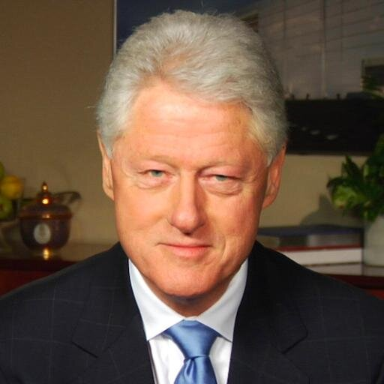
IN THE CLINTON ADMINISTRATION…
The National Defense Authorization Act for fiscal year 1997 (in the 1033 Program) authorized surplus military equipment to be sent to law enforcement agencies for "use in counter-narcotics and counterterrorism operations, and to enhance officer safety.“
All of these programs and acts were expanded following 9/11
William Clinton

Slide 71
ONE REASON FOR RECENT CONSIDERATION…
In December 2014, President Barack Obama's office issued a report about these programs and gave his administration 120 days to develop an executive order that includes substantive reforms. Cited as consideration was a recognition that in the Obama era, police departments had received
tens of thousands of machine guns
nearly 200,000 ammunition magazines
thousands of pieces of camouflage and night-vision equipment
and hundreds of silencers, armored cars and aircraft.

Slide 72
ONE PERCEPTION…
“One result is that police agencies around the nation possess military-grade equipment, turning officers who are supposed to fight crime and protect communities into what look like invading forces from an army.”
The Militarization of U.S. Police Departments, (March 10, 2015), Heather Gray

Slide 73
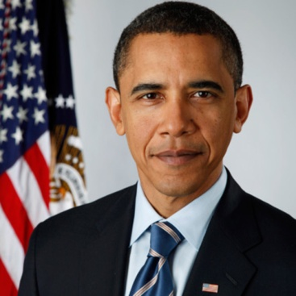
A PRESIDENTIAL INITIATIVE…
In a May 2015 address in Camden, NJ, then-President Obama noted the militarization can sometimes make residents feel like there is "an occupying force" in their neighborhood.
"It can alienate and intimidate local residents, and send the wrong message."
The directive of the President banned police from obtaining from the United States government some military-style equipment, including
tracked armored vehicles
weaponized aircraft
high-caliber weapons
Barack Obama

Slide 74
EFFORTS BY LAW ENFORCEMENT TO PROVIDE LEADERSHIP
An example of the efforts of some law enforcement agencies to assist agencies in effective and fair policing is the September 2006 guide,
Protecting Civil Rights: A Leadership Guide for State, Local, and Tribal Law Enforcement
created by the International Association of Chiefs of Police available at http://www.theiacp.org/portals/0/pdfs/PCR_LdrshpGde_Part1.pdf

Slide 75
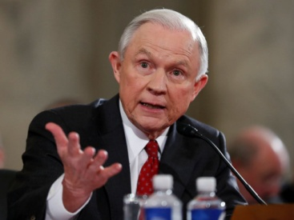
WITH THE CHANGING OF THE GUARD…
“Sessions Indicates Justice Department Will Stop Monitoring Troubled Police Agencies”
New York Times
FEB. 28, 2017
“…it is not the responsibility of the federal government to manage non-federal law enforcement agencies.”
Attorney General Jeff Sessions
Memo to DOJ staff
April 2017

Slide 76
Lindsey D. Draper
Lindrap@prodigy.net
414-462-8956

