Slide 1
What Challenges Might Face American Constitutional Democracy in the 21st Century?

Slide 2
Change & Difference
Population Growth by Region
Race/Ethnicity
Age
Resources
Religion

Slide 3
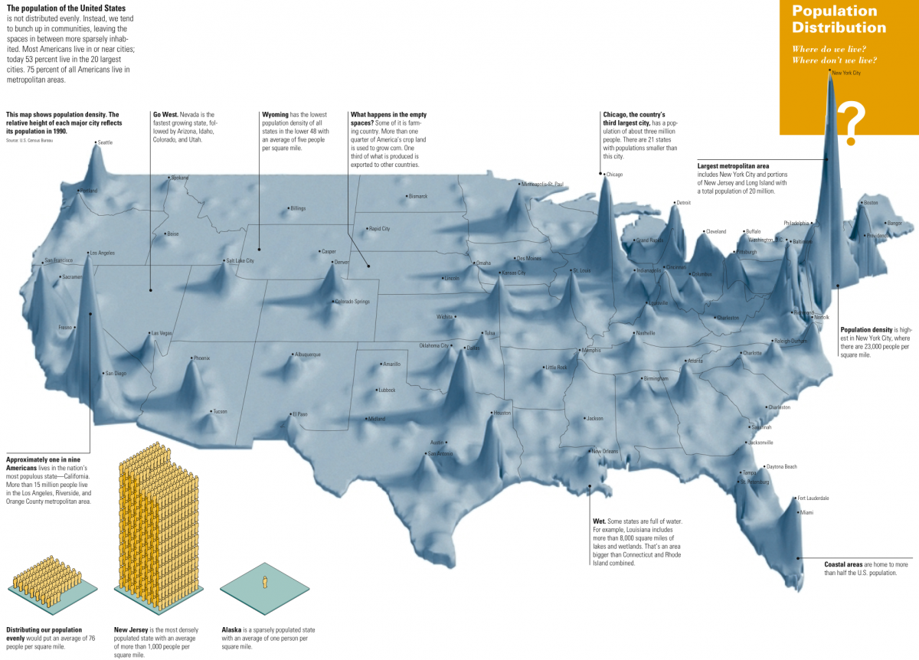

Slide 4
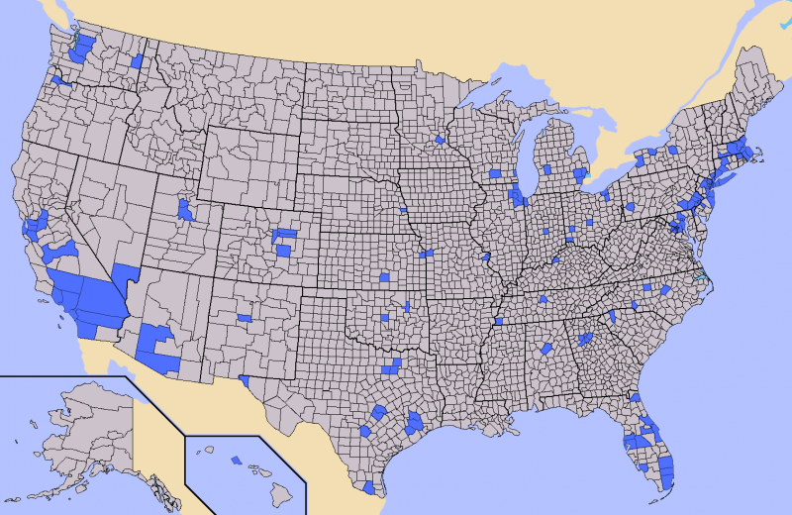

Slide 5
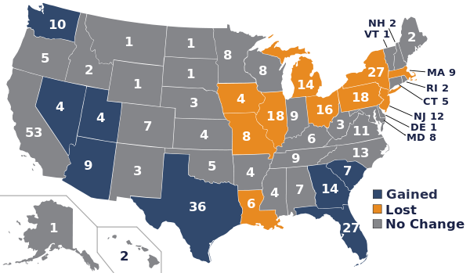

Slide 6
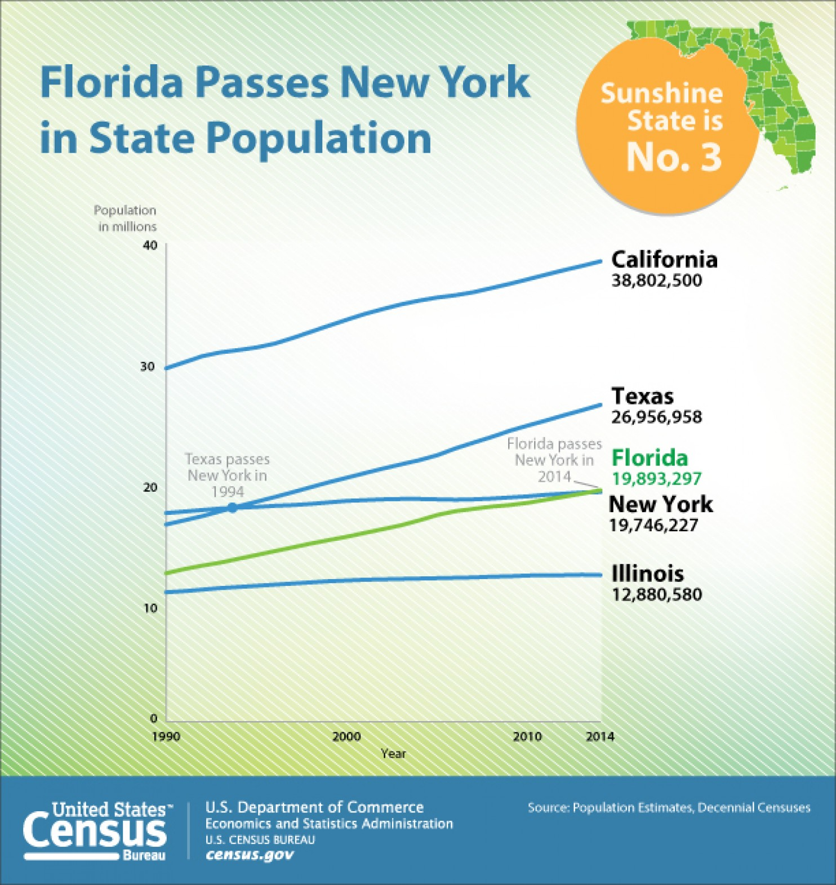

Slide 7
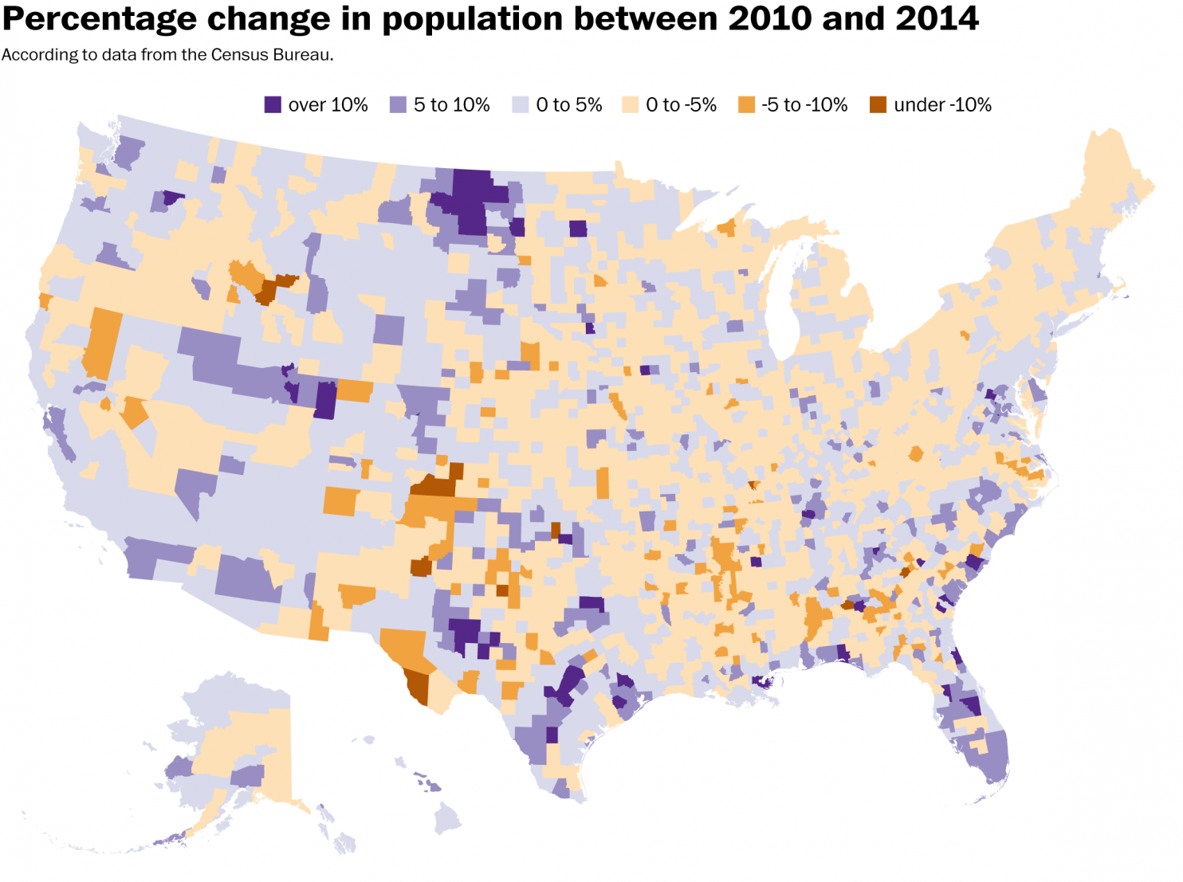

Slide 8
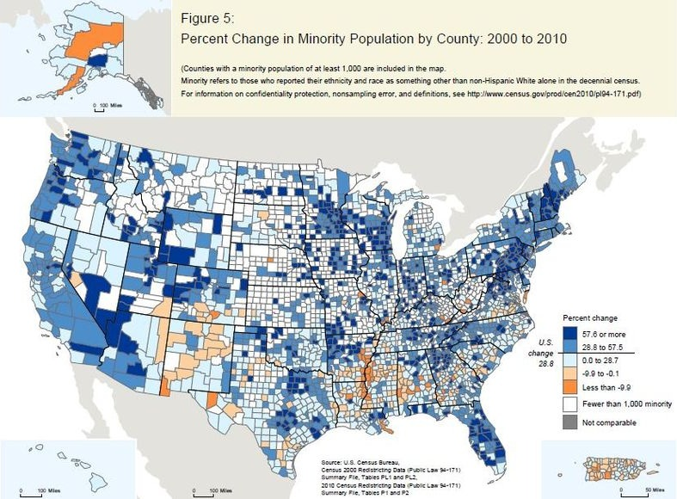

Slide 9
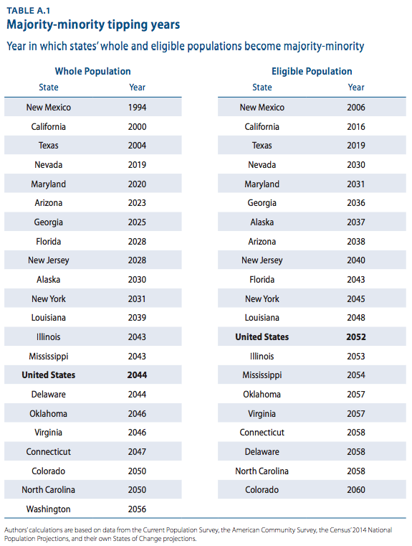

Slide 10
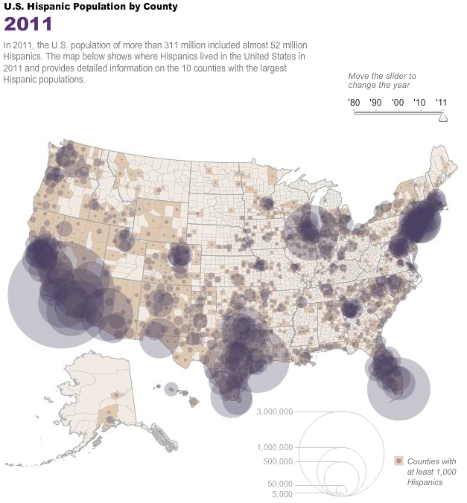

Slide 11
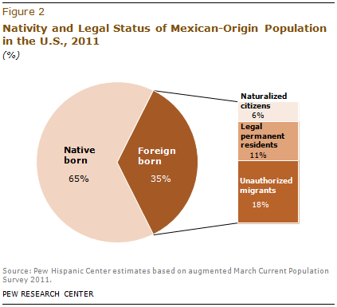

Slide 12
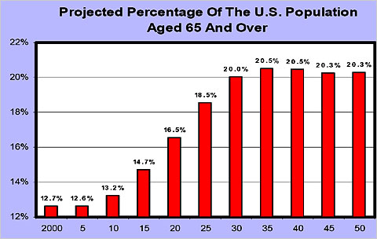

Slide 13
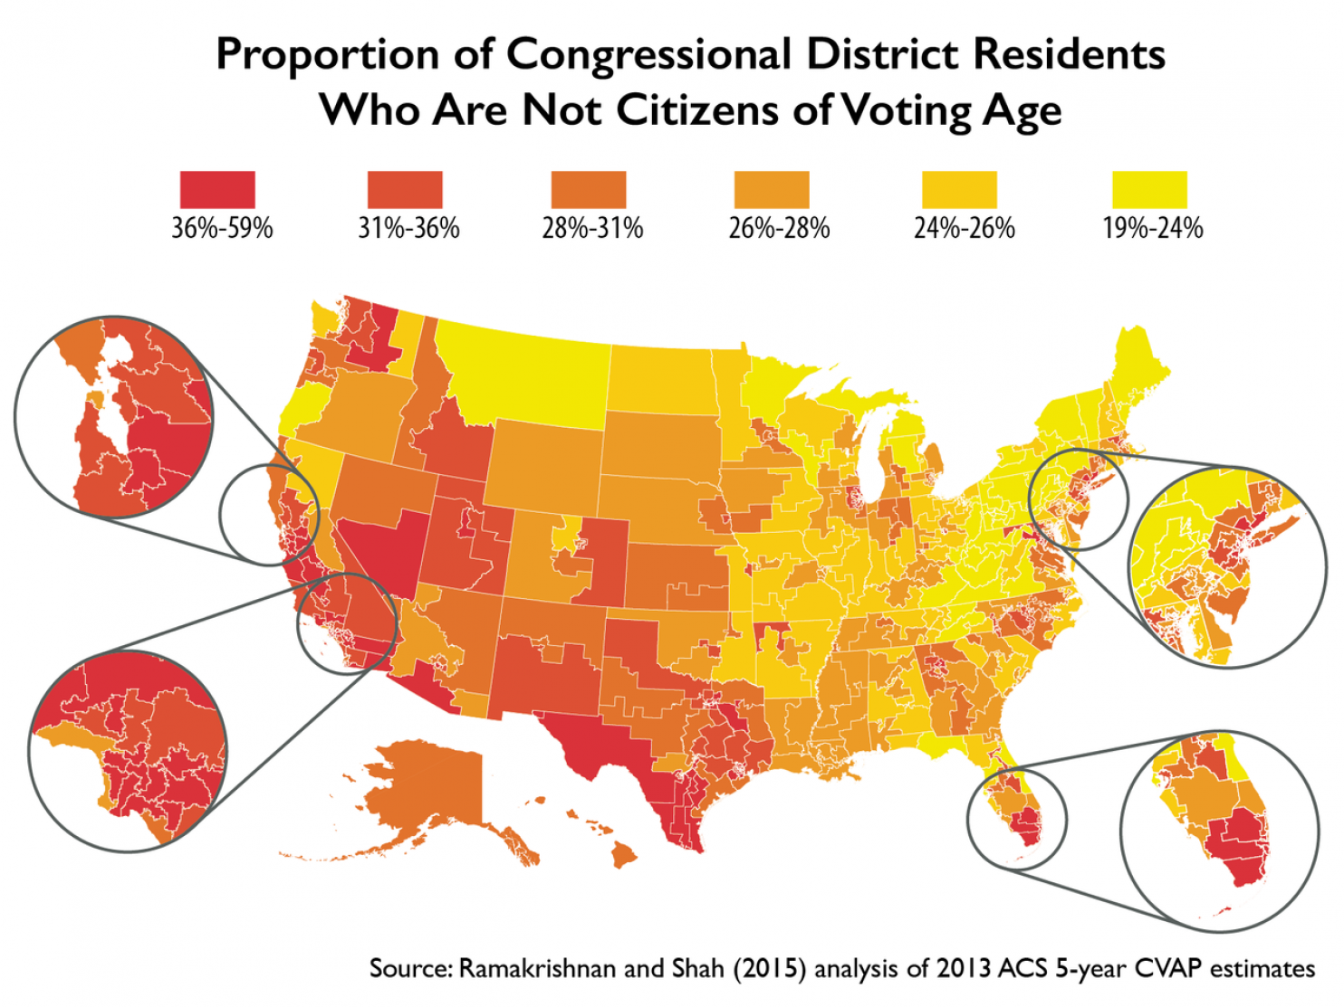

Slide 14
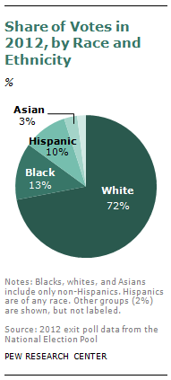

Slide 15
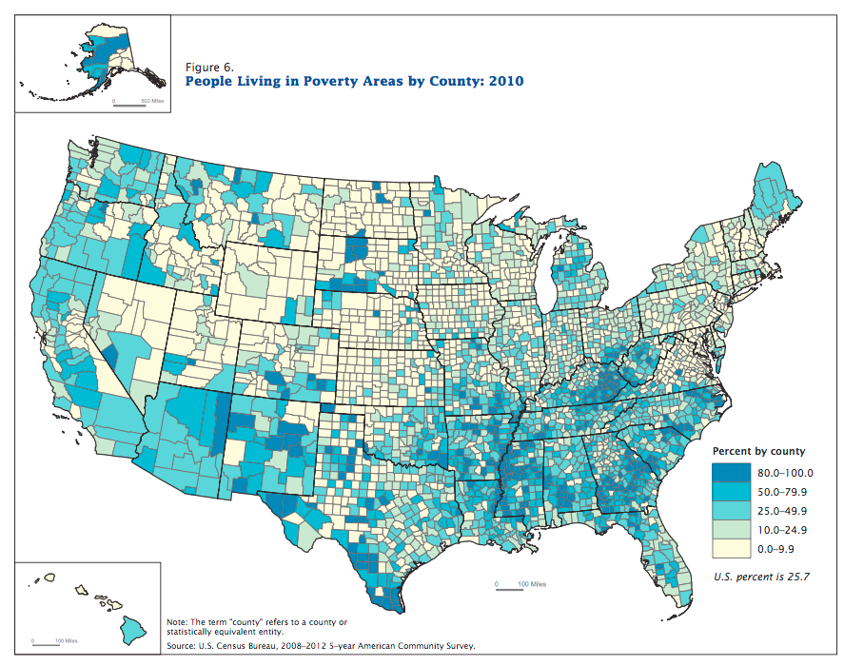

Slide 16
Religious Diversity
A large majority (83%) of Americans still identify as Christians.
Americans now claim affiliation with 1600 different religious affiliations & denominations.
About 16% are not religiously affiliated.

Slide 17
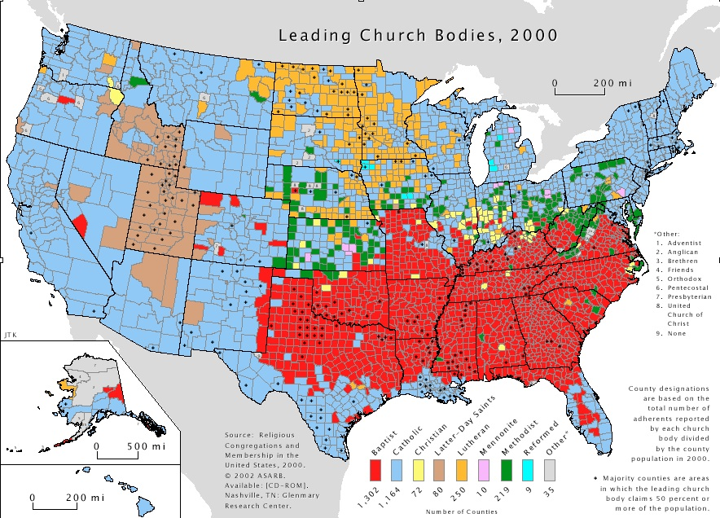

Slide 18
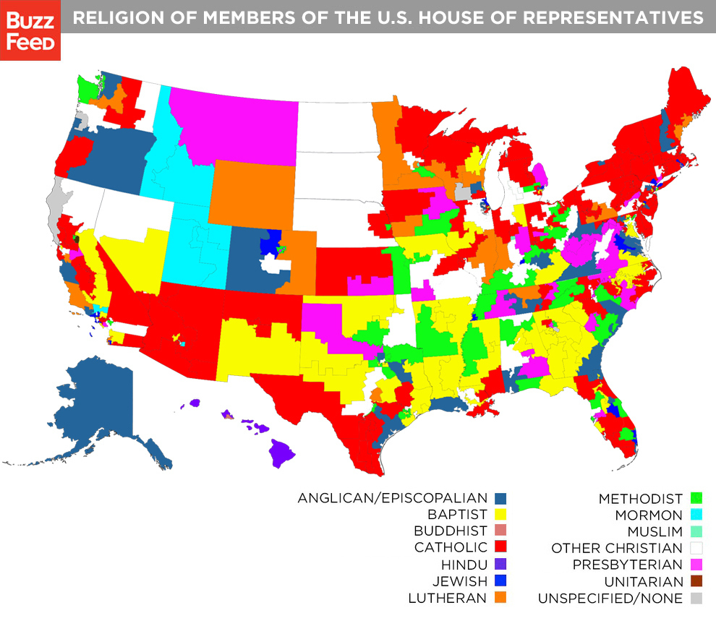
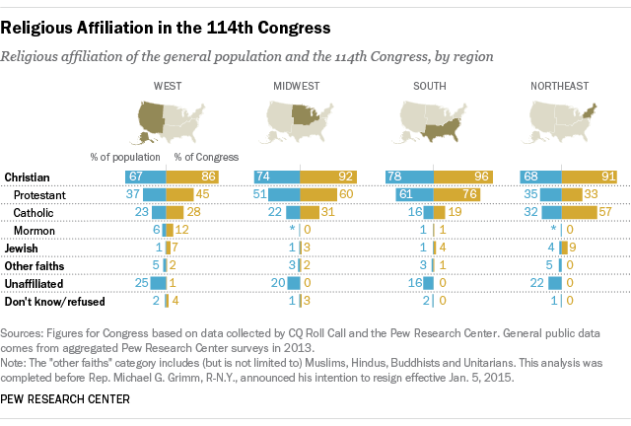

Slide 19
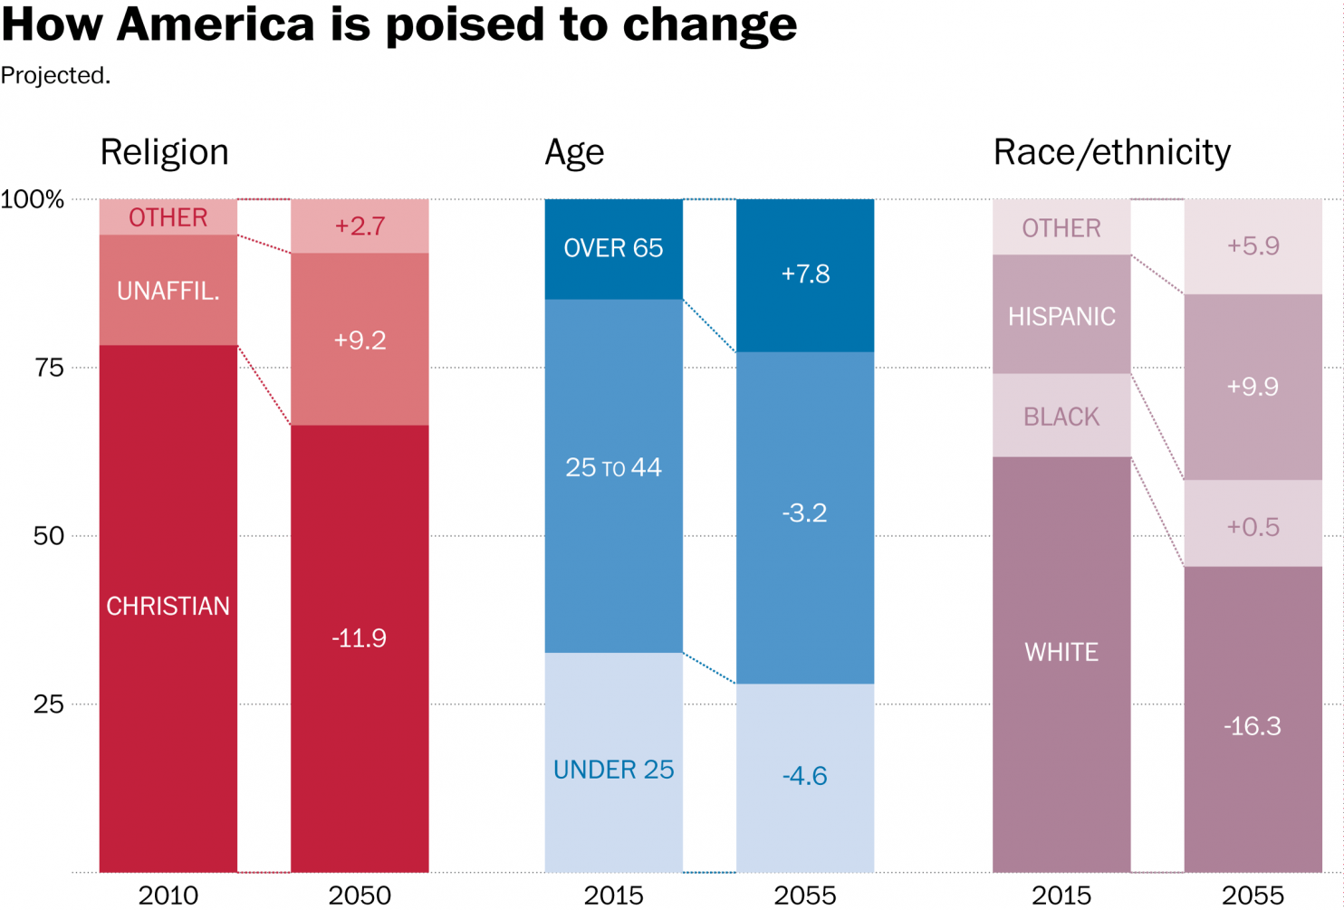

Slide 20
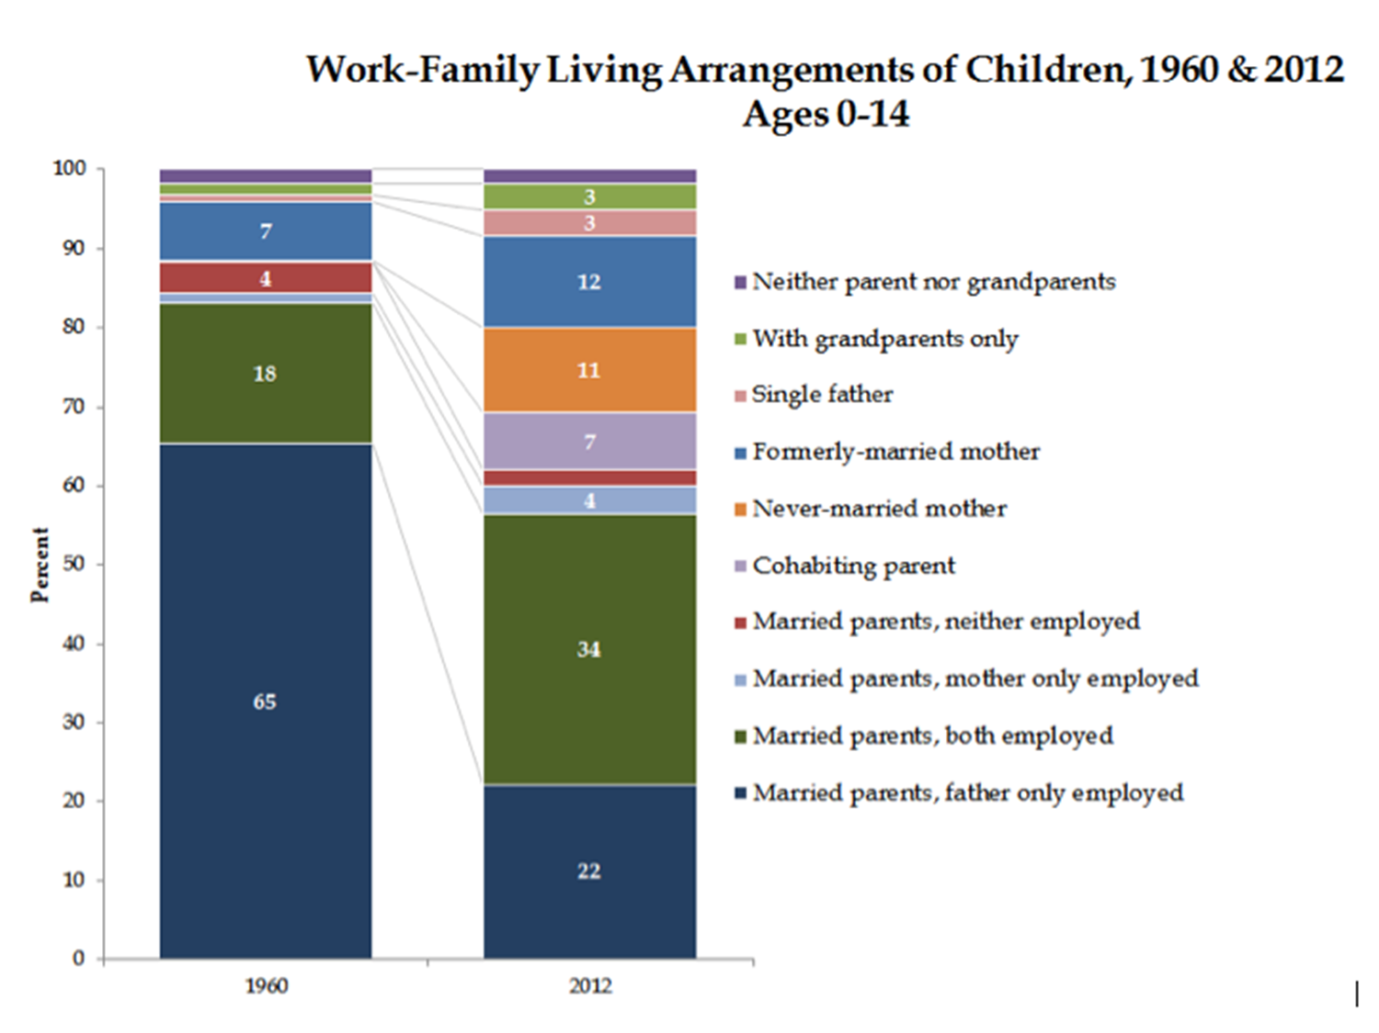

Slide 21
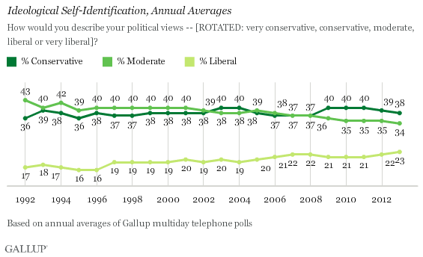

Slide 22
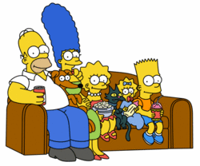
Testing Political Knowledge
Name the 5 1st Amendment rights
1 in 1000
Name these 5 Simpsons:
1 in 5

Slide 23
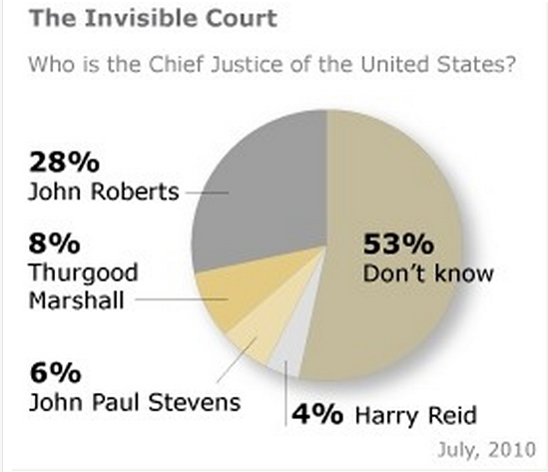

Slide 24
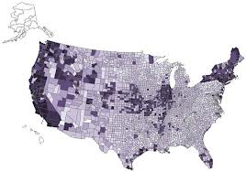
United States Governments
1 national
50 state
89,004 local
http://www2.census.gov/govs/cog/2012/formatted_prelim_counts_23jul2012_2.pdf

Slide 25
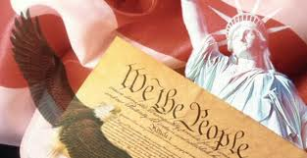
Activity
How many units of government are you aware of where you live?*
Which units of government affect you the most on a daily basis?
Which units of government do you care about most? Why?
* Are you remembering tribal governments?
Notes:
Human beings are mammals with physical needs (e.g., food, clothing, shelter) and non-physical needs (e.g., safety, trust, belonging). How do the various governments you identify help to meet those needs? In what ways might they stifle meeting those needs??

Slide 26
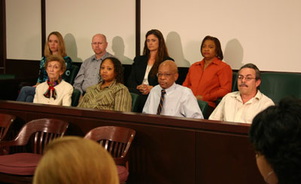
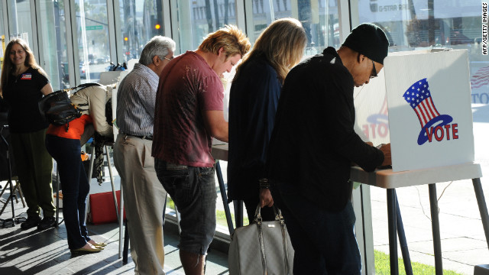
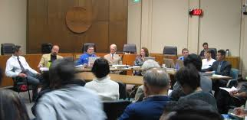
Citizen opportunities
Vote
Participate
Serve
Notes:
The American Revolution established the principle of popular sovereignty. Sovereignty means ultimate governing power. In a system of popular sovereignty, then, the people have ultimate governing power. How can and should they exercise that power? Through direct democracy? Through representative government (both as governors and governed)? Through civic engagement?

Slide 27
Challenges of voting intelligently
Understanding “the system”
Information
News
Opinion
Advertising
Making time
Notes:
The American political system is one of the most complex in the world. Its unique system of federalism (shared power between the national government and the states, and more than 550 recognized tribal governments) is a challenge to understand.
How can Americans obtain the information they need to vote intelligently?
Voting turnout in the United States historically has been low and particularly low compared to other democratic countries. It is lowest and the local and state levels. The most common reason given for not voting is “not enough time.” How might this problem be address?

Slide 28
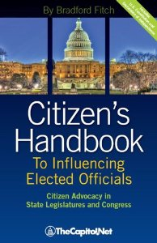
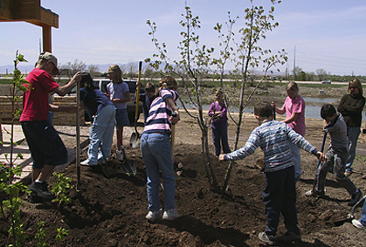
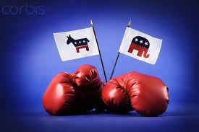
Participation
NGO’s
Political parties
Interest groups
Notes:
Non-governmental organizations provide services that government might otherwise have to provide. Some NGO’s are organized by religious organizations, some by businesses, and some have an international focus. See: http://library.duke.edu/research/subject/guides/ngo_guide
Political parties are the primary “linkage” between people and partisan government officials. America’s two-party system, described in Unit II of the WTP text, requires each party to appeal to a broad range of interests.
Interest groups typically are much more narrow in their policy focus than political parties. Many interest groups raise money to support lobbying on behalf of particular political issues.

Slide 29
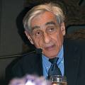
If we are not willing to rule in our turn, other men (Hegel’s civil citizens, professional politicians and professional revolutionaries, corporate bureaucrats, and so on) will rule out of theirs. They will call us citizens, but we will be something less. Perhaps I should say they do call us citizens, but we are something less.
Professor Michael Walzer - Obligations

Slide 30
HUMAN RIGHTS
Inalienable moral entitlements. . .
Attach to all persons equally. . .
Specify the minimum conditions for human dignity and a tolerable life. . .

Slide 31
Assumptions
World is “human family”
Rights are foundation of freedom, justice, peace
Everyone has duty to teach, educate, promote human rights
Notes:
World is a giant “polis.” Classical view of human interaction
Family: Kin, relatives, relations, unit— how does this view differ from people being defined by their race, ethnicity, religion, country of origin/residence/citizenship? Use these factors to highlight differences.
Article 1: People should act towards one another “in a spirit of brotherhood.”
Is it realistic or desirable to think this way? If it is, how can it happen? Importance of cultural exchanges in breaking down barriers. Music, citizen diplomacy, hobbies-across-borders, etc.
Preamble of UNDR also creates duties—to teach, educate, promote. Classical orientation

Slide 32
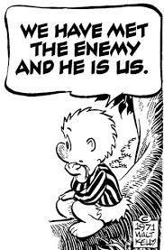
Paradoxes in U.S. Politics
Majority Rule v. Minority Rights
Consensus v. Freedom
Federalism v. Centralization
Authoritarian v. Individualistic
Hyperpluralism

