Slide 1
THE IMMIGRATION ISSUE – NOT NEW AT ALL!
We the People Summer Institute
Columbia, South Carolina
July 2018

Slide 2
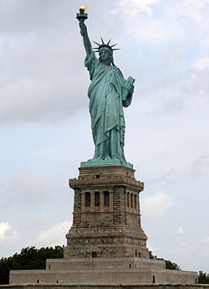
OVERVIEW
There are few topics that elicit stronger responses than “immigration” and what should be the appropriate policies or actions related to it. The discussion today will highlight
The history of our ”nation of immigrants” and the people who have contributed to that designation
The reactions of settled populations and the government to immigration ”waves”
Factors that have both caused and occurred as a result of significant immigration trends

Slide 3
ONE OF THE ISSUES…
In a nation that has prided itself on being a “melting pot” of peoples, blending the best of those of many backgrounds, what are the reasons for resisting the arrival of others?
While the de facto national motto, E Pluribus Unum – “out of many, one” – was initially intended to refer to a single nation coming from several states, it has come to represent a nation made of many peoples.

Slide 4
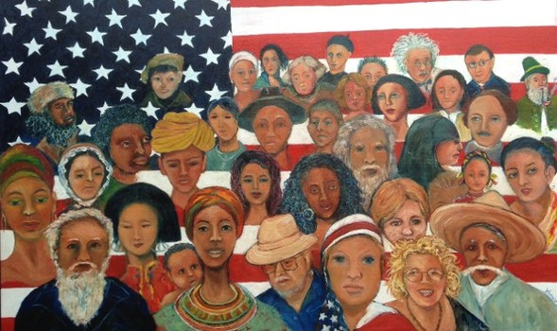
IT’S IMPORTANT TO REMEMBER…
The United States is history’s exception!
“The United States steadily evolved to define Americans by their shared values, not by their superficial appearance.”
Victor David Hanson June 8, 2016

Slide 5
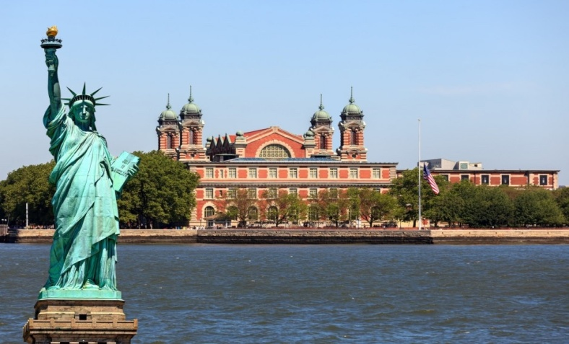
BECOMING AN “AMERICAN”
The traditional “melting pot” notion, communicated the historically exceptional notion of American identity as one formed not by the accidents of blood, sect, or race, but by the unifying beliefs and political ideals enshrined in the Declaration of Independence and the Constitution: the notion of individual, inalienable human rights that transcend group identity.

Slide 6
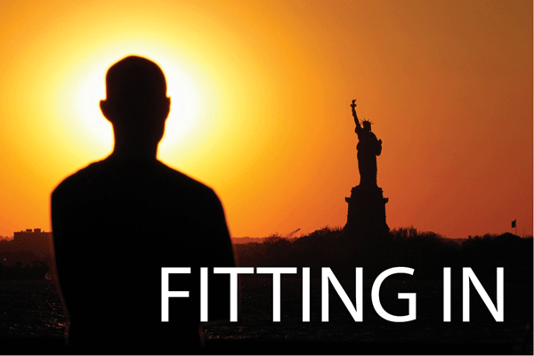
THE TRADITIONAL PRICE…
The process of assimilation also entailed costs and sacrifice. Having voted with his or her feet for the preference of America, the immigrant was required, in order to become American, to learn those things that identified one as an American, including
Language
History
Political principles
Civic customs

Slide 7
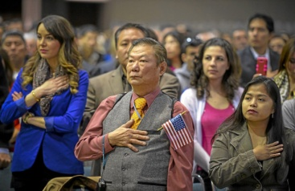
THE EXPECTATION…
The immigrant-citizen had to make his first loyalty to America and its ideals.
If some custom, value, or belief from the old country conflicted with core American values, the old way had to be modified or discarded
If the immigrant wanted to participate fully in American social, economic, and political life, the immigrant had to adjust.

Slide 8
Naturalization Oath of Allegiance to the United States of America
"I hereby declare, on oath, that I absolutely and entirely renounce and abjure all allegiance and fidelity to any foreign prince, potentate, state, or sovereignty, of whom or which I have heretofore been a subject or citizen; that I will support and defend the Constitution and laws of the United States of America against all enemies, foreign and domestic; that I will bear true faith and allegiance to the same;…

Slide 9
that I will bear arms on behalf of the United States when required by the law; that I will perform noncombatant service in the Armed Forces of the United States when required by the law; that I will perform work of national importance under civilian direction when required by the law; and that I take this obligation freely, without any mental reservation or purpose of evasion; so help me God."

Slide 10
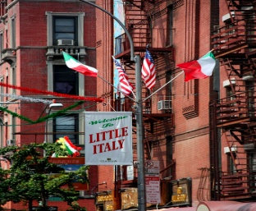
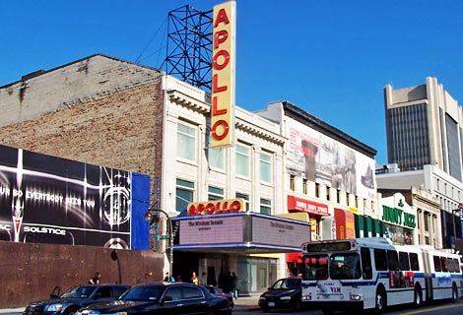
A SINGLE CULTURE…?
Although the concept of shared values has been one of the defining features of our country’s history, there have been other concepts used to describe our nation.
In the 1960’s, schools at times referred to the nation as a “salad bowl,” in which the country “ has become more of a cross-cultural mosaic, with people maintaining the traditions and characteristics on one culture while at the same time being American.”

Slide 11
SO NOW THE QUESTION…
What are the issues that have caused concerns about new immigration to this “nation of immigrants?”

Slide 12
THE CONCERNS THROUGHOUT…
Over the course of the nation’s history, immigration to the country has been opposed by those who already “belonged.” In an August 2016 blog, Alex Nowrasten identified as main arguments against immigration
“Immigrants will take our jobs and lower our wages, especially hurting the poor”
“Immigrants abuse the welfare state”
“Immigrants are a net fiscal cost”
“Immigrants increase economic inequality”
“Immigrants are especially crime prone”
“National sovereignty”

Slide 13
FURTHER OBJECTIONS…
“Today’s immigrants don’t assimilate like previous immigrants did”
“Immigrants pose a unique risk today because of terrorism”
“It’s easy to immigrate to the United States and we’re the most open country in the world”
“Amnesty or failure to enforce our immigration laws will destroy the Rule of Law in America”
“Immigrants will vote for one political party”
“Immigrants will increase crowding and harm the environment”
“Some races and ethnic groups are genetically inferior and should not come here decreasing the ethnic stock”

Slide 14
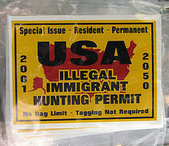
“America beckons,
But Americans repel.”
Old immigrant saying

Slide 15
FROM THE NATION’S BEGINNING…
Multiple nations contributed to the initial settlement of America. The indigenous population was joined by
European immigrants from Spain and France who established settlements by the 1500s.
The English, who founded their first permanent settlement at Jamestown in what became the colony of Virginia (1607). That settlement also included about 20 Africans who were forced into indentured servitude.
The Pilgrims, who landed at Plymouth (1620) and were followed by Puritans who, in their quest for religious freedom, established the Massachusetts Bay Colony
Enslaved Africans, whose number increased from roughly 7,000 in 1680 to over 500,000 by 1790.

Slide 16
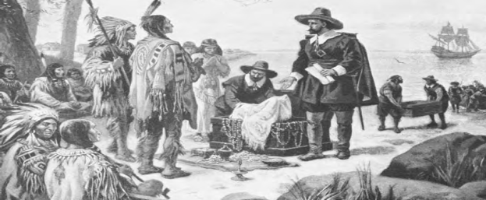
THE APPEAL OF THE NEW LAND…
Settlers were attracted/brought to the colonies by
Economic opportunities including the promise of free land and freedom of enterprise
The promise of religious freedom with its appeal to English Pilgrims, Quakers and various Protestant sects
The ability to earn the cost of passage across the ocean by agreeing to work as indentured servants for a fixed number of year
Newly-landed owners who, in order to answer the desire for cheap labor, imported West Africans as slaves (or what amounted to “involuntary” immigrants)

Slide 17
PARLIAMENTARY PUSH FOR IMMIGRATION
In 1740, the British Parliament passed the Plantation Act (a/k/a the Naturalization Act) which sought to encourage immigration to the colonies and systematize naturalization procedures.
The Act required a profession of Christian (Anglican) faith,
But allowed exceptions for Quakers and Jews
Excluded Papists (Catholics) from the rights conveyed

Slide 18
AMONG THE OTHER SETTLERS…
In the period prior to the Revolution, significant numbers of European immigrants came from northern European lands of
Sweden
The Netherlands
Germany

Slide 19
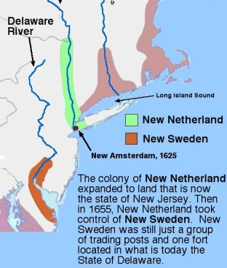
NEW SWEDEN
In the seventeenth century, Sweden was a major European power and, seeing wealth generated by colonies of other European nations, founded a fort in 1638 at present-day Wilmington, DE
The Swedes began to farm and settle in what became Delaware, New Jersey, Pennsylvania, and Maryland.
In 1654, the Dutch took over New Sweden.

Slide 20
NEW NETHERLAND
In 1609, English explorer Henry Hudson, working for the Dutch East India Company, sailed to North America and was followed soon thereafter, by Dutch traders.
In the 1620s and 1630s, additional settlers began and established a series of trading posts. Many of the early settlers focused on the fur trade as the colony expanded up the Hudson River.
Having taken over what was New Sweden in 1654, New Netherland was surrendered to England in 1664 as one consequence of the Second Anglo-Dutch War.

Slide 21
A SPECIAL GROUP OF IMMIGRANTS…
In 1718, in response to what was seen as a growing problem with crime and housing of criminals – and as a possible response to the colonial desire for additional cheap labor – the British Parliament passed the Transportation Act.
Transportation – the shipping of convicts to the colonies - became an institutionalized practice of emptying jails and forcibly ridding the country of undesirable elements.
Roughly 50,000 English emigrants (or about a quarter of those who came from Britain in the 18th century) entered America as a result of “transportation.”

Slide 22
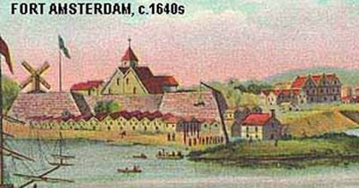
THE GERMANS…
Germans were among the first non-English-speaking immigrants to enter the United States in large numbers.
Although most German immigration to the United States occurred during the nineteenth century, Germans began arriving as early as 1608, helping English settlers at Jamestown, VA.
In the early 1620s, Germans played a role in the Dutch settlement of New Amsterdam, later known as New York City.
Early German immigrants helped settle North and South Carolina.

Slide 23
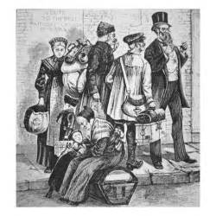
FACTORS PROMPTING EARLY GERMAN IMMIGRATION
Although later German immigration to the United States was driven by warfare among religious and political entities, many of the early emigrants left
Due to heavy taxation
Because of local laws of primogeniture which permitted only the eldest sons in families to inherit their fathers’ land
The appeal of minimal government interference in a place where there was the hope for having one’s own land and the chance to prosper was a huge magnet.

Slide 24
THE GERMANS…
Until 1871, there was no “nation” of Germany.
Following the collapse of the Holy Roman Empire, German nation-states emerged, and religious differences often led to persecution by more powerful states.
The Thirty Years War (1618 – 1648) began due to hostilities between German Protestants and German Catholics, and ultimately led to the deaths of about between 3,000,000 and 11,000,000 people.
During the colonial period, some 65,000 to 100,000 German-speaking people emigrated to the U.S.

Slide 25
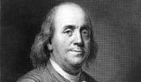
NOT EVERY AMERICAN WAS WELCOMING….
“these (German) immigrants are ‘generally the most ignorant Stupid Sort of their own Nation’ and that ‘they will soon out number us, that all the advantages we have will not, in My Opinion, be able to preserve our language, and even our government will become precarious’.”
- Benjamin Franklin (1753)

Slide 26
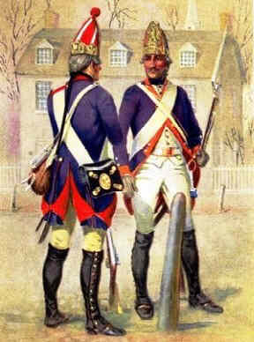
GERMANS IN THE REVOLUTIONARY WAR
Persons of German ancestry fought on both sides during the Revolutionary War.
By the late eighteenth century, many German immigrants had deep roots in North America and fought for independence
Britain used as many as 30,000 Hessian mercenaries who may have constituted as much as a third of the British combat troops.
Following the war, many of the Hessian troops remained in the country, in part because there weren’t funds to send them home.

Slide 27
SO, EXACTLY WHO WERE WE AT THE START…?
At the time of the first national census in 1790, the American population of about 3.9 million included
Roughly 65% people of British descent (including from England, Wales, Scotland and Ireland)
About 19% people from Africa
Dutch (which included many later described as German)
French
Swedish
Some not primarily attached to any country (such as immigrants of the Jewish faith)

Slide 28
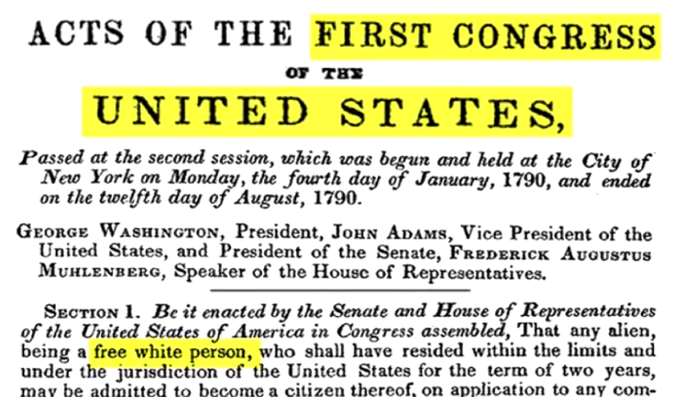
NATURALIZATION ACT OF 1790
The Naturalization Act of 1790 opened the door of citizenship to
White persons of good moral character
Residents, meeting that qualification, of the United States for at least two years
Excluded from the citizenship through naturalization were
Indigenous people
Free African Americans
Indentured servants
Slaves

Slide 29
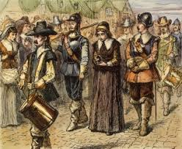
FIVE YEARS LATER…
During the early 1790s, Americans began to worry that a number of the immigrants entering the country – particularly those driven out by the French Revolution – might pose a threat to the country.
On January 29,1795, the Naturalization Act of 1790 was modified to
Raise the period of residence from two to five years before a person could be naturalized
Require renunciation of “allegiance and fidelity” to any other country in order to gain citizenship

Slide 30
AND AS THE CONCERN GREW…
Although France had been an ally of the United States in the Revolutionary War, the Jay Treaty (1793) signed between the U.S. and Britain at a time France and Britain were at war, led to the French seizing many American merchant ships.
In 1796, the French government refused to receive Charles Cotesworth Pinckney as U.S. minister and, in 1797 President John Adams sent a three-man delegation in an effort to restore peace. The French demanded money in order to see the delegation and the resulting Congressional response to the XYZ Affair led to the Quasi War with France

Slide 31
ALIEN AND SEDITION ACTS
With Americans concerned about a possible French invasion and in an atmosphere in which President Adams warned that foreign influence in the country was dangerous, in 1798, Congress passed
The Naturalization Act, extending to fourteen years the time immigrants had to live in the United States before becoming a citizen
The Alien Enemies Act which allowed, in the event war was declared, the arrest, detention, and deportation of all male citizens of the opposing nation
The Alien Friends Act authorizing the President to deport any non-citizen suspected of plotting against the government during wartime or peacetime.

Slide 32
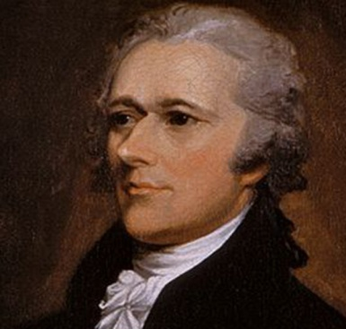
THOUGHTS ON THE INCREASINGLY HARSH RESPONSE TO IMMIGRANTS BECOMING CITIZENS…
“To admit foreigners indiscriminately to the rights of citizens the moment they put foot in our country would be nothing less than to admit the Grecian horse into the citadel of our liberty and sovereignty.”
Alexander Hamilton (1802)

Slide 33
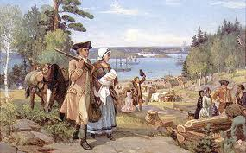
A SLOWING INFLUX…
In the first three decades of the nineteenth century, there was less immigration to the United States. Most of the population increase in the country was by internal increase with the overwhelming percentage of the population being native-born.
Following the Revolution, there had actually been a significant emigration from the United States to Canada.
Many were Loyalists (or citizens who were harassed because believed to be not-sufficiently “patriotic”) who did not want severed ties with Britain.
Britain promised freedom to slaves who fought with British troops. Some 3500 former slaves settled in Nova Scotia.*
Many left and settled in what is now Ontario seeking better farmland

Slide 34
ONE VIEW OF AMERICA….
Americans have demonstrated “an enlightened regard for themselves (that) constantly prompts them to assist each other, and inclines them willingly to sacrifice a portion of their time and property to the welfare of the state.”
Alexis de Tocqueville
Democracy in America (1832)

Slide 35
BUT THEN, A SPIKE IN IMMIGRATION
A number of factors contributed to a major spike in immigration to the United States in the decade 1840 – 1850. They included
Repeated crop failures in Germany
The Irish Potato Famine (1845-1850)
Industrialization
Political unrest in Europe, including the Bourbon Restoration in France
The Mexican War (1848)
The discovery of gold in California (1848)

Slide 36
THE IRISH…
In the first half of the nineteenth century, almost half the population of Ireland lived on farms that struggled to be successful. Potatoes were a staple of their diet, and, in the 1840s, when the potato crop failed three years in a row,
Over 750,000 people starved to death
Over 2,000,000 Irish eventually moved to the United States, with most congregating in the cities where they landed
[As a result of the emigration from Ireland, the country has about half the population it did in the early 1840s, and there are more Irish Americans than Irish nationals].

Slide 37
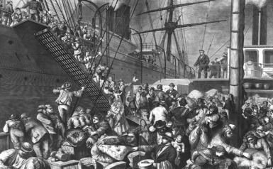
EARLY IRISH ARRIVALS…
Because of the circumstances of their migration, almost all the Irish who came to America were poor. Most settled in the cities at the place of their arrival
Many settled in Boston, a city with a population of roughly 115,000 which, in 1847, saw some 37,000 Irish Catholics arrive by sea and land
During the famine years, about 75% of the Irish who came to America landed in New York City. In 1847, approximately 52,000 Irish arrived in a city whose total population was about 372,000

Slide 38
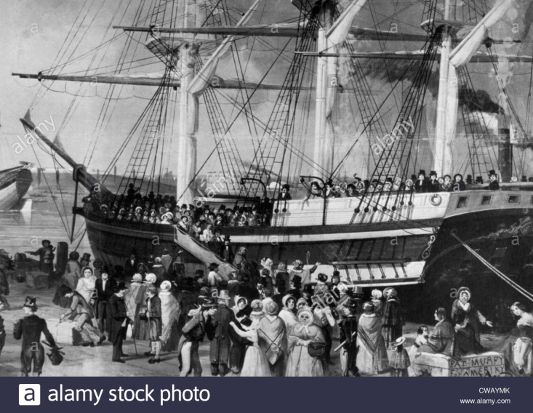
A COMMON PATTERN…
In Boston, New York, Philadelphia and every other city in which the Irish landed, they settled in enclaves that became exclusively Irish. The took any unskilled jobs they could find such as
Cleaning yards and stables
Unloading ships
Pushing carts

Slide 39
IMPACT ON THE CITIES…
In all the cities in which the immigrants settled, they were squeezed into “contained” neighborhoods of housing of any quality.
Unsanitary conditions were breeding grounds for disease, particularly cholera.
Rowdy behavior fueled by alcohol and boredom resulted in a staggering increase in crime
Intense rivalry developed between the Irish and working class natives over the limited number of unskilled jobs
From May 1, 1855
New York Times

Slide 40
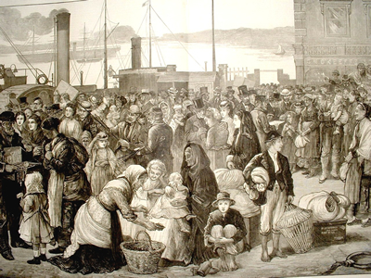
PERCEIVED PROBLEMS (AND STEREOTYPES) EMERGE…
Having huddled in cities, the Irish found that, while they had been known in their homeland for their honesty, law-abiding manner, and chastity, old social norms disintegrated in the new land and, in the American slums,
Both men and women ”behaved wildly”
Prostitution flourished
Drunkenness occurred, even among children

Slide 41
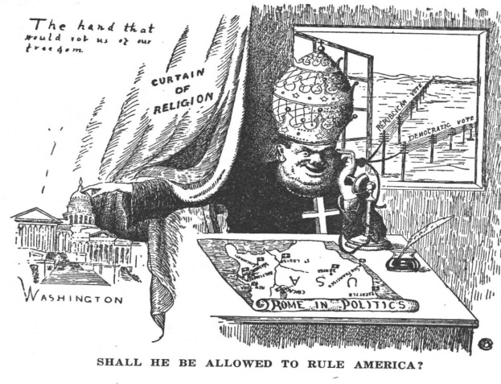
AS DO NEGATIVE FEELINGS
Because the Irish tended to keep to themselves wherever they settled, they were slow to assimilate.
“Established” Americans were slow to accept the Irish as equals
Newspapers published cartoon stereotypes of drunken, brawling Irishmen
The press derided the “aliens,” describing them as mindlessly loyal to Catholic leaders and the Papacy instead of to America

Slide 42
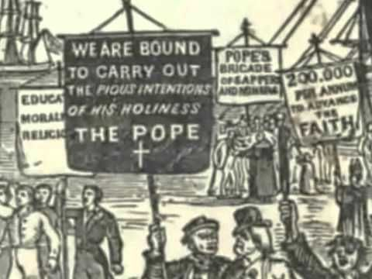
NATIVISTS AND NATIVISM
In the mid-1800s, outbursts of “nativism” occurred in varied parts of the country as immigrants with different religions, languages, and customs entered the nation in increasing numbers.
In the northeast, from the 1830s to the 1850s, there were nativist outbursts in response to a surge of Irish Catholic immigration.
From the 1840s through the 1920s, German Americans were distrusted because of a perceived separatist social structure; German-language schools; attachment to their native tongue over English; and neutrality in World War I.

Slide 43
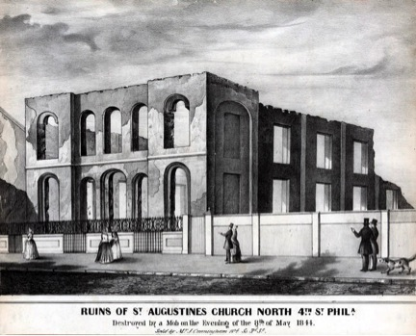
VIOLENCE ERUPTS
Beginning in 1844, anti-Catholic violence spread throughout the country, with outbreaks in, among other locations, Baltimore, St. Louis, New Orleans, Louisville, Boston, and New York.
In Boston, a mob of Protestant workmen burned down a Catholic convent
In Philadelphia, over three days of violence, two Catholic churches were burned down, hundreds of Irish homes were destroyed, and a dozen immigrants killed

Slide 44
THE IMPACT OF EMPLOYMENT ON RELATIONS WITH IMMIGRANTS IN THE EAST
During the anti-alien riots in Philadelphia in 1844-45, the Union of Workers, which eventually became known as the Order of United American Mechanics (OUAM) was founded during a depression at a time many American workers were laid off and poor Germans allegedly took their jobs at lower wages. The Order
Required members to undertake efforts to publicize and campaign against the hiring of cheap foreign labor
Mandated that members patronize only “American” businesses

Slide 45
FROM THE OUAM CONSTITUTION
From the Order of United American Mechanics Constitution preamble
We, the undersigned American born citizens, having for years, and more particularly of late, felt the peculiar disadvantages under which we are placed from foreign competition and foreign combinations, and believing from past experience and present appearances of the future, that instead of the evil abating, there is a strong probability if not certainty of its increasing, therefore we feel ourselves bound to provide for our own protection by forming ourselves into an association to advance such objects and carry out such principles as shall best promote the interest, elevate the character and secure the happiness of the body of American born citizens…..”

Slide 46
THE KNOW NOTHING PARTY
With the splintering and disintegration of the Whig Party over the issue of slavery, the Know Nothings seemed to fill the vacuum, leveraging economic concerns over immigration as a major part of their platform. The Know Nothings displayed three nativist characteristics:
The embrace of nationalism
Religious discrimination (Protestants v. Catholics)
A working-class identity
Christopher Phillips Professor of History University of Cincinnati

Slide 47
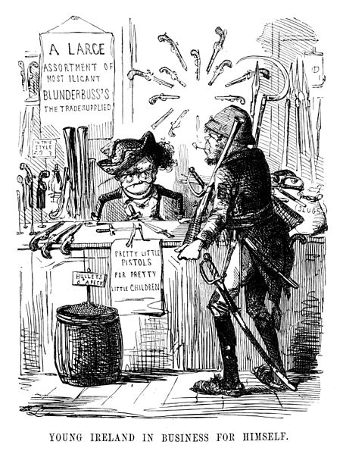
FORMAL ORGANIZATION AND AFFILIATION
In 1849-50, the Order of the Star Spangled Banner was organized by Charles B. Allen in New York City and established, as membership criteria, that a man be
At least twenty-one years of age
A believer in God
A Protestant
Willing to obey the dictates of the order without question
When asked about the secret society, members replied they “know nothing” and became known as Know Nothings

Slide 48
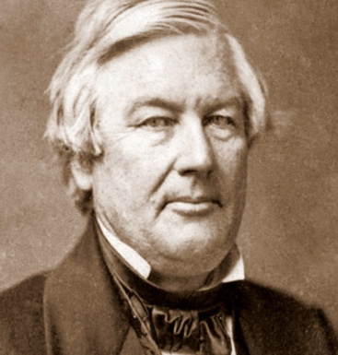
AN OFT-REPEATED THEME
“Americans must rule America”
Millard Fillmore
- President (1850-1853) - American Party Presidential nominee (1856)

Slide 49
THE CIVIL WAR INTERVENES…
At the same time the mid-century influx of immigrants was causing tension in northeastern cities, slavery was dividing the nation on regional lines. Following the 1860 election of Abraham Lincoln,
Over 140,000 Irish enlisted in the Union army during the Civil War
Some 177,000 troops who were born in Germany joined the Union Army
Many Germans could see the parallels between slavery and serfdom in the old fatherland
Roughly 45% of all German Americans who fought for the Union had been born in Europe

Slide 50
CONSCRIPTION ACT OF 1863
On March 3,1863, President Lincoln signed the Conscription Act (Enrollment Act) of 1863 which enabled the military draft to be used on a federal scale for the first time. Already tense racial tensions were exacerbated by the terms of the Act as
The Emancipation Proclamation allowed freed slaves to “volunteer” to fight, but Blacks were not drafted or forced to fight
White men with money could bribe doctors for medical exemptions, legally hire a substitute, or pay for a commutation of a draft
Lower-class workers could not afford to pay for deferments

Slide 51
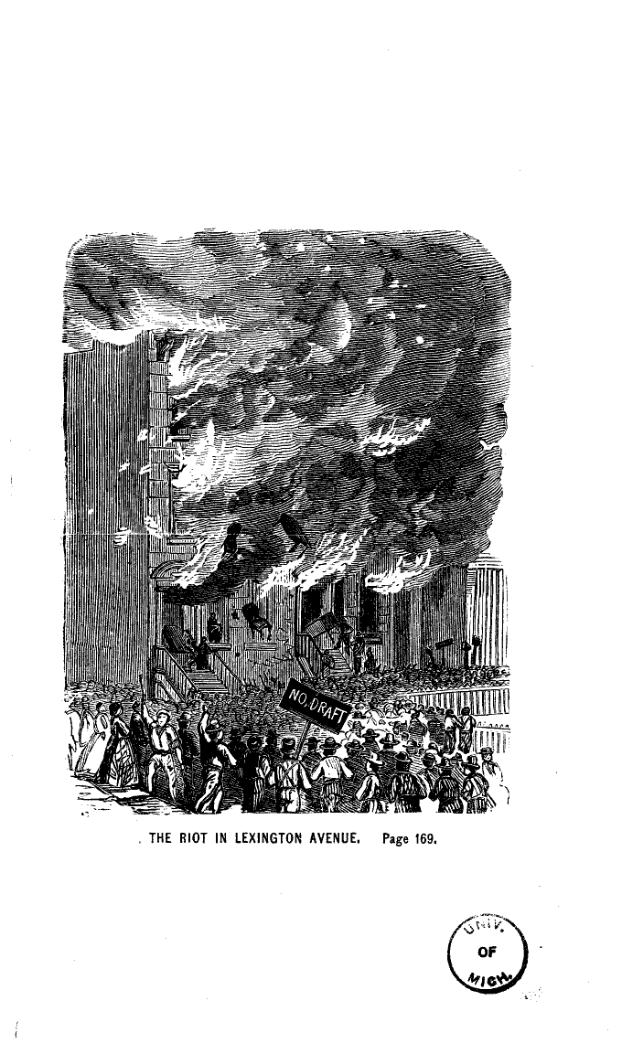
DRAFT RIOTS….
From their earliest arrival, the Irish competed with freed slaves for the most menial jobs and cheapest housing, and the Conscription Act added to the tension.
Several cities suffered draft riots, beginning June 11, 1863 in New York City when an angry mob murdered more than 100 people. The mob
Burned down a draft office
Attacked police officers and well-dressed whites
Focused its attention on killing nearby blacks

Slide 52
THE GERMAN IMMIGRANTS DIFFERED…
German immigrants were more difficult to stereotype that the Irish as they came from different socio-economic and religious backgrounds, including
Roman Catholic
Lutheran
Reformed (Protestant)
Jewish
Anti-clerical or Free-thinkers

Slide 53
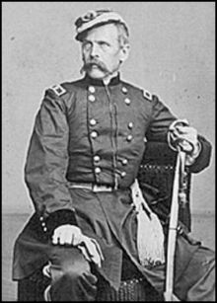
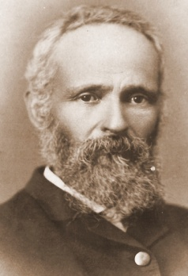
CONTRIBUTIONS TO THE WAR EFFORT
Many German Americans had been involved in the anti-slavery movement in the United States prior to the war.
August Bondi, a German-born Jew, fought with John Brown during the Missouri-Kansas border wars
Louis Blenker, who’d led troops in the German revolution of 1848, organized the 8th New York Volunteer Infantry Regiment when the Civil War began
August Bondi Louis Blenker

Slide 54
ASSIMILATION
Although Germans did face discrimination, they were able to assimilate into mainstream American culture with less difficulty than the Irish. By 1900, Germans and German-Americans made up the largest single foreign group in
Wisconsin
California
Kansas
Missouri
New Jersey
New York

Slide 55
IMPACT OF THE HOMESTEAD ACT OF 1862
In the midst of the Civil War, the Homestead Act of 1862 opened up millions of acres of federal lands to ownership, making available 160 acres of surveyed public lands for a minimal filing fee and after five years of continuous residence on the land, to
Any adult who had never taken up arms against the U.S. government
Women
Immigrants
Blacks (who were explicitly included in the 1866 version of the Act. Although rampant discrimination slowed Black gains, by 1900, one quarter of all Southern Black farmers owned their own farms).

Slide 56
ON THE WEST COAST
The 1848 discovery of gold in California did not just result in mass migration to the western state, but also caused significant overseas immigration, including many Chinese, to get a piece of the “Gold Mountain.”
The mid-19th century found a significant immigration to the United States of Chinese male manual laborers who tended to work in
Agriculture
Mining
Railroad construction
Factory work, especially in the garment industry

Slide 57
AS AN ASIDE, CHINESE LABORERS DON’T APPEAR IN THE PHOTOS OF THE MEETING OF THE TRANCONTINENTAL RAILROAD

Slide 58
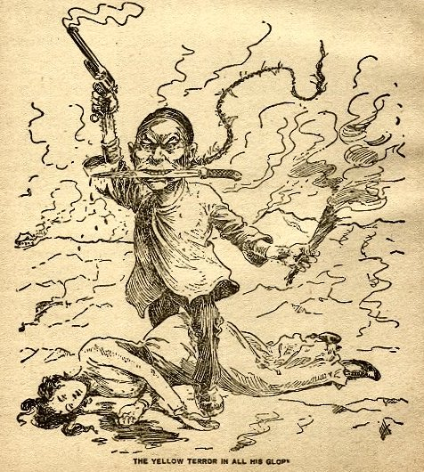
A FAMILIAR PATTERN
Many of the Chinese immigrant laborers found themselves forced to take jobs that paid wages less than other non-immigrants because of
The need to send money back to support families in China
The obligation to repay loans to Chinese merchants who had paid for their passage to America
As the number of immigrants increased, so did anti-Chinese sentiment, spurring economic and cultural tensions

Slide 59
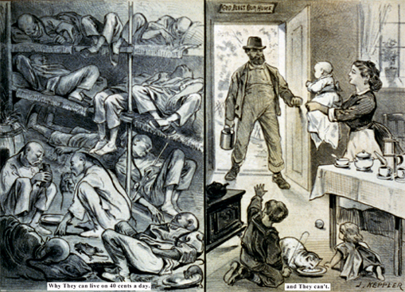
THE STEREOTYPING BEGINS…
As the anti-Chinese tensions began to rise, advocates of limiting Chinese immigration, noting that the Chinese tended to settle in their own neighborhoods or “Chinatowns”
Described the Chinatowns as places where large numbers of men would gather to visit prostitutes, smoke opium, and gamble
Argued that admitting the Chinese to America lowered the cultural and moral standards of the American society

Slide 60
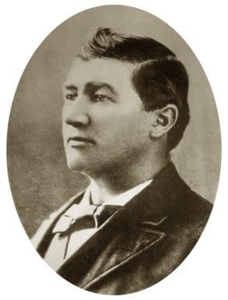
AS THE YEARS PASSED…
As western states began to attract immigrants from varied backgrounds,
Irish Americans targeted violence against Chinese workers, driving them out of smaller towns
Having received a number of migrants from eastern states experiencing depression-led job losses in the 1870s, San Francisco hosted a rally July 23, 1877 rally which was interrupted by a procession which ended in two days of riots directed at Chinatown
An Irish wagon-driver, Denis Kearney, started the Workingmen's Trade and Labor Union of San Francisco, which used the slogan "The Chinamen Must Go!”
Denis Kearney

Slide 61
CHINESE EXCLUSION ACT
Driven largely by growing western resentment of Chinese labor competition, on May 5, 1882, Congress approved the Chinese Exclusion Act which
Suspended Chinese immigration of laborers (skilled and unskilled laborers and Chinese employed in mining) for ten years
Required any Chinese who left the United States to obtain certifications for reentry
Prevented Chinese (and later other Asian) immigrants from becoming naturalized citizens
Prohibited Chinese children born in the United States from becoming citizens*

Slide 62
THE “LAW OF THE SOIL”
The Fourteenth Amendment employs the principle of “jus soli,” the “law of the soil” or the “right of birthplace.”
Any child born in the United States is a citizen of the United States even if the child’s parents are not citizens

Slide 63
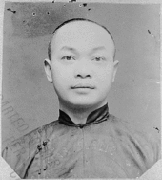
*WHAT ABOUT THE 14TH AMENDMENT?
Children of Chinese born in the United States were excluded from citizenship until the Supreme Court, in United States v. Wong Kim Ark, 169 U.S. 649 (1898) established their rights as citizens.

Slide 64
SPECIFIC PROVISIONS OF THE CHINESE EXCLUSION ACT
The Chinese Exclusion Act sought to impose restrictions on the ability of states to grant rights to Chinese, providing in Sec. 14
“That hereafter no State court or court of the United States shall admit Chinese to citizenship; and all laws in conflict with this act are hereby repealed.”

Slide 65
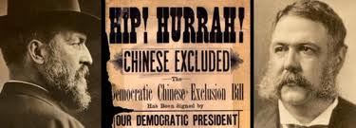
PUBLIC ATTITUDE TOWARDS THE CHINESE EXCLUSION ACT
Supporters of the Exclusion Act felt comfortable embracing their political leaders in celebrating possible legislation as illustrated by this poster including images of President Garfield and Vice President Arthur.
In 1882, by-then-President Arthur vetoed the first Exclusion Act which set a twenty-year suspension of immigration, but signed a second Act which set the term as ten years.

Slide 66
AFTER TEN YEARS…
In 1902, the Chinese Exclusion Act was extended an additional ten years by the Geary Act which was sponsored by and named for Congressman Thomas J. Geary. In addition to extending the terms of the Exclusion Act, the Geary Act
Required that people of Chinese origin carry “certificates of residence” or face 1 year hard labor or deportation
Barred persons of Chinese descent from “bearing witness” in court
Excluded Chinese from receiving bail in habeas corpus proceedings

Slide 67
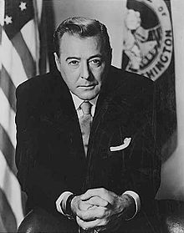
MAGNUSON ACT (1943)
The terms of the Chinese Exclusion Act continued until, during the Second World War when China was allied with the United States in opposing the Axis powers, the Magnuson Act was signed into law on December 17, 1943 in the United States.
It allowed Chinese immigration for the first time since the Chinese Exclusion Act of 1882
It permitted some Chinese immigrants already residing in the country to become naturalized citizens
The Magnuson Act provided for the continuation of the ban against the ownership of property and businesses by ethnic Chinese. The ban continued until the Magnuson Act was repealed in 1965
Warren G. Magnuson

Slide 68
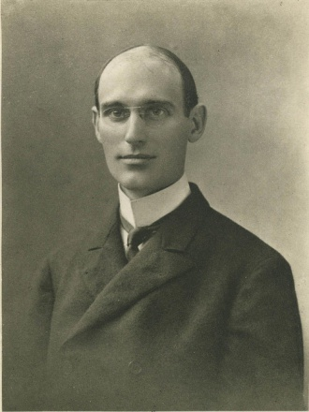
IMMIGRATION RESTRICTION LEAGUE
As a result of increased suspicion by “old immigrants” of English, Irish, and German stock of the “new immigrants” from Italy and Eastern Europe and the belief these recently arrived “undesirables” were inherently unable to participate in self-government or to adopt American values, in 1894, the Immigration Restriction League was founded by three Harvard College graduates. Advocating literacy tests as a means to limit immigration, the league eventually spread from Boston to
New York
Chicago
San Francisco Prescott F. Hall

Slide 69
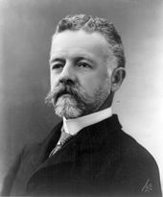
CAMPAIGN FOR IMMIGRANT RESTRICTION
Throughout the 1890s, nativists and labor unions campaigned for immigrant restriction, urging literacy tests as a tool to exclude workers. Among the advocates for such tests was Sen. Henry Cabot Lodge who argued
“It is found, in the first place, that the illiteracy test will bear most heavily on the Italians, Russians, Poles, Hungarians, Greeks, and Asiatics, and lightly or not at all, upon English-speaking emigrants, or Germans, Scandinavians and French. In other words, the races most affected by the illiteracy tests are those…who are most alien to the great body of the people of the United States.”

Slide 70
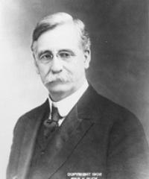
DILLINGHAM COMMISSION
In 1907, the U.S. Immigration Commission – known for its Chairman, Vermont Senator William P. Dillingham – was formed and
In May 1907, went to European countries that had sent immigrants to the United States
Interviewed 108 former immigrants who had returned to their home countries
Amassed and organized statistics within the United States published a forty-one volume report that help lead to the Emergency Immigration Act of 1921 and the Immigration Act of 1924
Senator William P. Dillingham

Slide 71
“OLD IMMIGRANTS VS. NEW IMMIGRANTS”
In 1911, the Dillingham Commission produced a report that highlighted the differences between “Old Immigrants” vs. “New Immigrants” and identified “differences” on the nation’s welfare caused by the immigrants in ways that were
Social and cultural
Physical
Economic
Moral
The argument of Old Immigrants vs. New Immigrants concluded that immigration from southern and eastern Europe posed a serious threat to American society and should therefore be greatly reduced.

Slide 72
IMMIGRATION ACT OF 1917
In what was the first Congressional effort to restrict instead of regulate immigration, the Immigration Act of 1917, in many ways a response to national security concerns raised during World War I
Implemented a literacy test
Increased the tax paid by new immigrants on arrival
Gave greater discretion to immigration officials in deciding what peoples to exclude
Excluded anyone born in a geographically defined “Asiatic Barred Zone” except for Japanese and Filipinos

Slide 73
ASIATIC BARRED ZONE

Slide 74
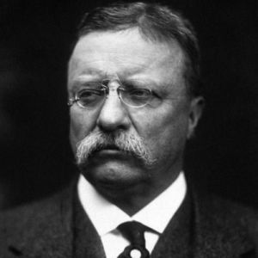
TOLERANCE OF OTHER LANGUAGES…?
‘We have room for but one language in this country, and that is the English language, for we intend to see that the crucible turns our people out as Americans, of American nationality, and not as dwellers in a polyglot boarding house.’
- Theodore Roosevelt (1919)

Slide 75
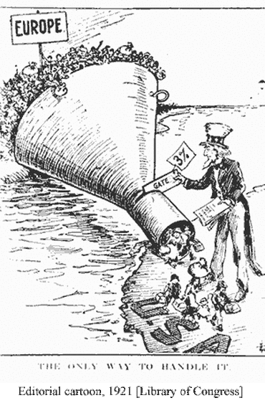
EMERGENCY QUOTA ACT
In the years immediately following World War I, efforts to direct immigration focused on Catholics, Jews, and south-eastern Europeans.
Followers of the eugenics movement and inspired by books such as The Passing of the Great Race by Madison Grant, many Americans accepted the belief the American racial stock was being diluted by the influx of new immigrants from the Mediterranean, the Balkans, and the Polish ghettos.
The Emergency Quota Act of 1921 capped the inflow of immigrants from outside the Western Hemisphere at 357,803.

Slide 76
THE DESIRED IMPACT…?
Fear of low-skilled immigrants flooding the labor market was a significant issue in the early 1920’s – the primary focus was on immigrants from Italy and Poland.
The Emergency Quota Act established, for the first time,
Numerical limits on immigration
The use of a quota system for establishing those limits.

Slide 77
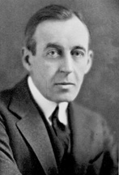
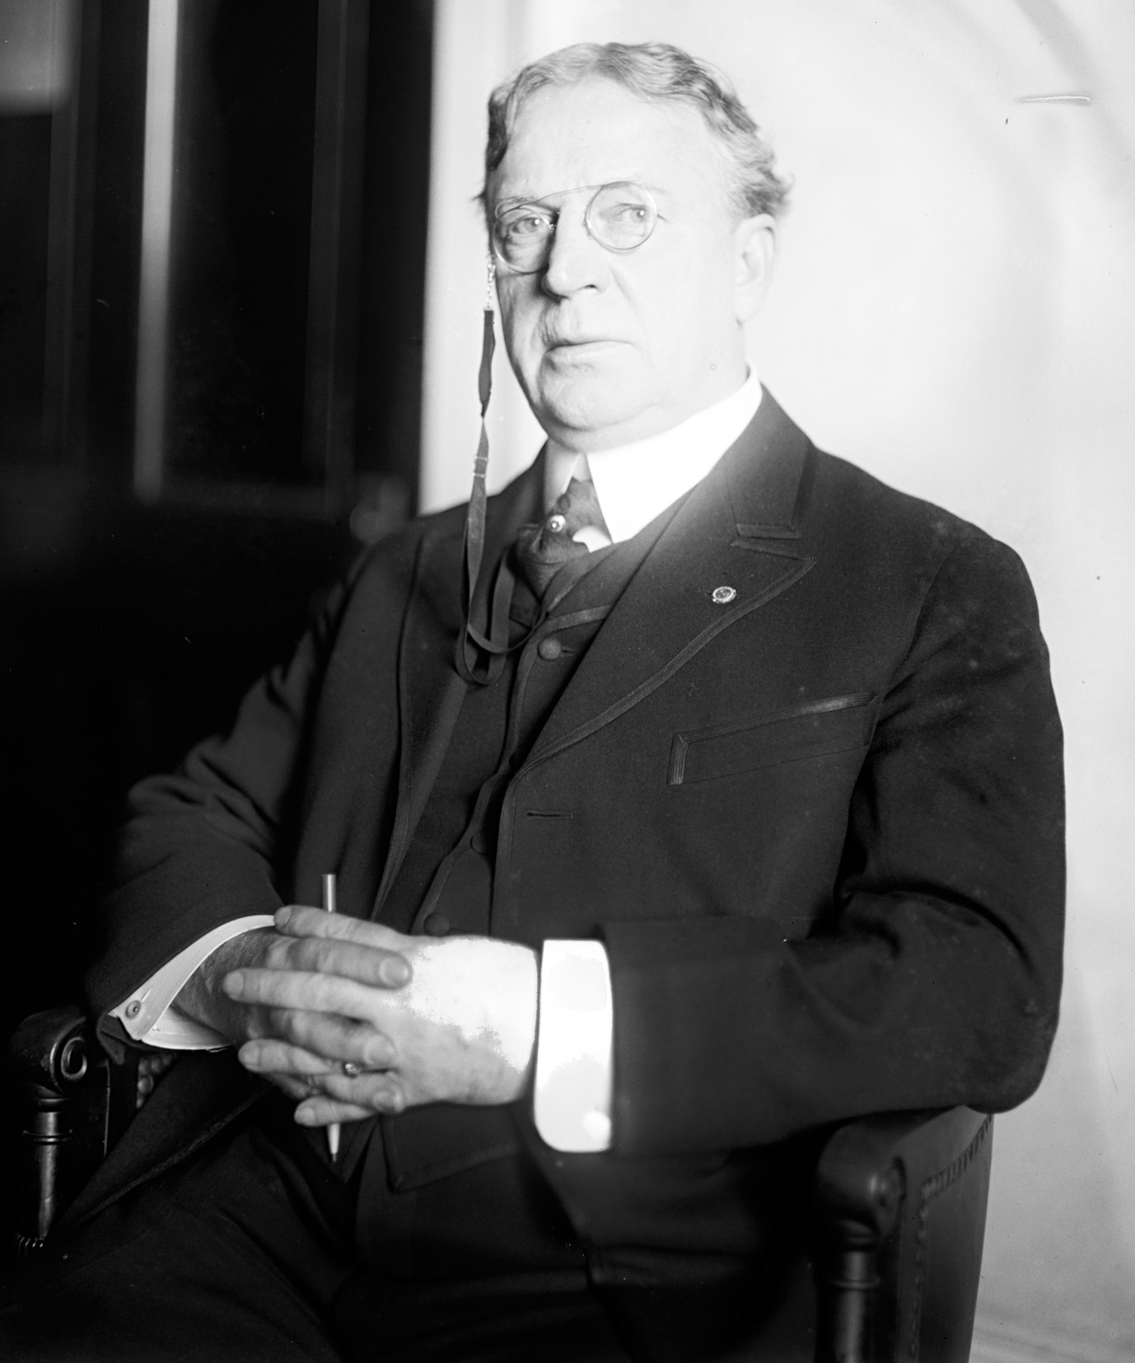
THE IMMIGRATION ACT OF 1924 (THE JOHNSON-REED ACT)
The Immigration Act of 1924 (Johnson Reed Act) provided
That quota calculations to determine the visas to be issued to potential immigrants would be based on lineage of the whole U.S. population in 1890
That no alien ineligible to become a citizen could be admitted to the United States as an immigrant.
Rep. Albert Johnson Sen. David Reed

Slide 78
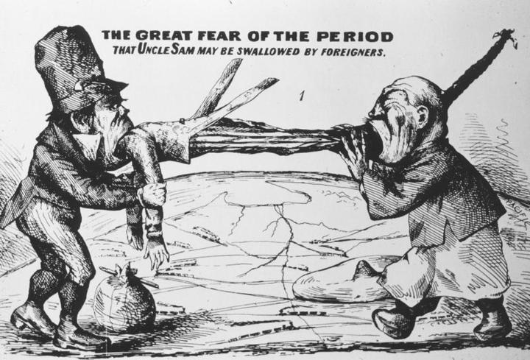
THE IMPACT OF THE ACT…
As a result of the Immigration Act of 1924,
The percentage of visas available to individuals from the British Isles and Western Europe increased
Newer immigration from other areas like Southern and Eastern Europe was limited
Asians not previously prevented from immigrating – mainly Japanese – would no longer be admitted

Slide 79
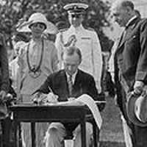
THE ATTITUDE OF THE PRESIDENT….
“America must remain American.”
President Calvin Coolidge signing the Immigration Act of 1924

Slide 80
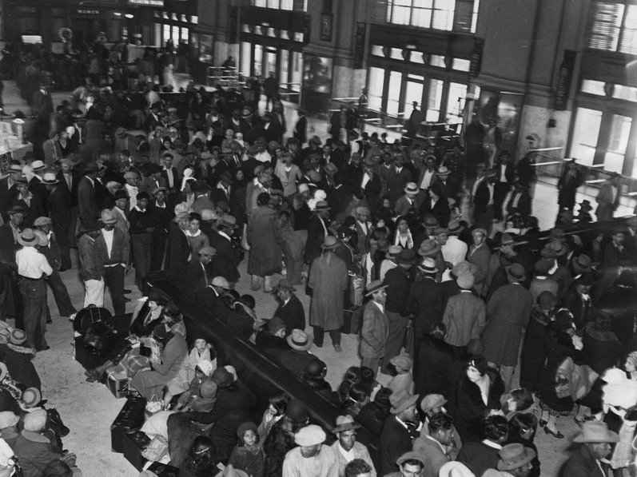
MEXICAN REPATRIATION
During the economic downturn surrounding the Great Depression, there was significant pressure to address job competition and the cost of public assistance for indigents.
Groups such as the American Federation of Labor argued that deporting Mexicans would free up jobs for American citizens
The federal government imposed restrictions for immigrant labor, requiring firms that supply the government with goods and services refrain from hiring immigrants
Families in Los Angeles wait to board trains to Mexico
March 8, 1932

Slide 81
AREA OF DISAGREEMENT
There is considerable disagreement as to how many Mexican citizens were deported or repatriated as a result of governmental action by order of the Hoover Administration.
Author Francisco Balderrama estimates that about 60% of the million or so Mexicans he asserts were involuntarily repatriated were actually American citizens
Michael T. Schaeffer, Archivist at the Hoover Presidential Library asserts “President Hoover never issued a statement, executive order or proclamation ordering the deportation of all illegal immigrants."

Slide 82
IMMIGRATION AND NATURALIZATION ACT OF 1952 (McCARRAN - WALTER ACT)
The Immigration and Naturalization Act of 1952
Upheld the national origins quota system established by the Immigration Act of 1924
Ended Asian exclusion from immigrating to the United States
Introduced a system of preference based on skill sets and family reunification
Eliminated laws preventing Asians from becoming naturalized citizens

Slide 83
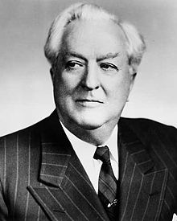
FROM ONE OF THE BILL’S AUTHORS…
“I believe that this nation is the last hope of Western civilization and if this oasis of the world shall be overrun, perverted, contaminated or destroyed, then the last flickering light of humanity will be extinguished.
Today, as never before, untold millions are storming our gates for admission and those gates are cracking under the strain. The solutions of the problems of Europe and Asia will not come through a transplanting of those problems en masse to the United States.”
Senator Pat McCarran
March 2, 1953

Slide 84
AN EFFORT TO ADDRESS MEXICAN IMMIGRATION
In May 1954, the United States responded to a request from the Mexican government to slow the illegal entry of Mexican nationals into the United States.
The program had the unfortunate name Operation Wetback and was primarily a response to pressure from a broad coalition of farmers and business interests concerned with the effects of Mexican immigrants living in the United States without legal permission.
One consequence of the program was that a number of American citizens of Mexican origin were deported without the opportunity to prove their American citizenship.

Slide 85
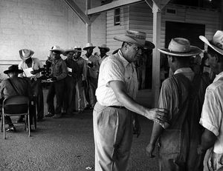
THE SOURCE OF THE PROBLEM…
In the early 1940’s, easing restrictions on importation of men from Mexico to assist with farm labor was seen as being of benefit to both the United States and Mexico
Growers argued that labor shortages resulting from World War II required the recruitment of Mexican nationals.
Mexico saw the program as a contribution to the war effort.
Mexican peasants, desperate for cash work, were willing to take jobs at wages scorned by most Americans.

Slide 86
BRACERO PROGRAM
Growing out of this World War II concern by growers of agricultural products, the Bracero Program resulted from a series of bilateral agreements between the American and Mexican governments and promised
Contracted immigrant workers payment of at least the prevailing area wage received by native workers
Employment for three-fourths of the contract period
Adequate, sanitary and free housing
Decent meals at reasonable prices
Occupational insurance at employer’s expense
Free transportation back to Mexico at the end of the contract

Slide 87
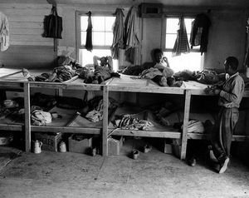
PROMISES WERE NOT ALWAYS KEPT…
Despite the “guarantees” of the agreements, many laborers lived in sub-standard conditions. From the Smithsonian Collection:
"This is housing provided by a Texan farmer for 200 braceros in this long building, with the beds made out of stretched canvas, upper and lower. Such close living conditions make for high incidences of respiratory illnesses among the braceros."

Slide 88
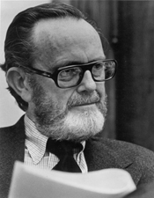
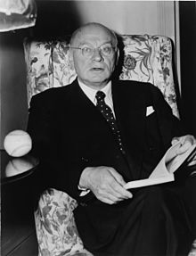
IMMIGRATION AND NATURALIZATION ACT OF 1965
The Immigration and Naturalization Act of 1965 (Hart-Celler Act)
Was influenced greatly by the Civil Rights movement’s focus on equal treatment regardless of race or nationality
Established a new immigration policy based on reuniting immigrant families and attracting skilled labor to the United States
Resulted in a demographic change in immigrants to the United States. In the 1950s, more than half of all immigrants were Europeans, whereas by the 1990s, only 16% were Europeans.
Sen. Phillip Hart Rep.Emanuel Celler

Slide 89
CHANGES IN THE FACE OF AMERICA
Between 1965 and 2000, the greatest number of immigrants came to the United States from
Mexico (4.3 million)
The Philippines (1.4 million)
In that same period, between 700,000 and 800,000 immigrants entered the United States came from
Korea
The Dominican Republic
India
Cuba
Vietnam

Slide 90
ILLEGAL IMMIGRATION
Land routes through Canada and Mexico were the means by which a number of illegal immigrants entered the United States in the 1980s and 1990s.
The Immigration and Reform Act of 1986 attempted to address concerns by
Providing better enforcement of immigration policies
Creating more possibilities to seek legal immigration
Including two amnesty programs for unauthorized aliens
Collectively granting amnesty to more than 3,000,000 aliens

Slide 91
APPROACHING IMMIGRATION FROM A DIFFERENT PERSPECTIVE
Through the Illegal Immigration Reform and Immigrant Responsibility Act (IIRIRA) of 1996, Congress sought to
Strengthen and streamline U.S. immigration law
Incorporating employment eligibility guidelines, including sanctions for employers who fail to comply with regulations and restrictions on unfair immigration-related practices
Establishing provisions governing the disbursement of government aid to aliens

Slide 92
THE IIRIRA SPECIFICALLY ADDRESSED…
The general intent of the IIRIRA is to increase penalties for being in the United States illegally. The act increased penalties for certain activities related to assisting illegal immigrants, including
Creating false identity documents
Smuggling
Imposing on employers a responsibility to confirm U.S. employment eligibility of any new hire

Slide 93
AS ISSUES OF POLITICS HAVE ENTERED THE DISCUSSION…
Recent discussions relating to immigration have taken on a political tone as questions have arisen regarding
The impact of what were referred to as “anchor babies” on efforts of immigrant parents to gain priority for admittance to or ability to remain in the United States
Calls for the building of a wall to impede illegal immigration into the country
Presidential candidate Jeb Bush attempts to explain “anchor babies” reference in Aug August 2015

Slide 94
THE “LAW OF THE SOIL” – PART II
The Fourteenth Amendment employs the principle of “jus soli,” the “law of the soil” or the “right of birthplace.”
Any child born in the United States is a citizen of the United States even if the child’s parents are not citizens

Slide 95
BUT WAS THAT THE FINAL RESOLUTION?...
"I don't think they have American citizenship and if you speak to some very, very good lawyers -- and I know some will disagree, but many of them agree with me -- and you're going to find they do not have American citizenship…“
Donald Trump on children of illegal immigrants –August 18, 2015

Slide 96
SUPPORT FOR BUILDING A WALL…
Support for building a wall to challenge those illegally entering the country across its southern border at times comes from those in unique positions of knowledge:
Chief Patrol Agent Manuel Padilla Jr., who oversees the Rio Grande sector for Border Patrol, believes a wall is 'critical' to securing the border
Area of Mexico Padilla's agents face across the Rio Grande is designated by State Department as so dangerous no American should go there
Sector has highest number of apprehensions of “illegals” and biggest haul of drugs made by agents

Slide 97
ONE JUSTIFICATION FOR THE WALL
Padilla says a 'physical barrier' is vital to stopping the flow of people and narcotics ….
Manuel Padilla, Jr.
Rio Grande Valley Patrol Border Sector Chief

Slide 98
AS THE ISSUE HAS BECOME POLITICIZED…

Slide 99
IN SOUTH CAROLINA…
Nearly 5 percent of South Carolina residents are immigrants, while almost 4 percent are native-born U.S. citizens with at least one immigrant parent.
In 2015, 232,749 immigrants (foreign-born individuals) comprised 4.8 percent of the population.
South Carolina was home to 105,708 women, 110,484 men, and 16,557 children who were immigrants.
The top countries of origin for immigrants were Mexico (28.2 percent of immigrants), India (5.7 percent), Philippines (4.5 percent), China (4.5 percent), and Germany (4.1 percent).
In 2016, 188,884 people in South Carolina (3.9 percent of the state’s population) were native-born Americans who had at least one immigrant parent.
https://www.americanimmigrationcouncil.org/research/immigrants-in-south-carolina

Slide 100
ONE LAST THOUGHT…
“[Immigrants are] not the refuse, but the sinew and bone of all the nations.”
Mary Antin
The Promised Land

Slide 101
Lindsey D. Draper
lindrap@prodigy.net
414-462-8956

