Slide 1
How Have the Values & Principles Embodied in the Constitution Shaped American Institutions & Practices?

Slide 2
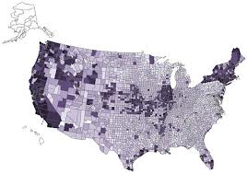
United States GovernmentS
1 national
50 state
89,004 local
http://www2.census.gov/govs/cog/2012/formatted_prelim_counts_23jul2012_2.pdf

Slide 3
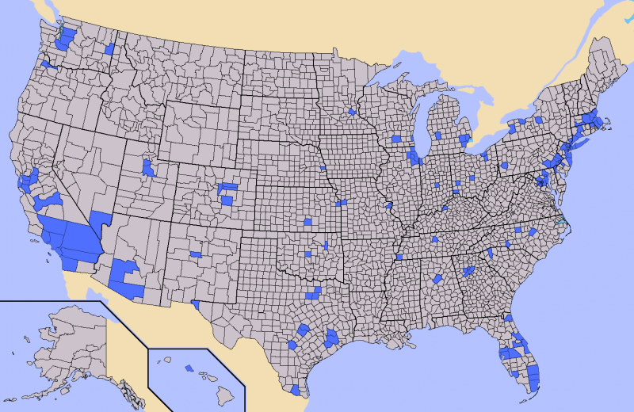

Slide 4
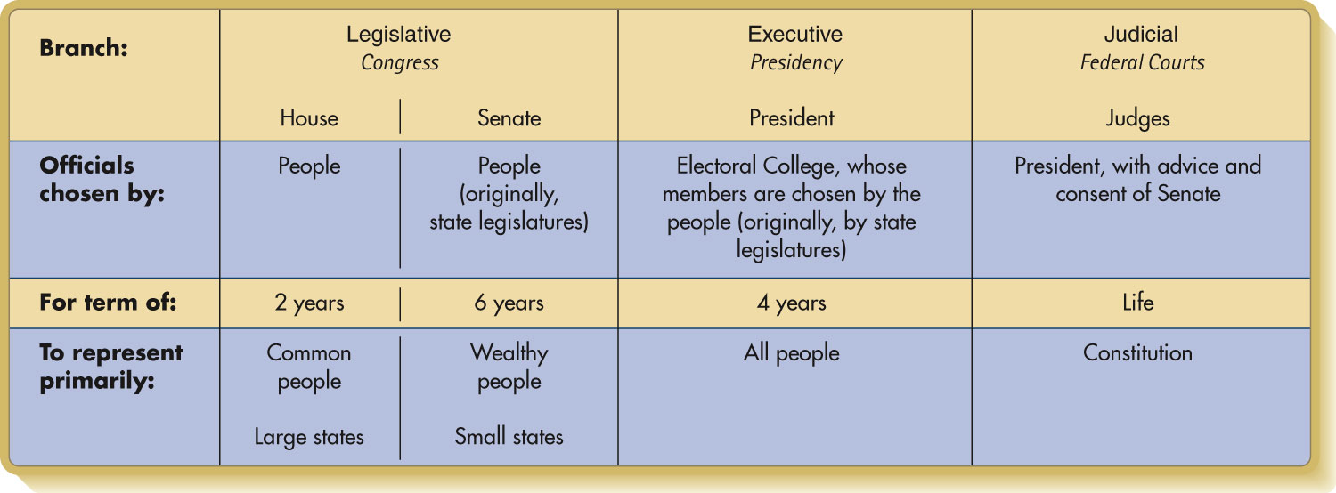
Separation of Powers

Slide 5
A rEPUBLICAN FORM OF GOVERNMENT
“Well, Doctor, what have we got—a Republic or a Monarchy?” “A Republic, if you can keep it.”—Benjamin Franklin, n.d.

Slide 6
Representational Roles
Delegate
Trustee
Politico
Demographics
Approval Ratings

Slide 7
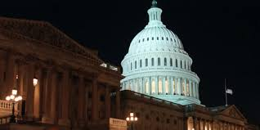

Slide 8
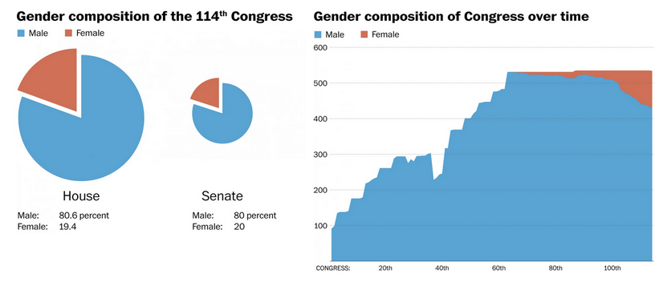

Slide 9
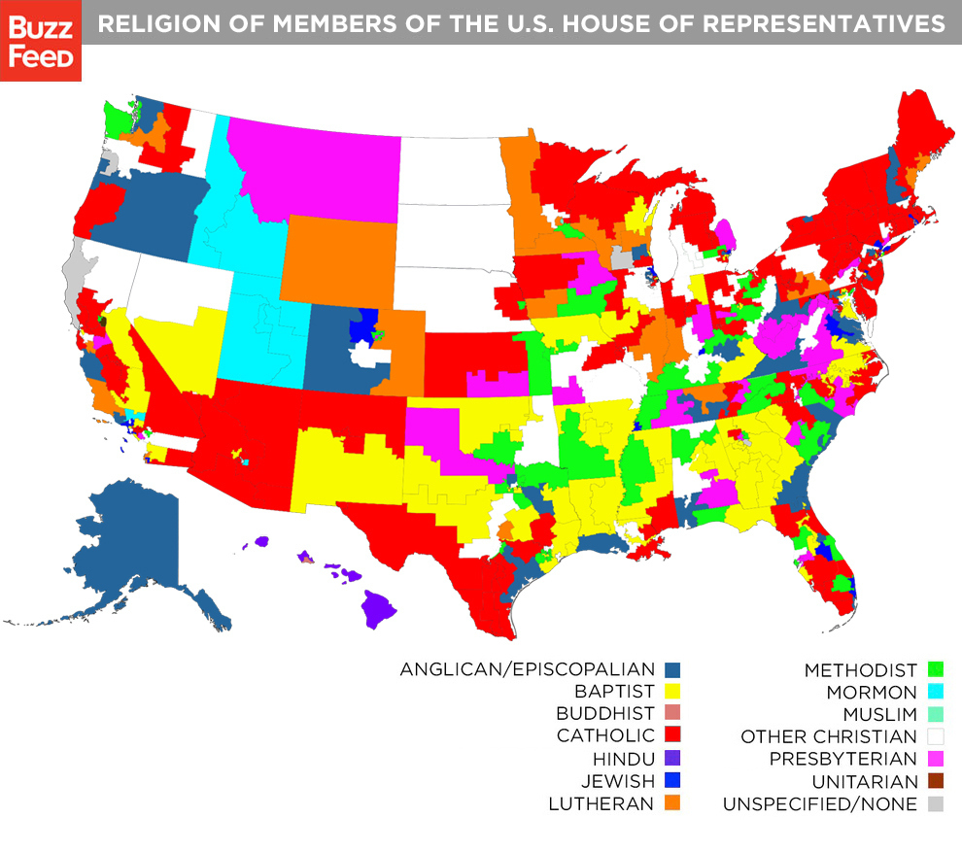
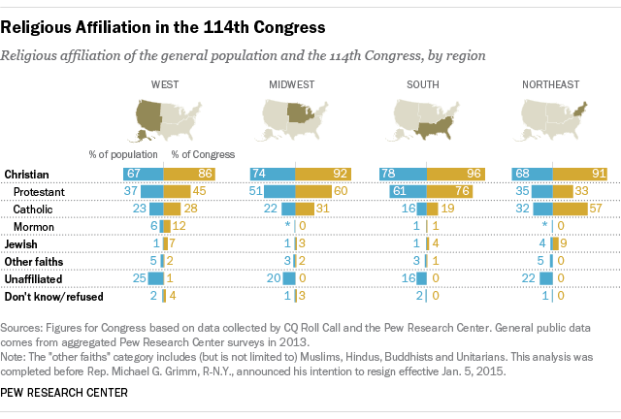

Slide 10
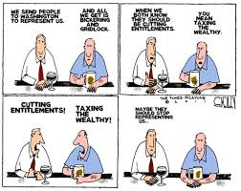
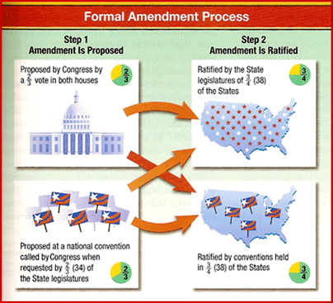

Slide 11
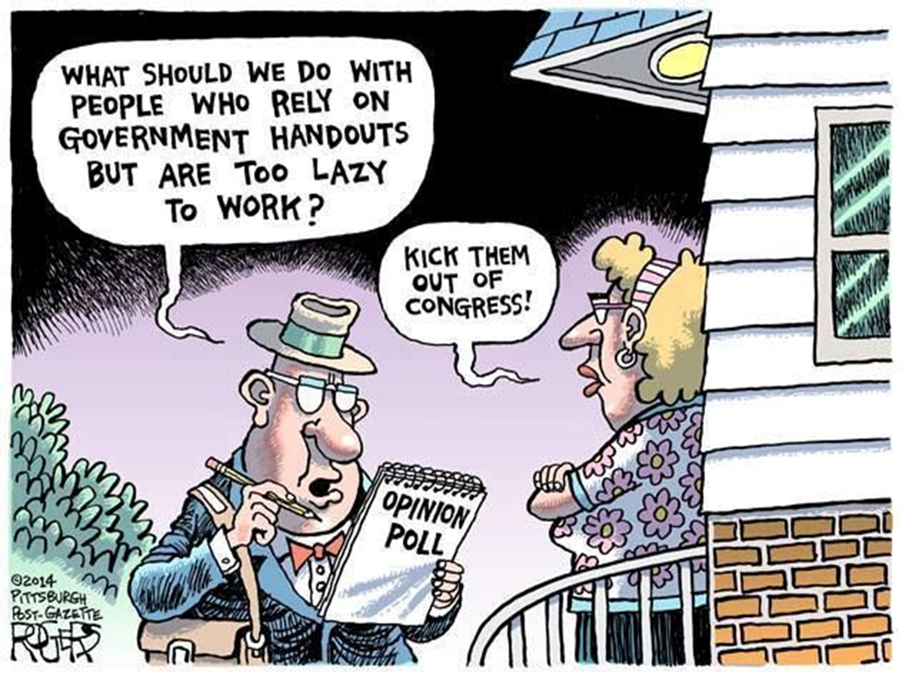

Slide 12
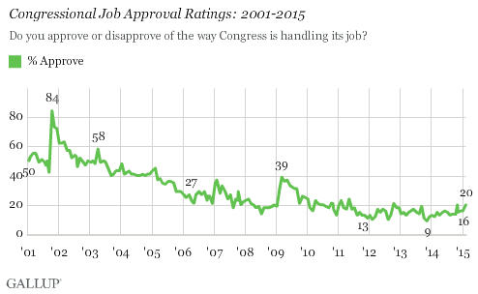

Slide 13
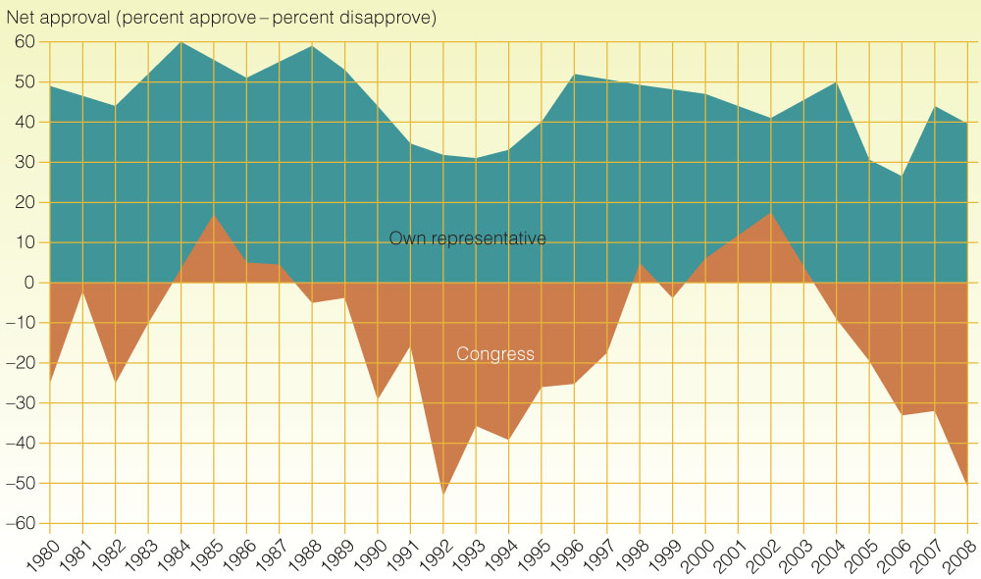
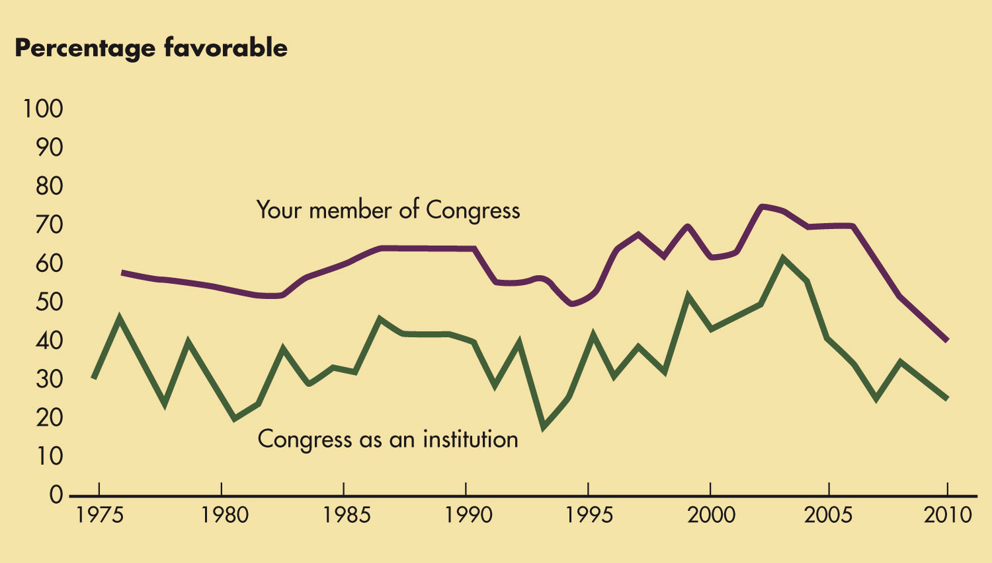

Slide 14
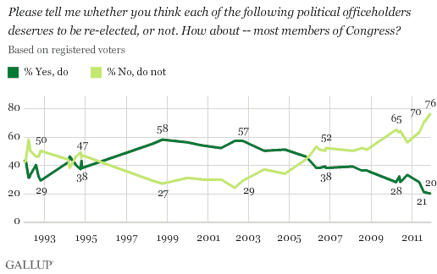

Slide 15
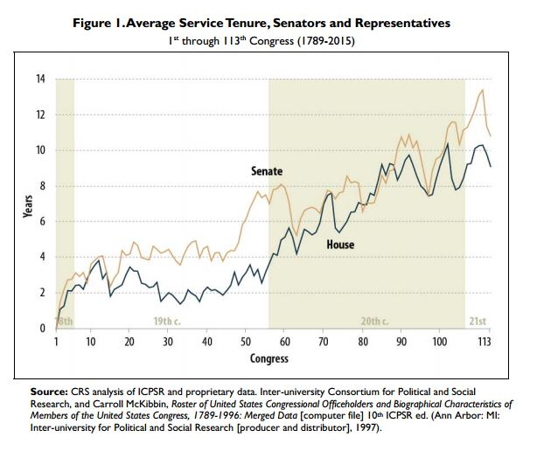

Slide 16
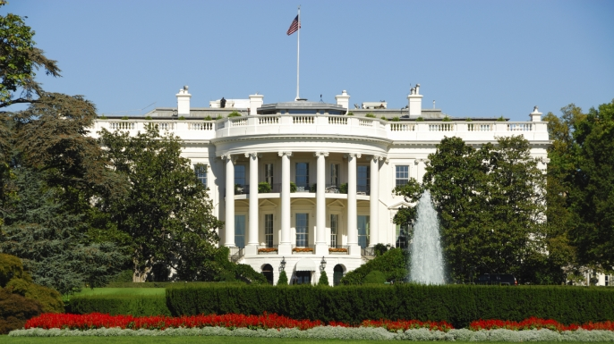

Slide 17
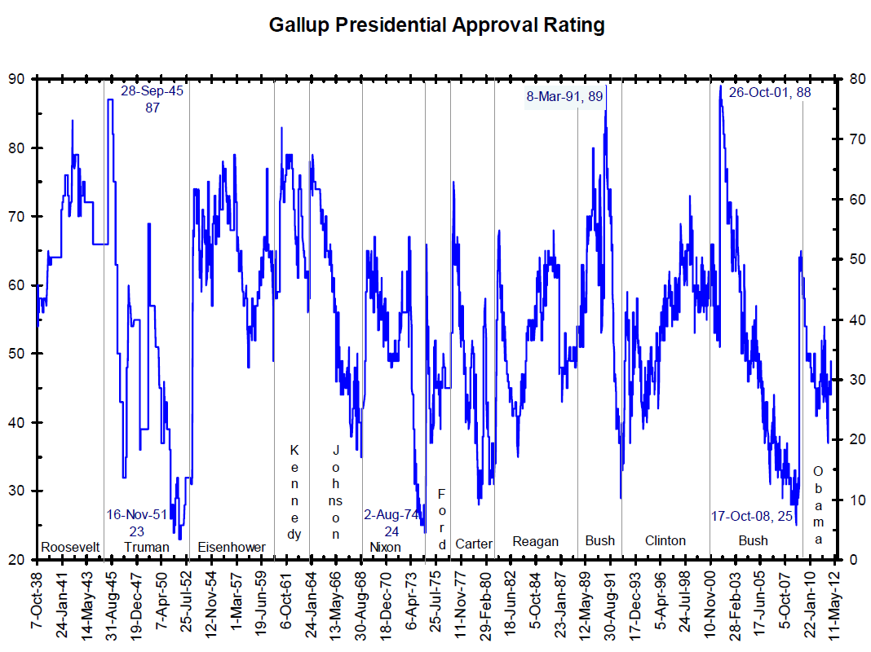

Slide 18
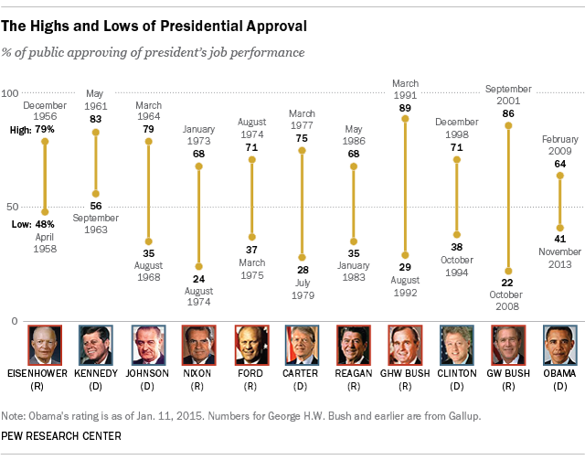

Slide 19
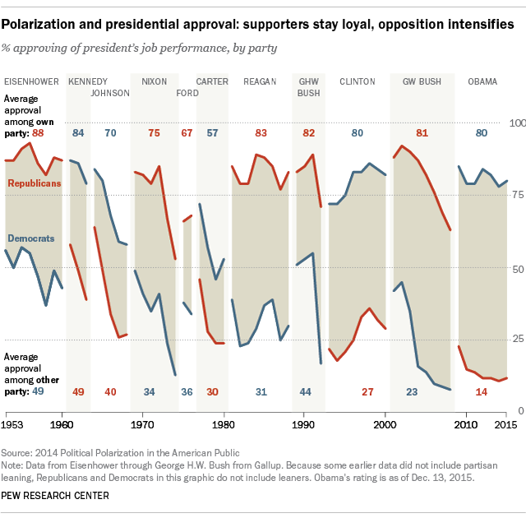

Slide 21
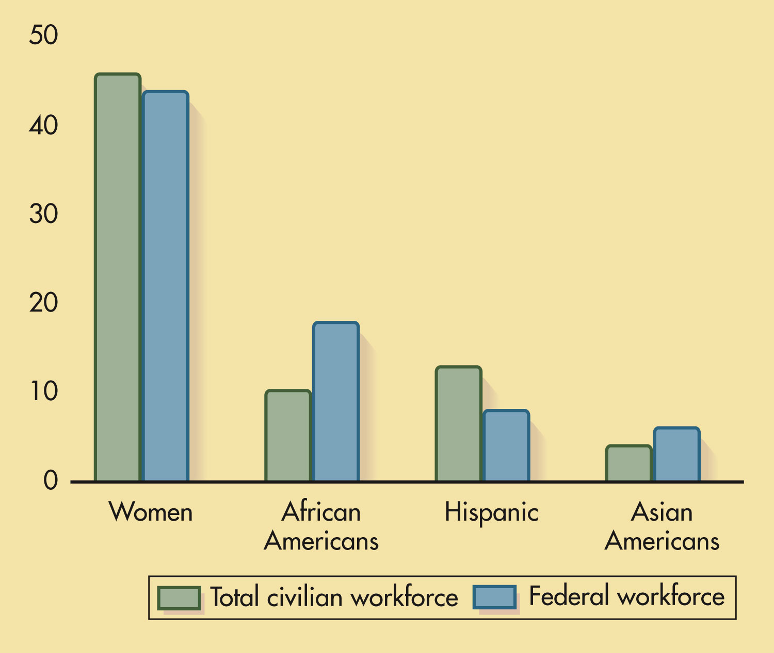
p. 376
Notes:
African Americans Are Overrepresented and Hispanics Underrepresented in the Federal Workforce Compared to the Overall Civilian Workforce

Slide 22
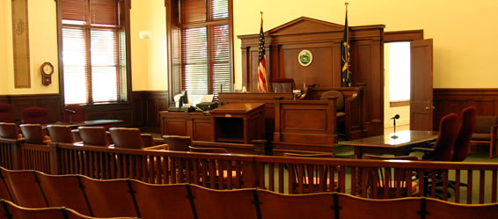

Slide 23
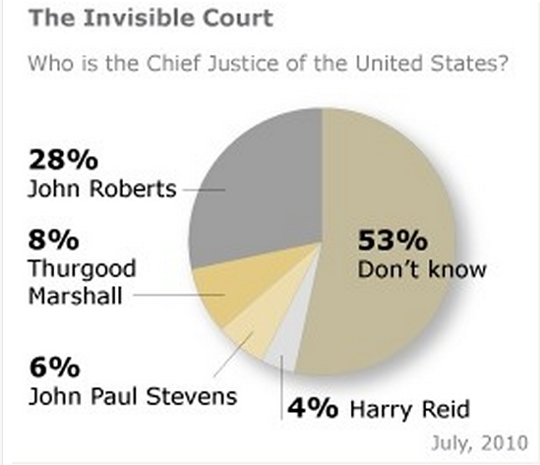

Slide 24
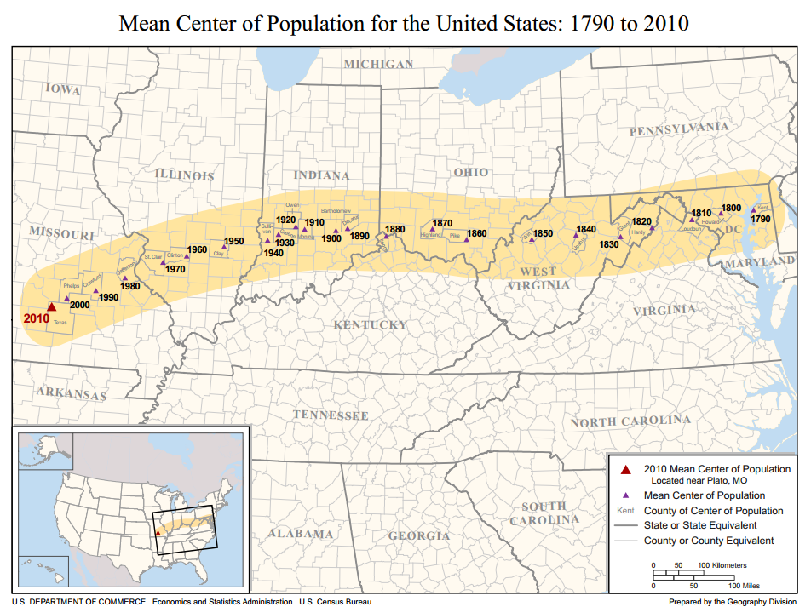

Slide 25
States as “Laboratories of Democracy”

Slide 26
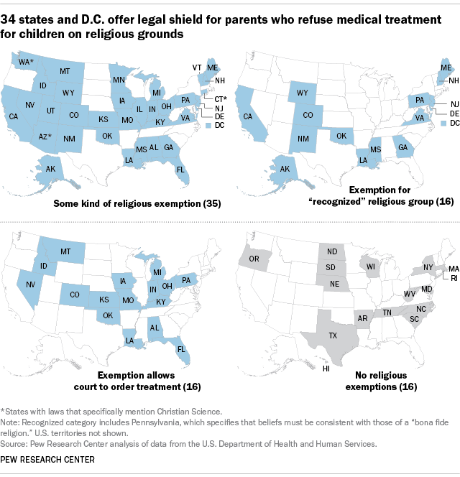

Slide 27
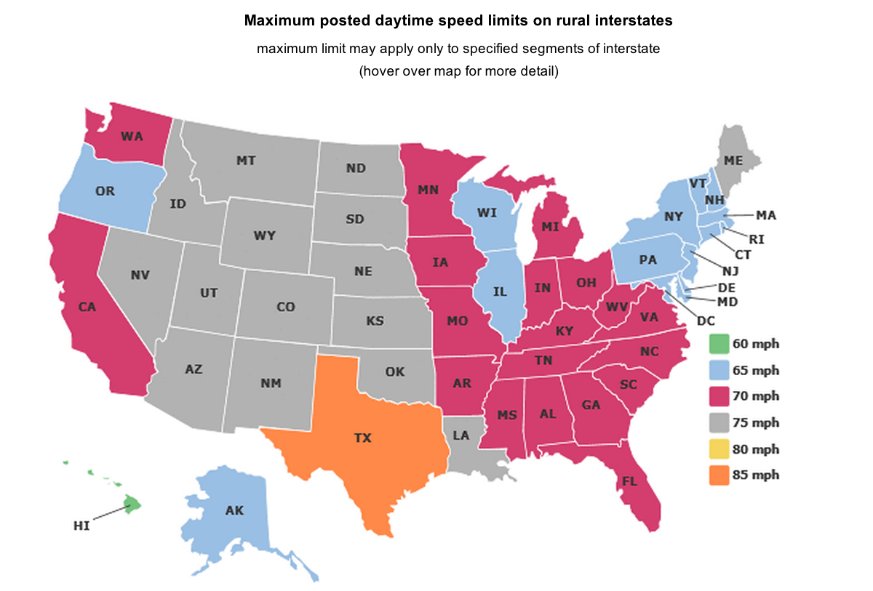

Slide 28
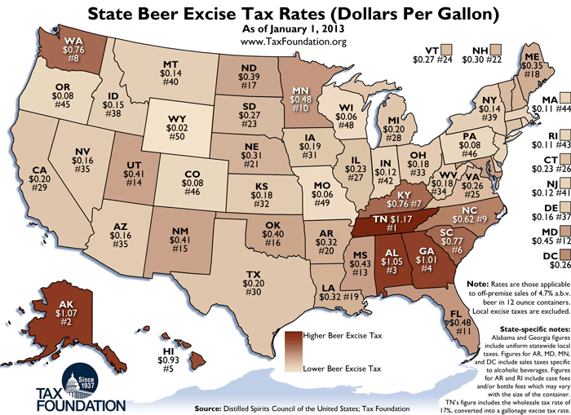

Slide 29
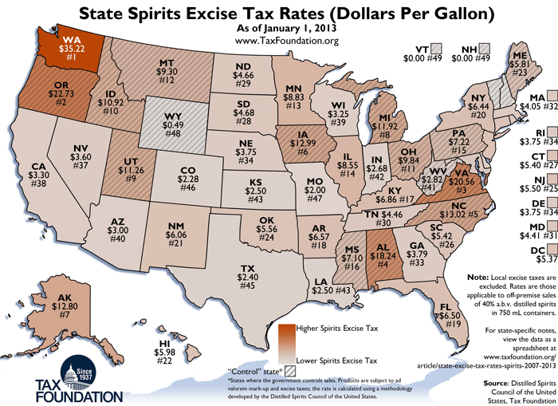

Slide 30
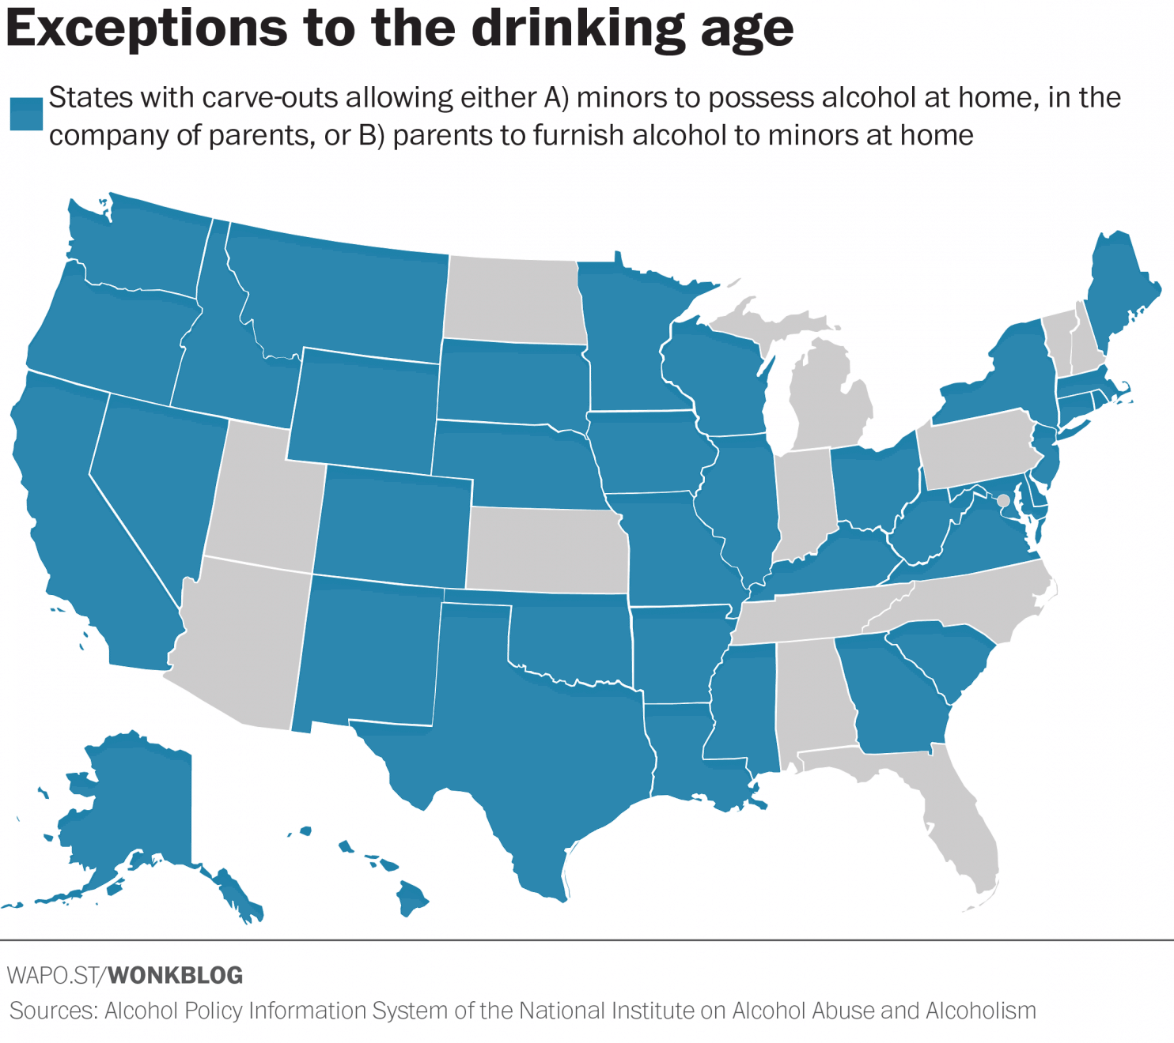

Slide 31
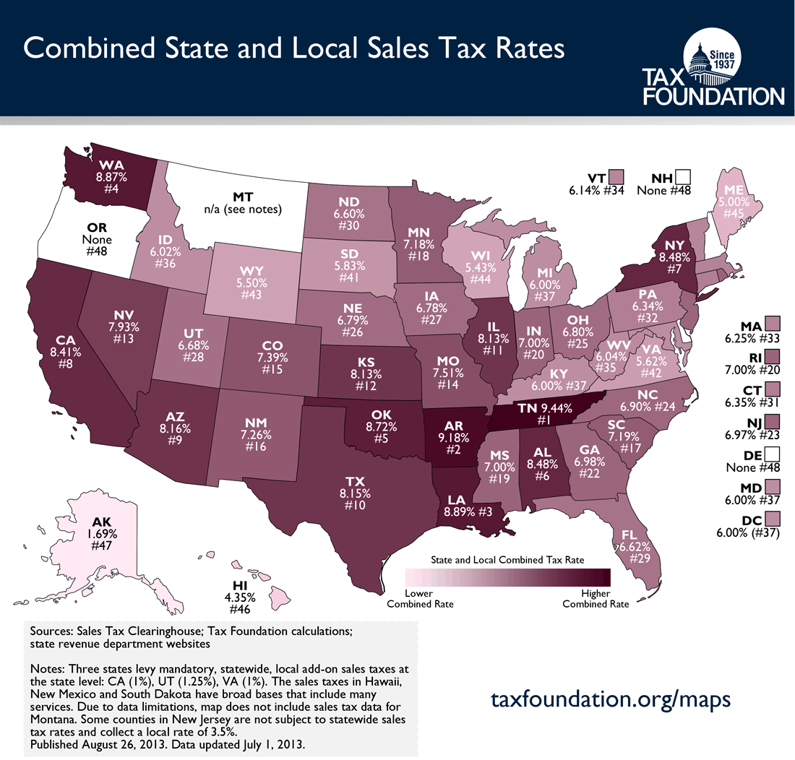

Slide 32
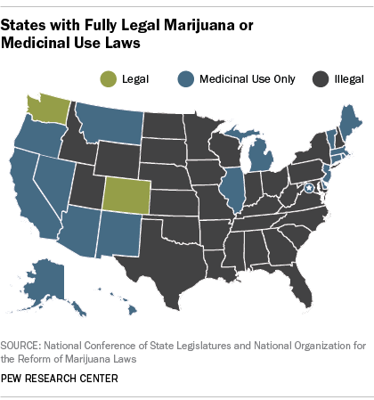
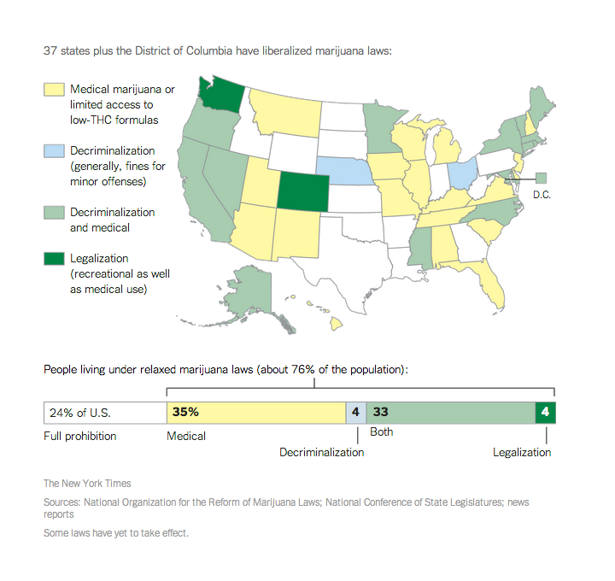

Slide 33
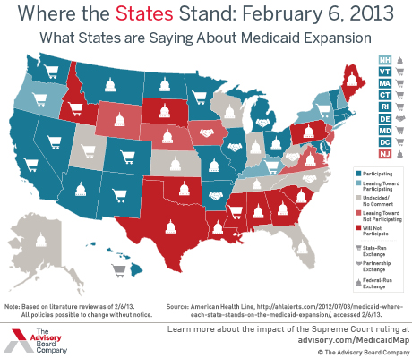
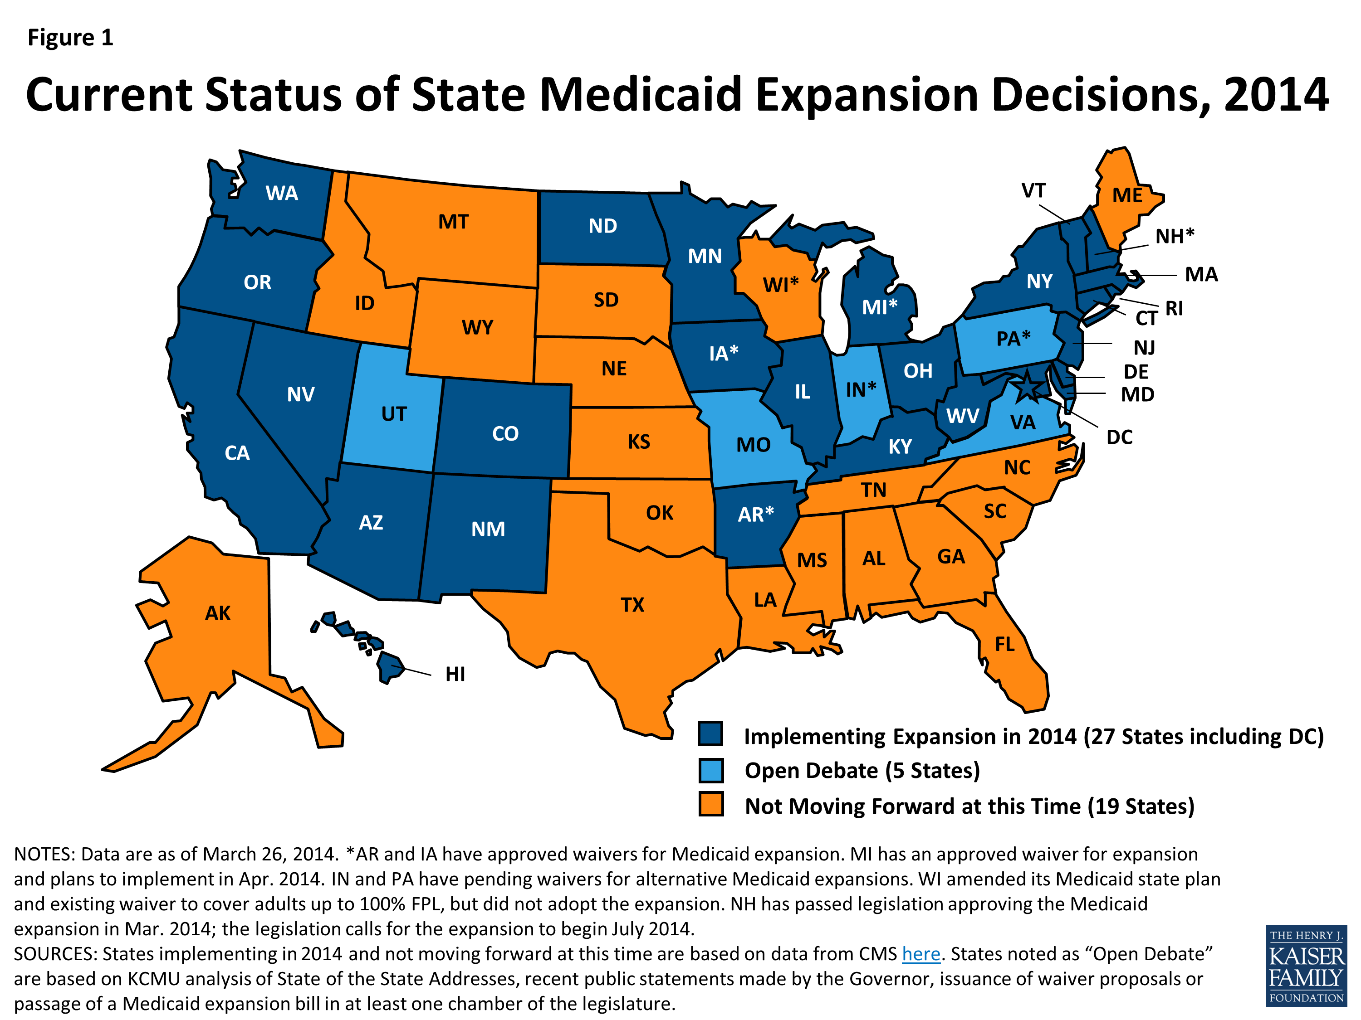
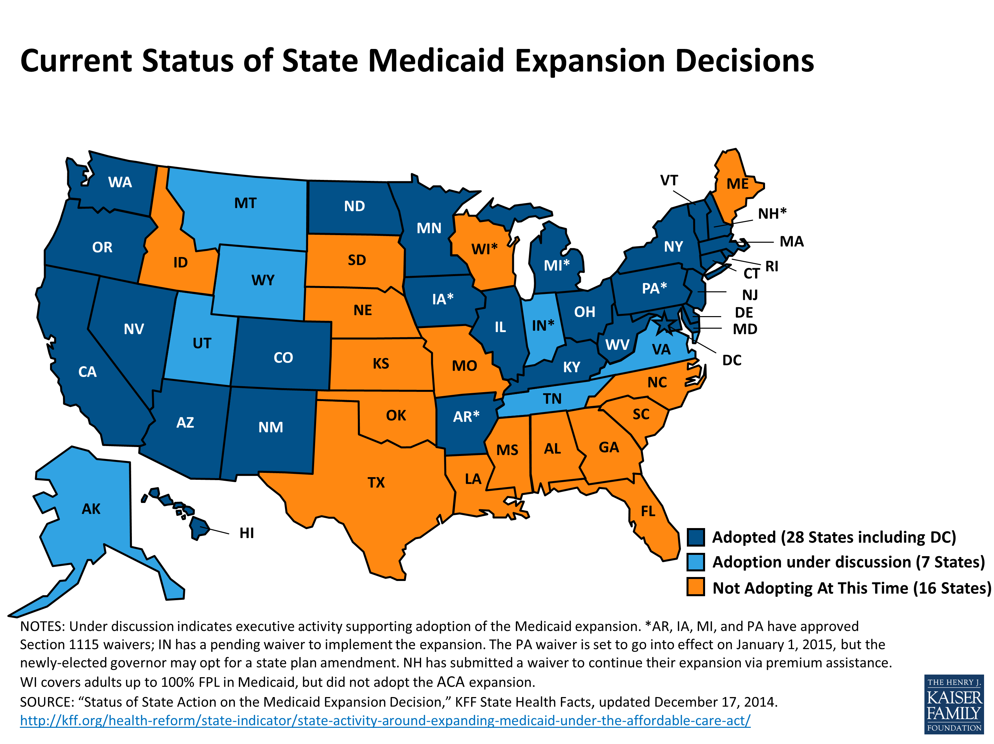

Slide 34
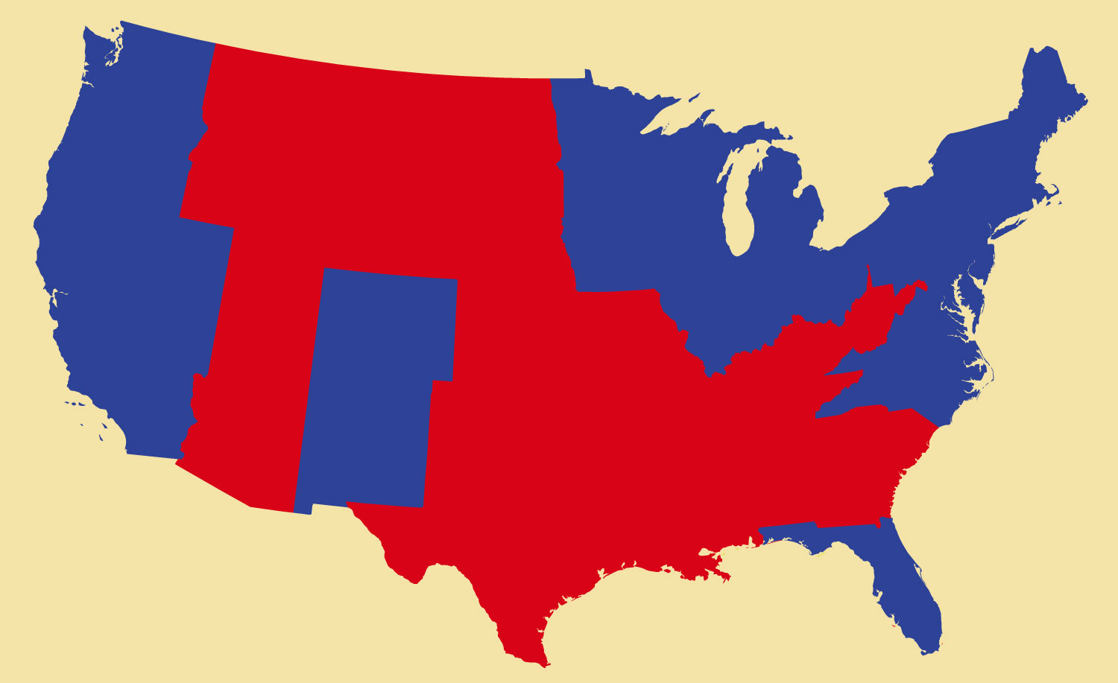
Fig. 4-3, p. 112
Notes:
Figure 3: Election Results Reflect Geographic Pattern

Slide 35
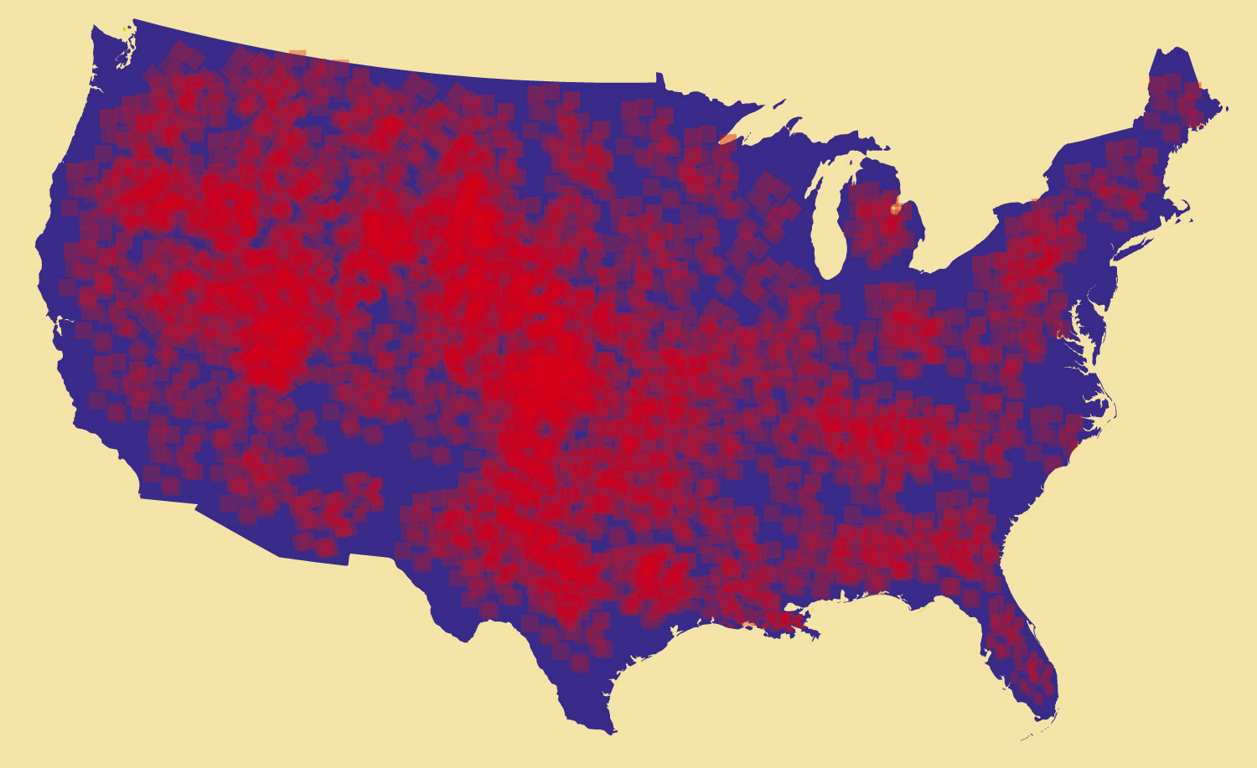
Fig. 4-4, p. 113
Notes:
Figure 4: Most States Are Purple

Slide 36
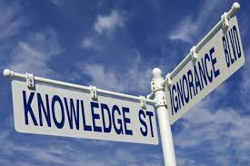

Slide 37
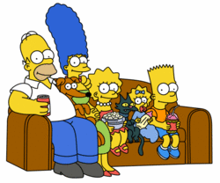
Testing Political Knowledge
Name the 5 1st Amendment rights
1 in 1000
Name these 5 Simpsons:
1 in 5

Slide 38
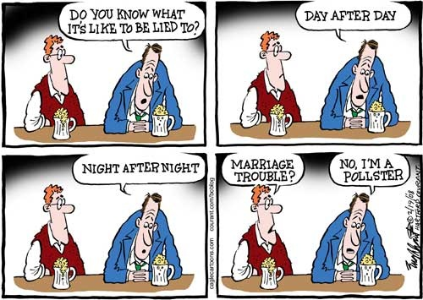

Slide 39
