Slide 1
What Rights Does the Bill of Rights Protect?
Selective Incorporation
Fundamental Freedoms, but Not Always Clear & Never Absolute

Slide 2
Protection Against Whom?, I
National majorities who might impose conformity costs on those individuals whose views differ from those of the majority
Barron v. Baltimore (1833)
Basically rendered the Bill of Rights meaningless, because most citizens’ quarrels were with their states, not the national government
According to Barron, if citizens wanted protections at the state level, they should look to their state constitution

Slide 3
How Changed?
14th Amendment
“No State shall … deprive any person of life, liberty, or property, without due pro-cess of law.”
Selective Incorporation: the process of bringing state laws & practices under the Bill of Rights protections by applying the Due Process Clause of the 14th Amend-ment to the States
Consequences: altered the balance of power between National & State governments, ex-panding the range of protections offered by the Bill of Rights

Slide 4
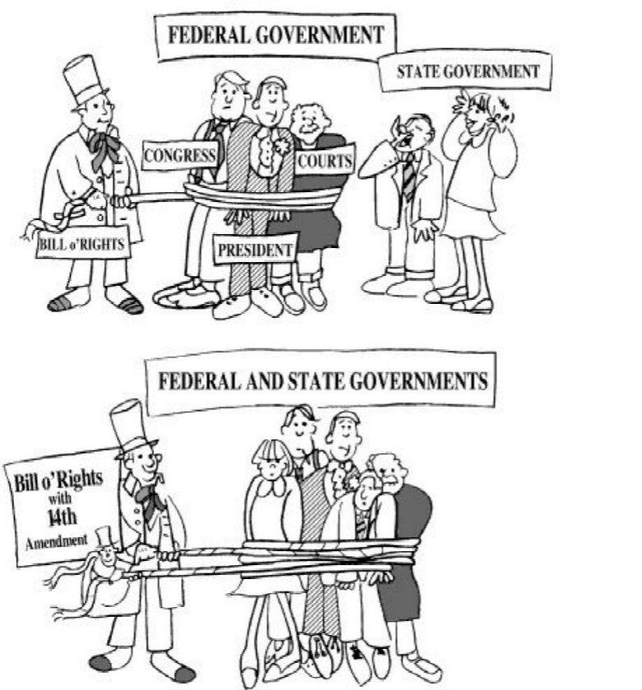

Slide 6
All Protections Limited!
Balancing Test

Slide 7
1st Amendment: Religion, Establishment Clause, I
“Congress shall make no law respect-ing an establishment of religion, ….”
Everson v. Bd. Of Education (1947): first articulation principle of church/state separation; state may neither support/ prefer
Engel v. Vitale (1962): S.Ct. strikes down use of the NY “Regent’s Prayer” —a daily invocation that students are compelled to recite

Slide 8
1st Amendment: Religion, Establishment Clause, II
Abington Township v. Schempp 1963); Murray v. Curlett (1963): Mandatory Bible reading & daily recitation of Lord’s Prayer in public schools de-clared unconstitutional
Stone v. Graham (1980): KY law re-quiring public schools to post the Ten Commandments in classrooms de-clared unconstitutional

Slide 9
1st Amendment: Religion, Establishment Clause, III
Edwards v. Aguillard (1987): LA law mandating “balanced treatment” between evolution & creationism struck down
Lee v. Weisman (1992): Clergy-led prayers at public school graduations ruled unconstitutional
Santa Fe Independent School District v. Doe (2000): Student-led prayer before football games struck down

Slide 10
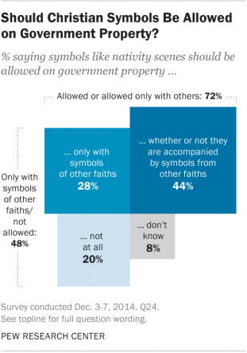

Slide 11
1st Amendment: Religion, Establishment Clause: General Rule
Government authority cannot approve or support activity of religious content

Slide 12
1st Amendment: Religion, Free Exercise Clause
“Congress shall make no law … prohibiting the free exercise [of religion.]”
What is religious faith?

Slide 13
1st Amendment: Religion, Free Exercise Clause
Justice Douglas: “The religious views espoused [in this case] might seem incredible, if not preposterous, to most people. But if those doctrines are subject to trial before a jury charged with finding their truth or falsity, then the same can be done with the religious beliefs of any sect” U.S. v. Ballard (1944).

Slide 14
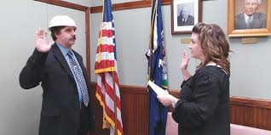

Slide 15
1st Amendment: Religion, Free Exercise Clause
Reynolds v. U.S. (1879): belief/action distinction; Federal law banning po-lygamy (clearly targeting LDS)
Attempts to limit JWs duties to spread gospel by fees, permits, & taxes generally struck down

Slide 16
1st Amendment: Speech & Press=Expression
Issues
Prior Restraint
Differing Interpretations Depending on Context
“Clear and present danger”—Schenk v. U.S. (1919)
“Dangerous tendency”

Slide 17
1st Amendment: Speech & Press
Issues
Symbolic Speech (e.g. Tinker v. Des Moines [1969]; Texas v. Johnson [1989])
Hate Speech: enhanced sentences
Speech Zones

Slide 18
1st Amendment: Speech & Press
Unprotected Speech
“Imminent Lawless Action,” aka “Fighting Words”
Libel (written) v. Slander (spoken)
Requirements for Proof of Libel (for Non-Public Figures)
Publication Observable by Third Parties
Aggrieved Party Clearly Specified
Aggrieved Party Must Suffer
For Public Figures: + “actual malice” & “reckless disregard” for the truth

Slide 19
1st Amendment: Speech & Press
Obscenity (Miller v. California [1973])
The average person applying contem-porary standards finds that the work as a whole appeals to prurient interests
The work “depicts or describes, in a patently offensive way, sexual conduct specifically defined by the applicable state law.”
The work lacks “serious literary, artistic, political, or scientific value”

Slide 20
1st Amendment: Freedom of Assembly & Petition
Connected with Speech, can be regulated by “time, place, & manner”

Slide 21
2nd Amendment: Right to Keep & Bear Arms
McDonald v. Chicago (2010)

Slide 22
4th Amendment: Rights of Criminal Defendants
4th addresses the “right of the people to be se-cure in their persons, houses, papers and effects, against unreasonable searches and seizures…. [&] “no Warrants shall issue, but upon probable cause, supported by Oath or affirmation, and particularly describing the place to be searched, and the persons or things to be seized.”
Congress first going beyond the physical with Federal Communications Act of 1934 (proscribing most police use of wiretaps legal until then)
Remedy: Exclusionary Rule (Mapp v. Ohio [1961])

Slide 23
5th Amendment: Rights of Criminal Defendants
5th Amendment: no person shall “be compelled in any criminal case to be a witness against himself”
Applies to testimony in a trial & to any statement made by a defendant awaiting trial
Remedy: Miranda v. Arizona (1966)

Slide 24
6th Amendment: Rights of Criminal Defendants
6th—Right to Counsel—Gid- eon v. Wainwright (1963)
6th—Jury Trials—Peers?

Slide 25
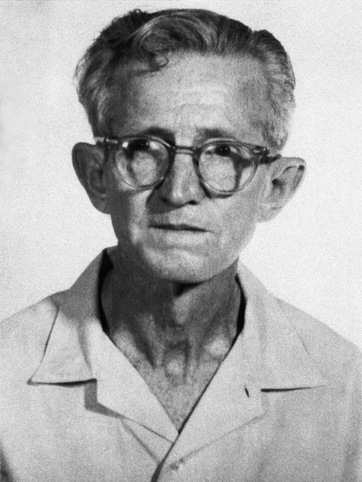

Slide 26
8th Amendment, I: Rights of Criminal Defendants
8th Amendment: “Excessive bail shall not be required, nor excessive fines im-posed, nor cruel and unusual punish-ment inflicted.”
Furman v. Georgia (1972) [243 pages, longest in Court history] put capital punishment on hold, but the death penalty itself was NOT declared un-constitutionally cruel & unusual

Slide 27
8th Amendment, II: Rights of Criminal Defendants
Gregg v. Georgia (1976): GA law separating conviction from sentencing stage of the trial, al-lowing juries to weigh the particular crime & defendant & any mitigating/aggravating circum-stances, proclaimed to be a “model” law
Decisions over the last 10 years have found the following to be cruel and unusual punishment:
Executing “mentally retarded” defendants
Executing juveniles
Executing a defendant who raped, but did not murder, a child
Sentencing a juvenile to life in prison without possibility of parole

Slide 28
9th Amendment: Right to Privacy
9th Amendment: “the enumeration in the Constitution of certain rights, shall not be construed to deny or disparage others retained by the people.”
Griswold v. Connecticut (1965) —9th + 1st, 3rd, 4th, & 14th –Contraception
Roe v. Wade (1973)—Abortion
Lawrence v. Texas (2003)—Homosexu-ality

