Slide 1
WE THE PEOPLE: THE CITIZEN AND THE CONSTITUTION Unit One: What are the historical and philosophical foundations of the American political system?
James Madison Legacy Project
Summer Institute
Columbia, South Carolina
June 2018

Slide 2
ON THE AGENDA…
The historical traditions, ideas, and people influencing the Founders
The European ideas that helped shape the “world view” of the colonists
The philosophers whose ideas, when combined with the colonial experience, are reflected in our founding documents
The differences between the colonies and England that helped frame the early development of the nation

Slide 3
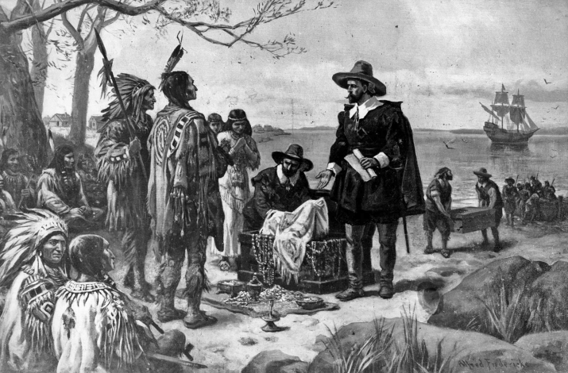
WHO WERE WE AT THE START?
The conversation must begin with a recognition there was not a common origin of the “first settlers.”
Native Americans inhabited much of the land before European settlers arrived. By the time of the Revolutionary War, few Indians lived along the Atlantic coast due to
Encroachment of colonial settlements
Disease
Warfare

Slide 4
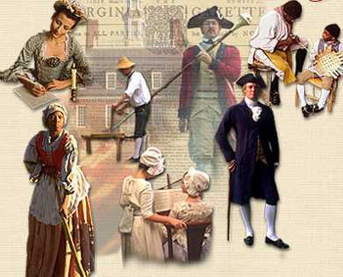
AND AS TO THE COLONISTS?
The settlers were not all the same
Some settlers came to the new land for religious reasons
Others came for economic reasons
Language differences existed in many areas, with German, French and Dutch joining English among the tongues spoken by settlers
Most colonies had established or official government religions
All the colonies practiced slavery

Slide 5
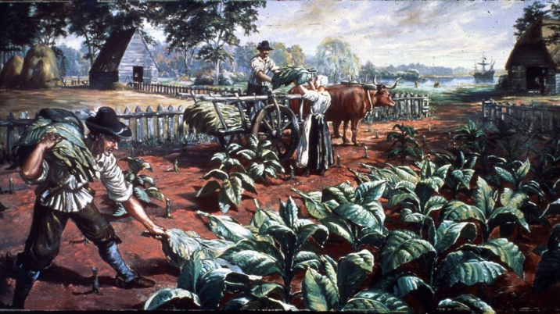
LIFE VARIED, DEPENDING ON LOCATION
An example of how life varied throughout colonial America, is seen in the fact that, while most settlers worked on farms or in rural communities, farming differed throughout the land, with
Farming in New England meaning growing crops and raising livestock for a local market
Farming in South Carolina’s coastal areas produced rice and indigo for export to England
Farming in Virginia was mainly to export tobacco

Slide 6
THE WORKFORCE
Southern plantations relied on slave labor
New England farmers relied less on slaves, but more on indentured servants
Colonists who did not work on farms frequently worked as tradesmen, working as sailors, shoemakers, silversmiths

Slide 7
INFLUENCES ON THE FOUNDERS
At the time of the founding of the nation, Americans had roughly a century and a half of experience with various forms of governmental activity as colonists within the British Empire
The Founders had the benefit of the writings of Greek and Roman philosophers as well as those of more recent philosophers such as Thomas Hobbes, John Locke, and Francis Bacon

Slide 8
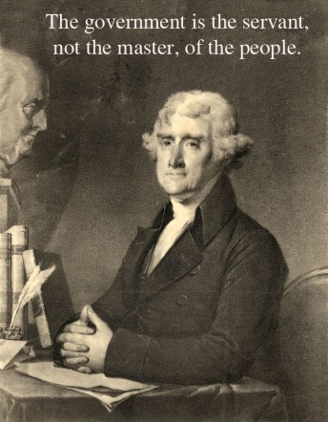
BASIC UNDERLYING PRINCIPLES
In designing the documents that served as the basis for the founding of our nation, the Founders had learned two lessons about government
Government should be the servant and not the master of the people
A fundamental higher law should limit government

Slide 9
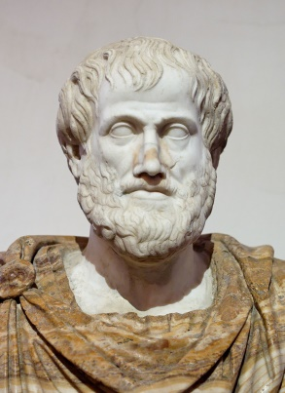
EVOLUTION OF IDEAS OF GOVERNMENT
Among the early writers with whom the Founders were familiar was Aristotle who posited that every state or country must
Deliberate about what is to be done and decide what public policy should be (the legislative function)
Perform and execute functions through which officials carry out public policy (the executive function)
Carry out a judicial function through which disputes about the interpretation of law are managed and applied in everyday life

Slide 10
ARISTOTLE’S THOUGHTS ON GOVERNMENTAL STABILITY
Incorporating economic considerations into his views of government, Aristotle concluded
The dominant group of most stable countries consists of those who are neither rich nor poor but occupy a middle ground of moderate wealth
Rule by those who are moderate yields the most stable form of government because those of moderate means are more likely to behave in accordance with reason
If a constitution can combine the many poor with the lesser number of wealthy persons, then it can achieve stability

Slide 11
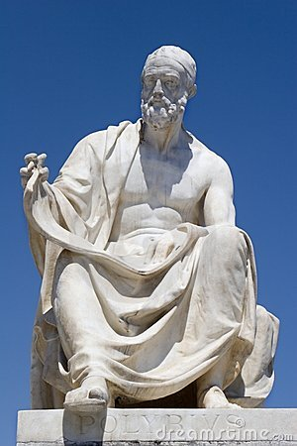
THE “MIXED” CONSTITUTION
The Roman statesman Cicero embraced and spread an idea popularized by Polybius (203 – 120 BC) that a mixed constitution was a combination of elements of
Monarchy
Aristocracy
Democracy
Polybius

Slide 12
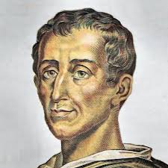
CHARLES-LOUIS de SECONDAT, BARON de LA BREDE et de MONTESQUIEU
In the eighteenth century, the French political thinker Montesquieu cited England as a mixed constitution, noting the British government had
A limited monarch
An aristocracy (the House of Lords) in one House of Parliament
A lesser house (the House of Commons)
Montesquieu

Slide 13
CONSTITUTION
A constitution is a plan that sets forth the structure and the powers of government. Constitutions
Specify the main institutions of government and the powers of each of their institutions
State the procedures the institutions must use to make, enforce and interpret law
Usually specify how they can be changed or amended

Slide 14
CONSTITUTION AS HIGHER LAW
A constitution differed from a law enacted by a legislature in that it
Sets forth the basic rights of citizens
Establishes the responsibility of the government to protect those rights
Establishes limitations on how those in government may use their power…
Can be changed only with the consent of the citizens and according to established and well-known principles

Slide 15
WRITTEN v. NON-WRITTEN CONSTITUTIONS
Nearly all constitutions are written. In those countries that don’t have written constitutions, the constitution consists of a combination of written laws and precedents. The only three major democracies with unwritten constitutions are
Britain
New Zealand
Israel

Slide 16
IDEAS ON CIVIC LIFE
One political idea that influenced the Founders was classical republicanism, a concept that placed the needs of the community above individual liberty and self-determination.
Citizens should work together to promote the good of the country
The cooperation of all citizens is how the republic could be maintained and defended from the domination of others
Survival in early America depended on the ability of neighbors and townspeople to work together to overcome obstacles

Slide 17
CITIZENSHIP AND CIVIC VIRTUE
In the view of classical republicans, the “office” of citizen was seen as important, and the citizen was to set aside personal interest to promote the common good.
From the classical perspective, citizenship should emphasize duties, not rights.

Slide 18
THE IMPORTANCE OF MORAL EDUCATION
Classical republicans believe that civic virtue must be learned. Moral education
Included instruction in the symbols, rituals and values of the society
Required that children develop proper habits, including generosity, self-control, respect, fairness and courage
Included instilling in children the importance of developing and preserving a good reputation
Classical republicans believed the entire community was responsible for the moral education of the young.

Slide 19
NATURAL RIGHTS
The period of the founding of the nation followed a rejection of the notion of the divine right which was an idea that monarchs derived their authority from God.
Natural rights philosophers argued that humans are not naturally social and traced government to an imaginary state of nature

Slide 20
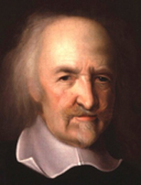
THOMAS HOBBES
Thomas Hobbes (1588-1679) argued that the state of nature would lead to individuals fearing violent death at the hands of others and, due to the chaos of the war of every man against every man, humans would enter a social contract in order for the state to maintain order, stability and peace.

Slide 21
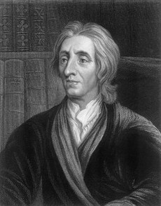
JOHN LOCKE
John Locke (1632-1704) held that each individual possessed inalienable rights to “life, liberty and estate” and to secure their natural rights, people would enter into a social contract to leave the state of nature and form civil society.
Locke argued that the government that would be formed by people failed to protect individual rights, then the people are entitled to replace it – if necessary, by revolution.

Slide 22
HISTORICAL DEVELOPMENTS THAT INFLUENCED IDEAS ON INDIVIDUAL RIGHTS
Christian teachings gave special importance to duties such as loving others, goodwill, and the dignity and worth of each human being
During the Protestant Reformation, people began to challenge the doctrines, traditions, and practices of the Catholic Church
The invention of the printing press using moveable type allowed more people the opportunity to read the Bible. Being able to read the Bible encouraged greater freedom of conscience and the freedom to decide about religious beliefs.
The increase in commercial trade and its expansion over greater distances

Slide 23
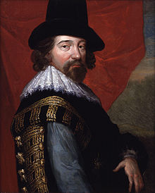
The Founders belonged to the Age of Enlightenment, a period in which science and technology advanced rapidly. An early figure in the movement was Francis Bacon (1561 – 1626) whose goal was to subdue nature for humanity’s purpose.
The Founders believed that reason and observation, complemented by the study of history and writers such as Locke and Montesquieu, would enable them to understand the workings of governmental and social institutions.
The end of scientific study is the “enlarging of the
bounds of human empire, to the effecting of all
things possible.”
Francis Bacon

Slide 24
BEGINNINGS OF ENGLISH GOVERNMENT
Following the fall of the Roman Empire
England was divided among a number of tribes
A king or other leader ruled each tribe
Eventually all the tribes were united under one king
However
England was too large for a single person to rule alone
Local customs developed over the years that determined means of governing

Slide 25
MODERN ENGLISH LAW
The development of modern English law can probably be noted as beginning with the defeat of King Harold II by William the Conqueror at the Battle of Hastings in 1066. William introduced feudalism, but also adopted and adapted many English practices.
At first, monarchs personally, or through representatives
Made laws
Supervised law enforcement
Heard cases (royal courts)
Utilized advisors to help understand local legal traditions and customs and when they needed to raise money

Slide 26
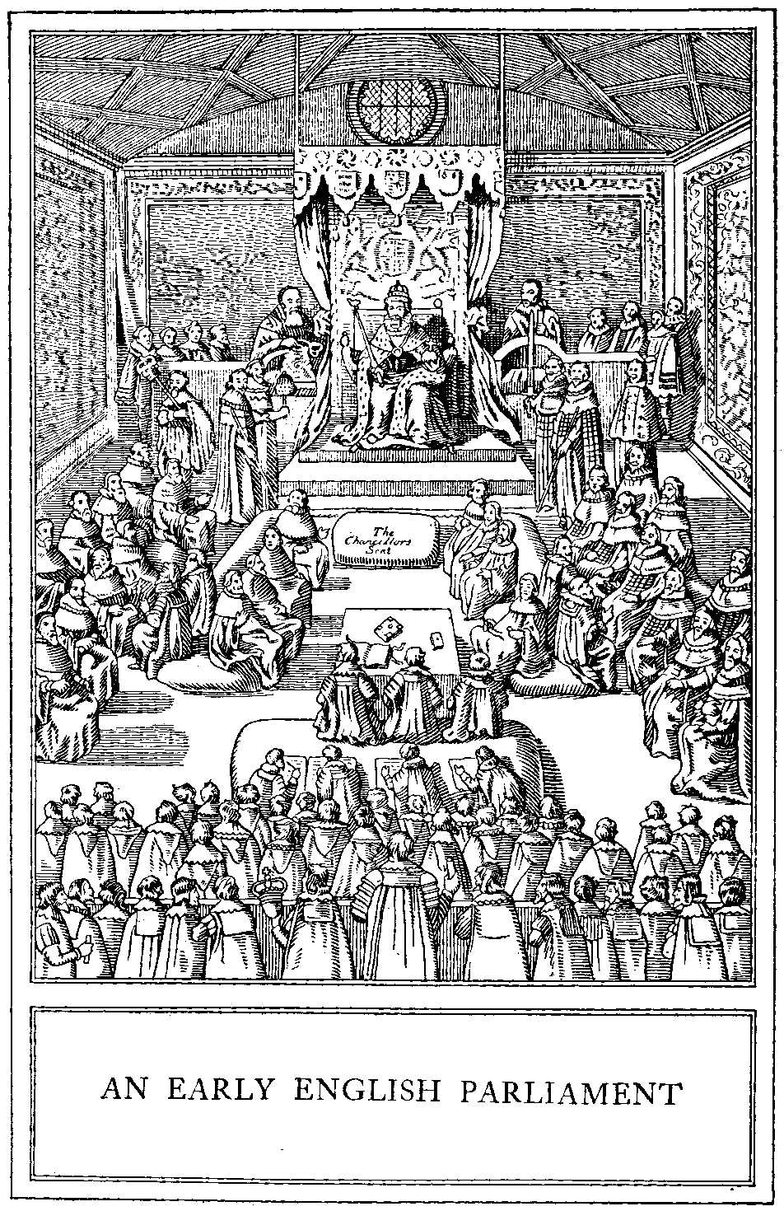
AND FROM THESE ADVISORS…
In time, the groups of advisors and assistants developed into separate institutions – Parliament and the royal court

Slide 27
MODEL PARLIAMENT
In 1295, King Edward I brought together two representative parts (or houses)
The House of Lords represented feudal nobility and major church officials
The House of Commons composed of people who had wealth and status, including two knights from each shire (county); two citizens from each city; and two citizens from each borough (town)

Slide 28
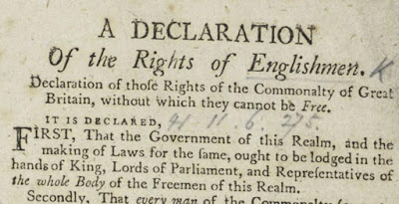
RIGHTS OF ENGLISHMEN
Fundamental rights neither the monarch nor Parliament would change or violate included
Right to a trial by a jury of one’s peers under the law of the land
Security on one’s home from unlawful entry
Limits on the government’s power to tax

Slide 29
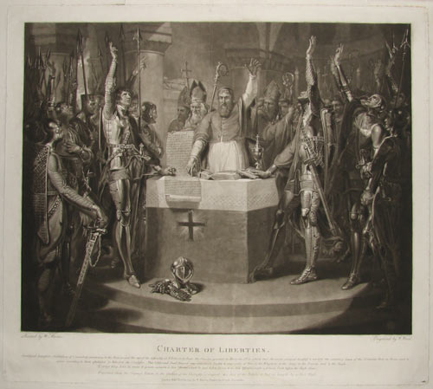
CHARTER OF LIBERTIES
In 1100, King Henry I issued the Charter of Liberties, binding the king to obey certain laws regarding the treatment of nobles and church officials

Slide 30
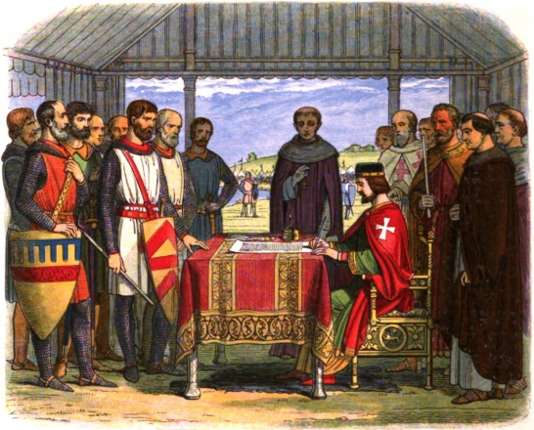
MAGNA CARTA
In June 1215, following the defeat of King John I by barons, the Magna Carta was signed, confirming traditional rights including
The rule of law and the obligation of the monarch to respect established rules
A way to secure redress of grievances
The acceptance that government was by agreement or contract

Slide 31
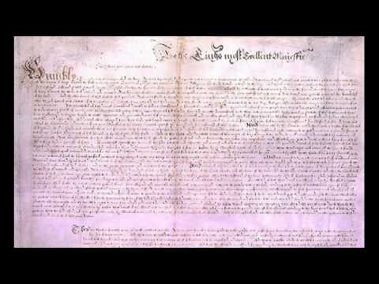
THE BRITISH CONSTITUTION
The British constitution consists of common law, important acts of Parliament, and political customs and traditions.
Three historical documents are important in the development of the British constitution:
The Magna Carta (1215)
The Petition of Right (1628)
The English Bill of Rights (1689)
Petition of Right

Slide 32
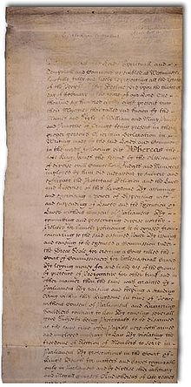
THE ENGLISH BILL OF RIGHTS
The English Bill of Rights
Restated the Magna Carta idea that the rule of law is the foundation of legitimate government
Established the idea that only representative government is legitimate

Slide 33
THE SETTLEMENT OF THE COLONIES
Recall that foremost among the reasons for England to want colonies in America was the desire to develop a profitable maritime empire.
To entice settlers to migrate to America, the crown offered
Royal proprietorships – Eleven of the original thirteen colonies were founded as proprietorships with most proprietors being personal friends of the king
Joint stock companies which were chartered ventures such as the Virginia Company of London (responsible for the first successful colony at Jamestown established in 1607)

Slide 34
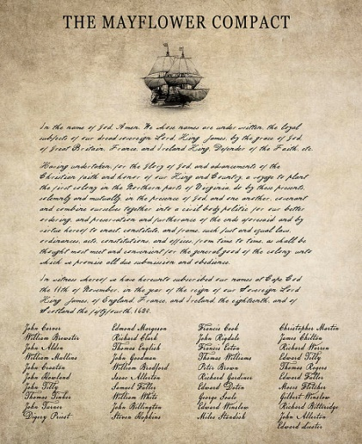
MAYFLOWER COMPACT
Despite the fact the Virginia Company settlers missed the location to which they were headed – they were supposed to settle in Virginia, but landed at Cape Cod, MA – before landing they created a prime example of the social contract – the Mayflower Compact

Slide 35
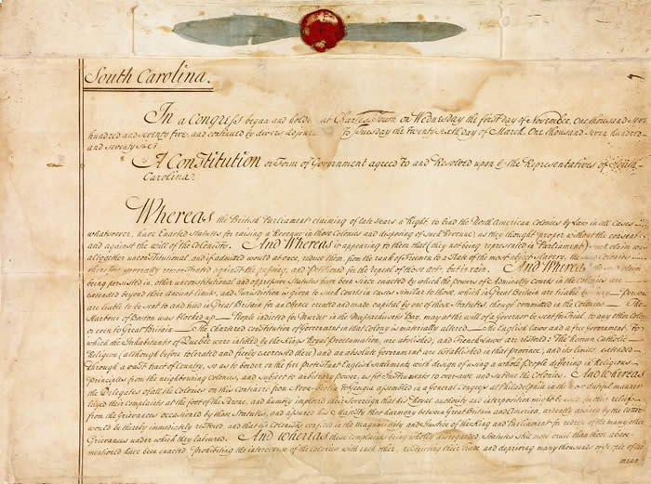
COLONIAL CONSTITUTIONS
All the colonial constitutions shared certain basic principles
A statement of fundamental rights
Belief in the rule of law
Representative government and the right to vote
Separation of powers

Slide 36
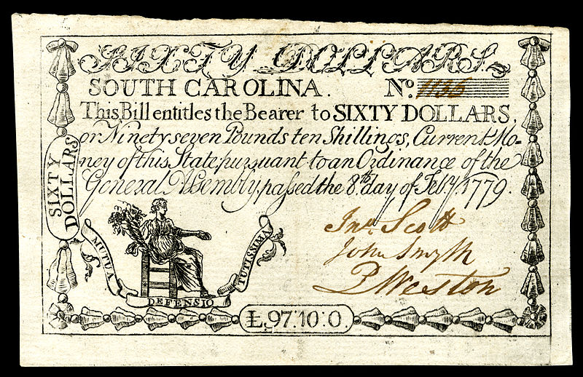
AND THE GOVERNMENTS…
Colonial governments typically consisted of
A governor who was the proprietor or someone else appointed by the Crown
A council of landholders advising the governor and sometimes serving as a court
An assembly elected by the people with a say in matters of taxation

Slide 37
THE UNIQUE AMERICAN EXPERIENCE
Settlement in the colonies offered opportunities that were unique due to
The availability of cheap and plentiful land
A scarcity of labor that allowed skilled workers to achieve, in many instances, moderate prosperity
Many indentured servants having the prospect of completing the period of servitude; earning wages; and buying lands
English law prohibiting the sale or distribution of property beyond male family members did not follow the settlers to America
The English class system being harder to maintain
The chance to improve one’s life becoming fundamental

Slide 38
THESE OPPORTUNITIES DID NOT EXTEND TO EVERYONE
Some were not protected by the “guaranteed” rights about which the colonists spoke because
Suffrage was limited, at times to Protestant males or those practicing a particular faith
Colonial laws often limited the rights of women to own property and conduct legal affairs
A significant portion of the immigrant population coming to the colonies came as indentured servants
Indians were treated as foreigners
African-American slaves were regarded as property and denied human rights

Slide 39
HOW DID COLONIAL GOVERNMENTS COMPARE TO BRITAIN?
American colonists believed the security of life and liberty depended on the security of property
Colonists so valued the protection of property and its ownership that suffrage was often limited to those who possessed land
Land was relatively easy to obtain and thus the body of eligible voters was larger than in England, making the colonial legislatures more broadly representative
Colonial elections usually featured a choice of candidates and they ran for shorter terms
Colonial legislators were required to live in the districts they represented, thus knowing the issues and lives of their constituents

Slide 40
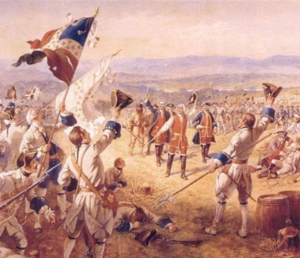
THE BREAKUP
Initially, Britain did not interfere in the lives of the colonists, but beginning in 1763, the British government was under heavy pressure to raise money because of
Debts incurred as a result of the Seven Years’ War
Pressure to reduce taxes at home
A belief the colonists should pay more taxes because the war was fought, in part, to protect the colonies

Slide 41
THE ACTS THAT STARTED IT ALL..
In an effort to increase control over the colonies, Parliament passed the
Proclamation Act of 1763, forbidding settlement on Indian land west of the Appalachians (ostensibly to reduce the costs of defense)
Stamp Act (1765), imposing duties needed for stamps for official documents
Quartering Act (1765) which, in 1774, was changed to require the colonists to shelter troops in their homes
Colonial resistance to these changes centered around
Loss of money due to new trade restrictions
The conflict with the colonists understanding of representative government

Slide 42
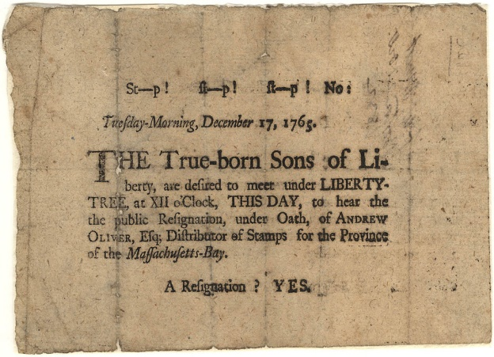
SONS OF LIBERTY
The Sons of Liberty originated in August 1765 in port cities of Boston and New York and throughout Connecticut with groups that were
Primarily nonviolent
A source of popular resistance to the Stamp Act
Sources of political agitation to precipitate crowd action

Slide 43
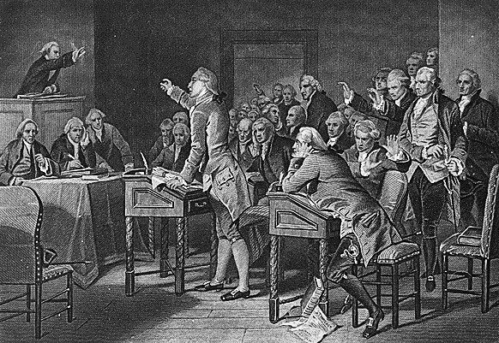
THE STAMP ACT CONGRESS
On October 7, 1765, twenty-seven delegates from nine British colonies met at Federal Hall in New York City and ultimately
Issued a Declaration of Rights and Grievances
Highlighted the Stamp Act and use of vice admiralty courts as a source of particular irritation
Ended with a statement of loyalty to the king
Notable was the absence of representation from Virginia as well as North Carolina, New Hampshire and Georgia.

Slide 44
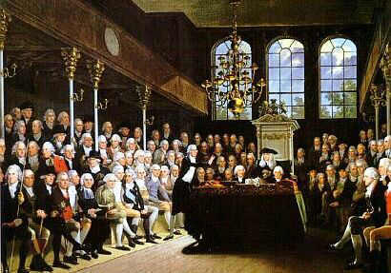
THE BRITISH RESPONSE?
Subsequently Parliament repealed the Stamp Act, but passed the Declaratory Act (1766) asserting that Parliament could make laws binding the colonies “in all cases.”

Slide 45
DAUGHTERS OF LIBERTY
Women, in various parts of the colonies responded to the Stamp and Townshend Acts:
“On the 4th instant, eighteen daughters of liberty, young ladies of good reputation, assembled … in this town…. There they exhibited a fine example of industry, by spinning from sunrise until dark, and displayed a spirit for saving their sinking country, rarely to be found among persons of more age and experience.”
Boston Gazette April 7, 1776

Slide 46
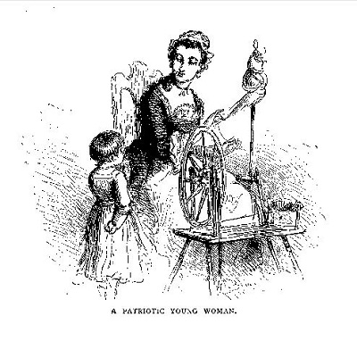
In various locales throughout the colonies, women, often calling themselves Daughters of Liberty, attempted to assist the resistance movement by
Producing cloth to help the colonies become independent
Boycotting products (such as tea) that would generate funds for the British

Slide 47
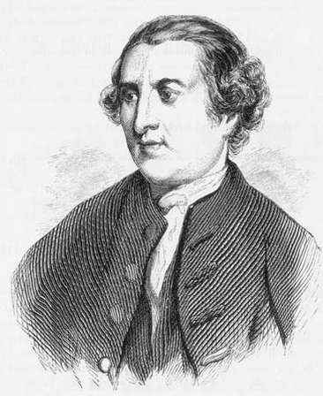
TOWNSHEND ACTS
Between June 15 and July 2, 1767, Parliament passed a series of acts designed to assert authority over the colonies. They were named for the sponsor of the legislation, Charles Townshend.
The Suspending Act prohibited the executive officers of and the New York assembly from conducting business until New York complied with the financial obligations of the Quartering Act for the expenses of British troops stationed there
Townshend Duties were imposed and were designed to raise monies for the British treasury by placing duties on lead, glass, paper and paint
Commercial duties on tea were lifted, allowing it to be exported to the colonies free of all British taxes.
Writs of assistance…
Charles Townshend

Slide 48
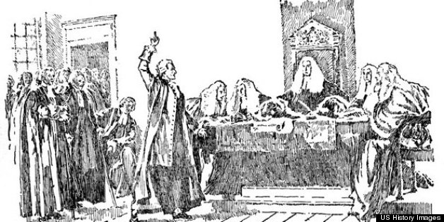
WRITS OF ASSISTANCE
As part of its assertion of authority (and continued effort to raise funds), Parliament created writs of assistance which
Created positions for new searchers, spies, coast guard vessels and a Board of Customs Commissioners at Boston funded out of customs revenues.
Empowered revenue officials to search and seize colonial property
Often led to colonists being charged with crimes and transported to Nova Scotia or England for trial

Slide 49
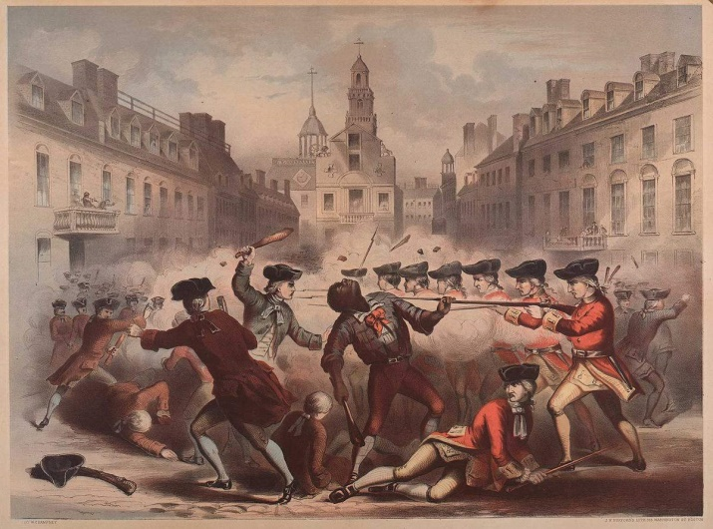
HOSTILITIES BEGIN…
To maintain order and facilitate tax collection, the British sent troops to the colonies and,
In 1770, conflict between British troops and colonists results in what became known as the Boston Massacre (in which five colonists were killed)
Parliament passed the Tea Act (1773) reasserting the right to tax the colonists – and leading to the Boston Tea Party
Crispus Attucks falls at the Boston Massacre

Slide 50
THE INTOLERABLE ACTS
The British government responded to the Boston Tea Party by passing what became known as the Intolerable (Coercive, Punitive) Acts which
Closed Boston Harbor to trade until the owners of the tea were compensated
Banned town meetings
Increased the authority of the royal governor
Granted greater freedom to British commanders wishing to house their soldiers in private homes
Recognized the Catholic Church as the established church of Quebec
Extended the boundary of Quebec into the Ohio Valley

Slide 51
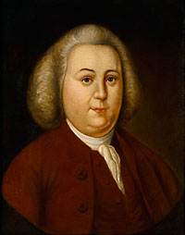
FIRST CONTINENTAL CONGRESS
Colonists responded to these Acts by gathering at Carpenter’s Hall in Philadelphia September 5 through October 26, 1774 at the First Continental Congress
Fifty-six delegates from each colony except Georgia convened with varied goals ranging from seeking an ultimate resolution with England to actual separation
Selected Peyton Randolph of Virginia as First President of Congress
Peyton Randolph

Slide 52
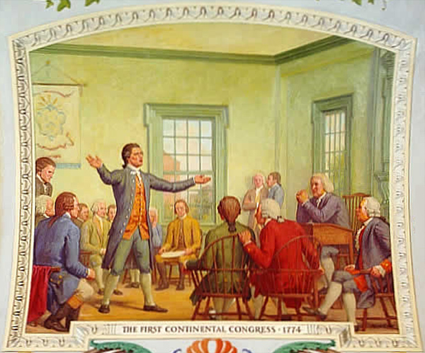
ULTIMATE OUTCOME OF THE FIRST CONTINENTAL CONGRESS
At the end of the Congress, the delegates
Ultimately petitioned King George for a redress of grievances
Voted to impose a ban on colonial trade with England
Called for a Second Continental Congress in case the efforts to halt the enforcement of the Intolerable Acts were unsuccessful

Slide 53
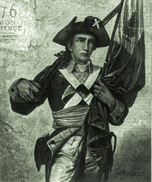
THE MINUTEMEN
The Minutemen had been organized as early as the mid-seventeenth century in the Massachusetts Bay Colony, providing towns with a “training band” prepared to respond to
Native-American uprisings
War with France
Potential local insurrections
Social unrest
Rioting

Slide 54
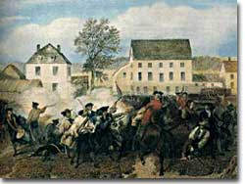
AGAIN, THE BRITISH REACT…
Having heard that the Minutemen had hidden arms and ammunition in Concord, MA on April 19, 1775, approximately 700 British troops attempted to march on Concord and
Capture and destroy Colonial military supplies reportedly stored by the Massachusetts militia at Concord
Arrest Samuel Adams and John Hancock
The resulting confrontation between the troops and approximately seventy-five Minutemen produced the “shot heard round the world.”

Slide 55
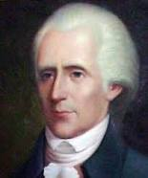
AND NOW, “IT’S ON!”
In August 1775, England declared the colonies to be in a “state of rebellion”
and
On June 1, 1776, Richard Henry Lee introduced a resolution in the Continental Congress declaring that
“these United Colonies are, and of right ought to be”, free and independent states, absolved from all allegiance to the British Crown…”
Richard Henry Lee

Slide 56
THE DECLARATION OF INDEPENDENCE
Having concluded that there was to be a break with the government to which they – and generations before them – had sworn allegiance, the colonial leaders determined
It was important to justify the decision to dissolve the relationship
Winning sympathy and active support required that the basic principles of legitimate government be identified
The Declaration should renounce the monarchy and appeal to natural rights common to people everywhere
The ultimate governing authority resides with the people.

Slide 57
THE DECLARATION (FRONT)

Slide 58
THE CONTENTS OF THE DECLARATION…
The Declaration of Independence included arguments based on
Natural rights: Neither constitutions nor government can violate the universally obligatory standards of justice that would prevail in the absence of man-made laws. If a government deprives the people of natural rights, then the people have the right to change or abolish that government and to form a new one.
Human equality: Humans are politically equal, and to be legitimate, the right to rule must be based on agreement (compact) among equal civic members

Slide 59
Government by consent: The colonies and England once had such a relationship so long as England protected rights to “Life, Liberty and the Pursuit of Happiness.”
“A long train of abuse:” King George III violated the compact with the colonies by acting with Parliament to deprive the colonists of the rights to which they were entitled
Right of revolution: Because of the abuses, the colonists had the right to withdraw their consent to be governed by England

Slide 60
AFTER THE REVOLUTION WAS WON…
At the time of the victory over the British, the states were united only by their common commitment to fight the war for independence.
Between 1776 and 1780, all the states adopted new constitutions, including basic principles of
Higher law and natural rights
Social contract
Popular sovereignty
Representation and the right to vote
Legislative supremacy
Checks and balances

Slide 61
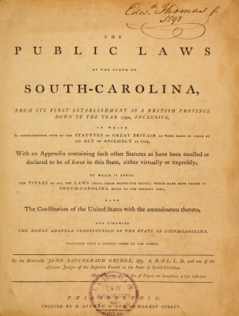
STATE CONSTITUTIONS
Based on the idea that people had certain inherent rights that must be protected from governmental interference
Most state constitutions began with a preamble and a declaration of rights
Referenced rights that differed from state to state

Slide 62
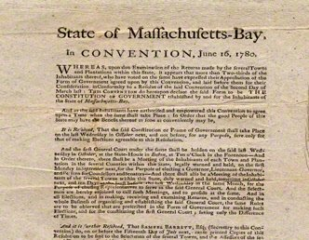
THE MASSACHUSETTS CONSTITUTION
The Massachusetts constitution differed from those of most of the states, and in fact was more like the U. S. Constitution. It provided
A strong system of checks and balances and separation of powers
A strong executive
Representation of varied economic classes

Slide 63
RIGHTS PROTECTED BY THE STATES
State declarations of rights included
Political guarantees such as the right to vote, free and frequent elections, freedom of speech and of the press, the right to petition the government to redress grievances, and no taxation without representation
Procedural guarantees of due process such as rights to counsel and trial by a jury of one’s peers, protection from illegal searches and seizures, and protection from forced self-incrimination, excessive bail and fines, and cruel and unusual punishment
A condemnation of professional standing armies in time of peace and the quartering of troops in civilian homes.

Slide 64
Lindsey D. Draper
414-462-8956
lindrap@prodigy.net

